Slide 1
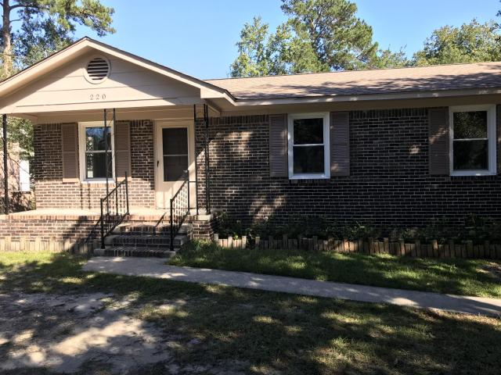
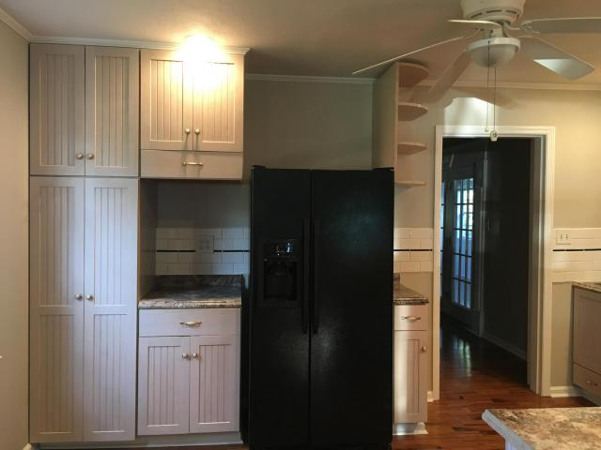
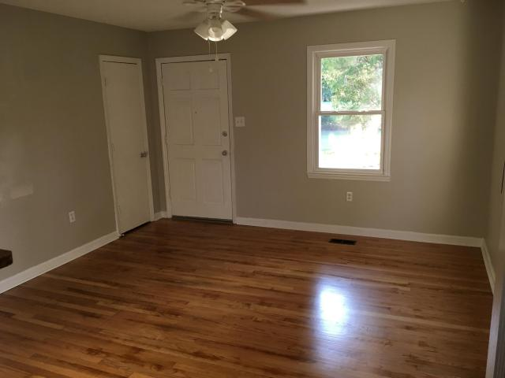
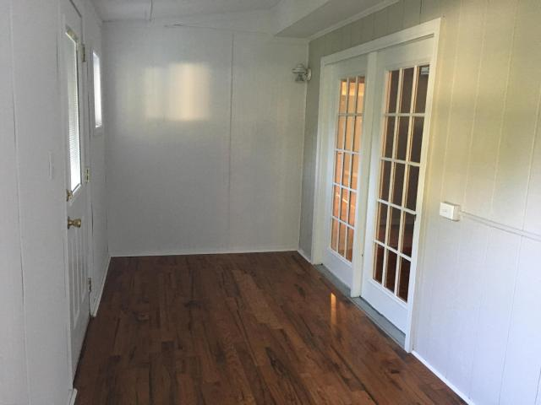
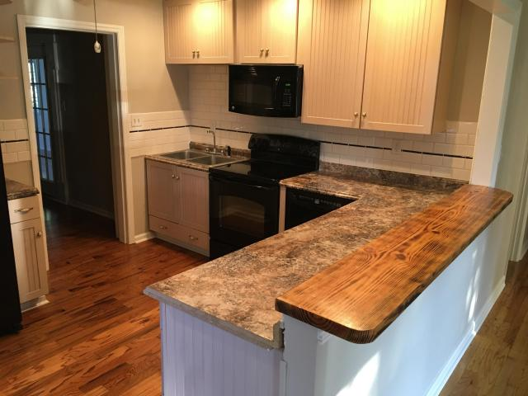
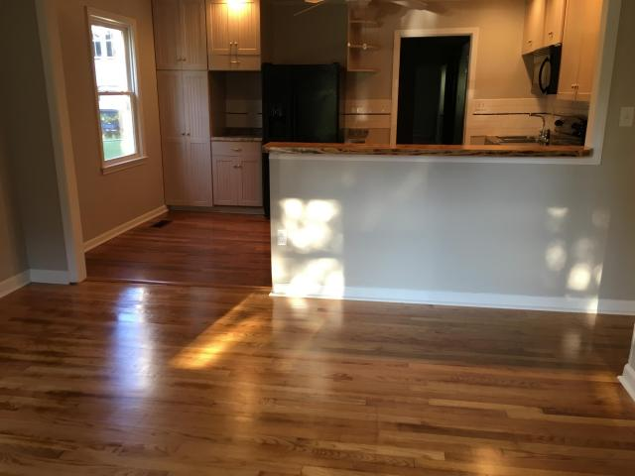


220 Broughton Road
Moncks Corner, SC 29461
MLS# 17023349
NEW PRICE! $152,900
Open House ~ Sunday, November 12th ~ 2pm-4pm
Tastefully renovated home in Moncks Corner. 4 bedrooms and 2 baths. Wow...what a nice surprise... updated, bright open layout with amazing refinished Hardwood flooring throughout the home. Updated Master Bath has pedestal sinks, MBR has huge walk-in closet. Kitchen appliances updated with side by side refrigerator included, new kitchen counter tops. Inviting bright sunroom area with wood flooring that could also be used as a home office. New Roof with Architectural Shingles. There is a Storage building in enclosed backyard.
Tennis Courts and Boat Landing nearby.
Cheri Hamner
843-364-4325
cheri.hamner@agentownedrealty.com
AgentOwned Realty Co. Premier Group, Inc | 141 A N. Main Street | Summerville, SC 29483

