Slide 1
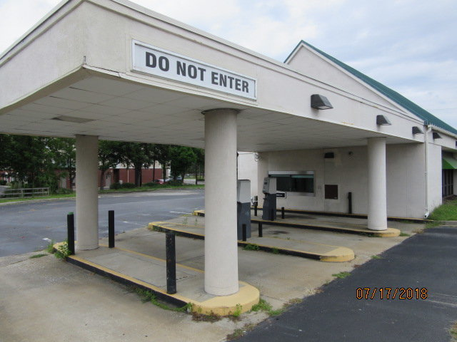
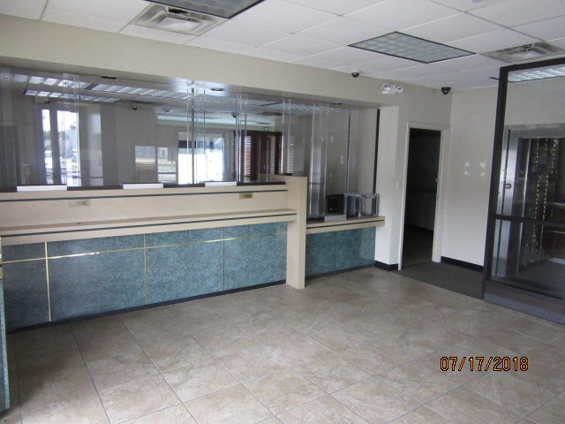
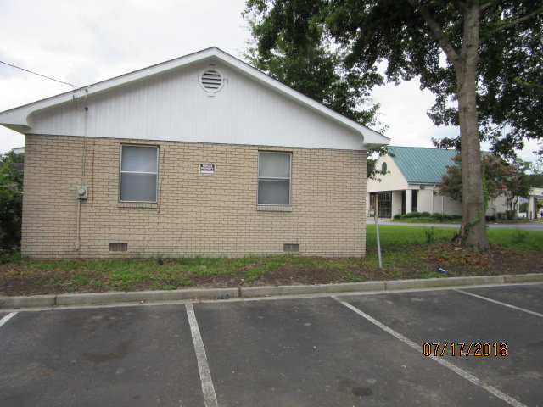
FORMER BANK FOR SALE/LEASE
$40,000
Price Reduction!
2210 Ashley Phosphate Rd
North Charleston, SC 29406
Catylist ID: #30326447 ~ $875,000
HIGH VOLUME TRAFFIC LOCATION AT I-26 AND ASHLEY PHOSPHATE. 2 BUILDINGS ARE INCLUDED TOTALING OVER 3,000 SQ.FT. ONE BUILDING FRONTING ON ASHLEY PHOSPHATE WAS USED BY A BANK AND IS STILL SET UP ON THE INTERIOR FOR A BANK...(TELLER WINDOWS, OFFICES, ETC) THE OTHER BUILDING ADJOINING THE BANK PROPERTY IS A FORMER BRICK SINGLE FAMILY HOME THAT HAS BEEN CONVERTED TO AN OFFICE. THE PROPERTY IS AVAILABLE FOR LEASE... LEASE/PURCHASE OR PURCHASE, LEASE ONLY OR LEASE WITH THE ABILITY TO PURCHASE AT A LATER DATE AT A PREDETERMINED PRICE...OWNER IS WILLING TO BE CREATIVE AND FLEXIBLE...PERHAPS EVEN ACCEPT ANOTHER PROPERTY IN TRADE.
Rick Willis
843-327-3017 Rick@RickWillis.com The Group, LLC

