Slide 1
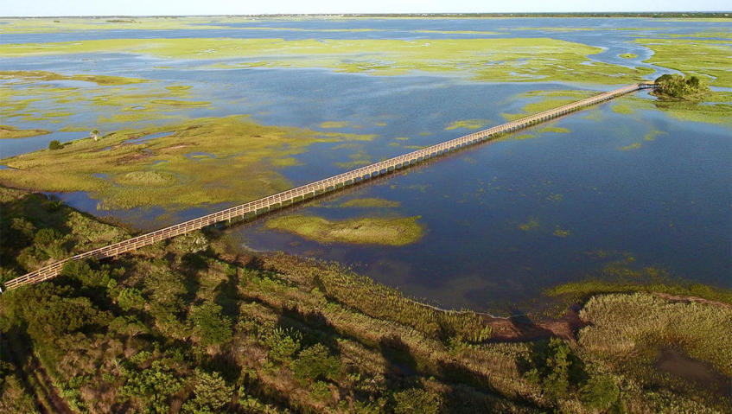
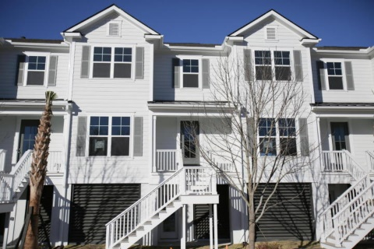
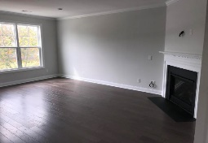
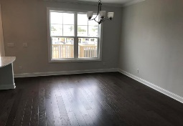
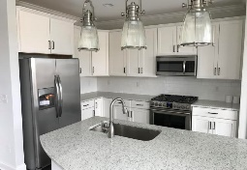
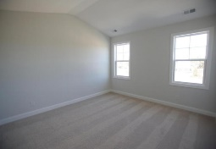
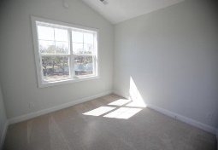
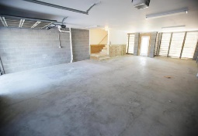
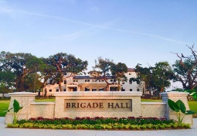
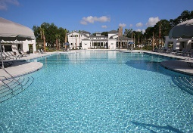
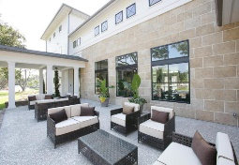
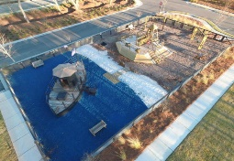
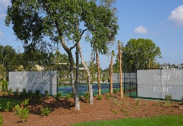
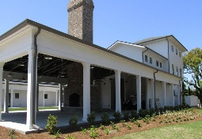
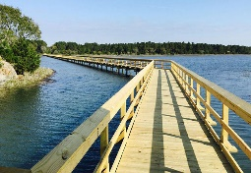


$1,000 Realtor Bonus with Signed Lease
2212 Hamlin Sound Circle Oyster Point
Mount Pleasant, SC 29466
MLS# 17026137
$2,650
Location, location, location!! Just 10 minutes to the Isle of Palms beaches, 25 minutes to downtown Charleston and less than 30 minutes to the airport, off of Six Mile on Highway 17. Brand new 3 bedroom, 2 1/2 bath townhouse in the new and desirable Oyster Point. Wide open living space with lots of windows overlooking the community's idyllic landscapes and amenities. Large living room with gas fireplace. Modern open floorplan with open kitchen with gas range and stainless appliances and upgraded quartz counters, Refrigerator included. Large master bedroom and bath with huge walk in closet. 2 secondary bedrooms with pond views and an upstairs laundry, washer/dryer included. Two car garage with openers that can park at least 3 cars. Beautiful new amenities with a huge pool, tennis courts, clubhouse and outdoor pavilion with a fireplace. Fully equipped fitness center. This is a beautiful community with a community dock on the marsh looking over the river.
DUDLEY SPANGLER
(843) 882-7530 | (704) 953-2735
dudleyspangler@me.com
AgentOwned Preferred Group | 824 Johnnie Dodds Blvd | Mt Pleasant, SC 29464

