Slide 1
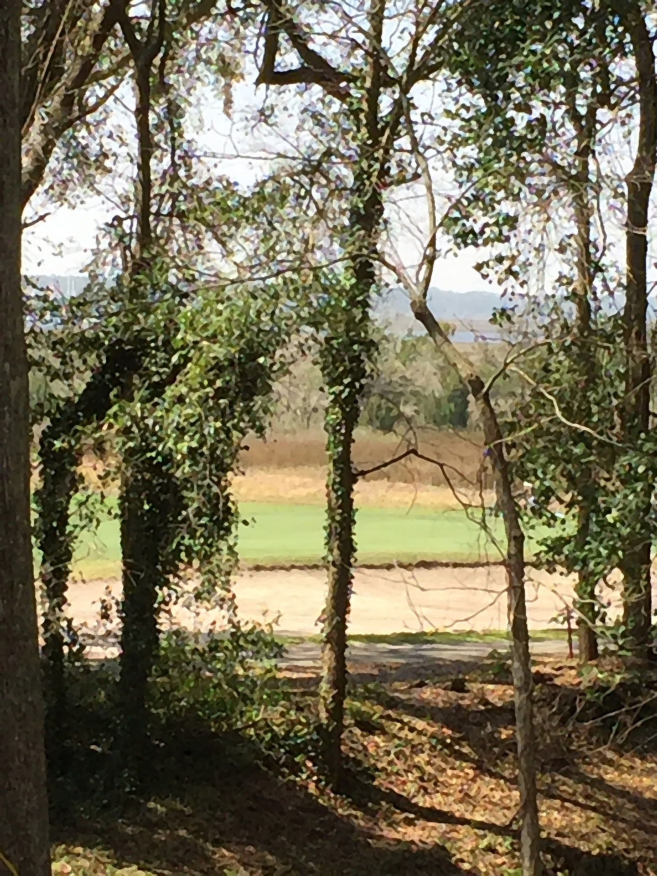
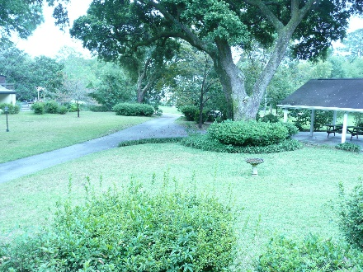
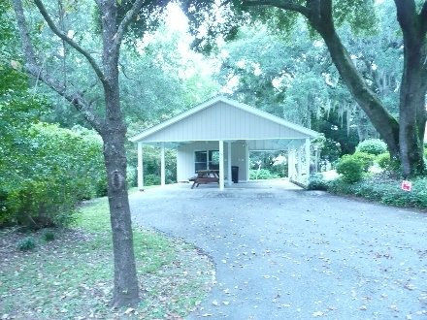
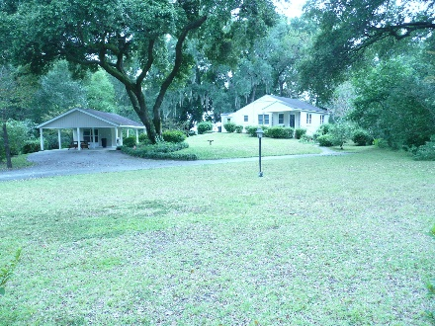

2212 Seroy Street
Riverland Terrace ~ Charleston ~ MLS# 16006735 ~ $499,000
Rare find on James Island! On the Golf Course!
Incredible Location in sought after Riverland Terrace with over a half acre lot. A beautiful unique property for this 3 bedroom home on a picturesque, spacious and private site with numerous large live oaks. House features living room, dining room with hardwood floors throughout, renovated eat-in kitchen with pantry, ceramic bath, linen closet, spacious laundry/utility room with lots of counter and storage space. A huge yard and a double carport with workshop. Fully automatic irrigation system. This quant home is set up on a hill and shaded by beautiful Grand Oaks. This could be a builders special or the opportunity to own a piece of the Lowcountry!
Jonathan Vroon
(843) 514-3114
jvroon@southernlivingre.com
www.southernlivingre.com
Southern Living Real Estate 2249 Salt Wind Way, Mt. Pleasant, SC 29466

