Slide 1
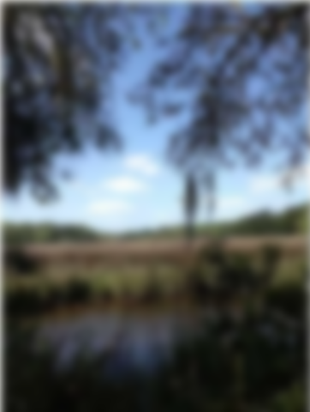
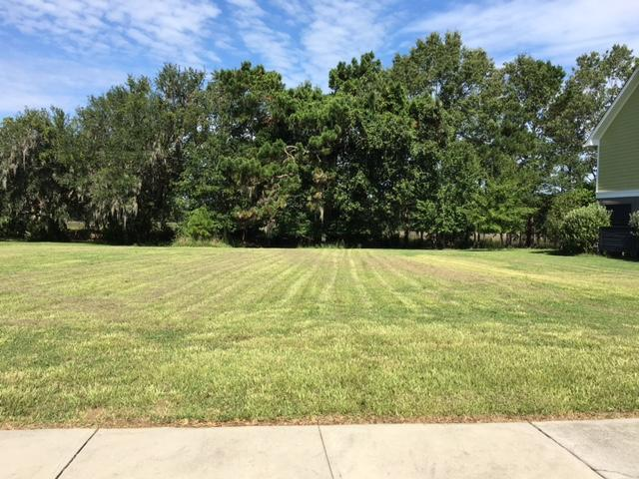
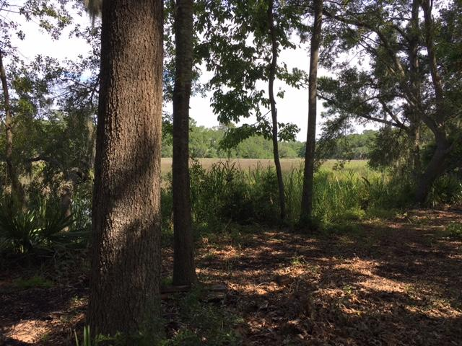
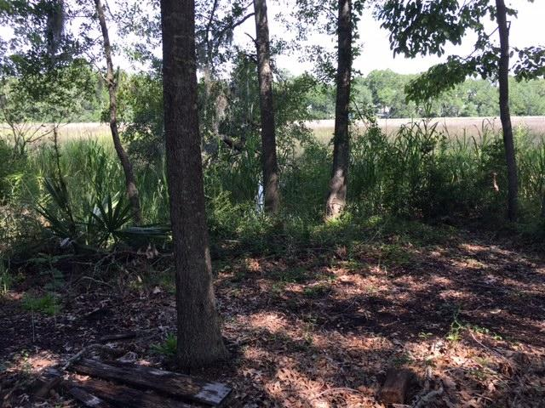
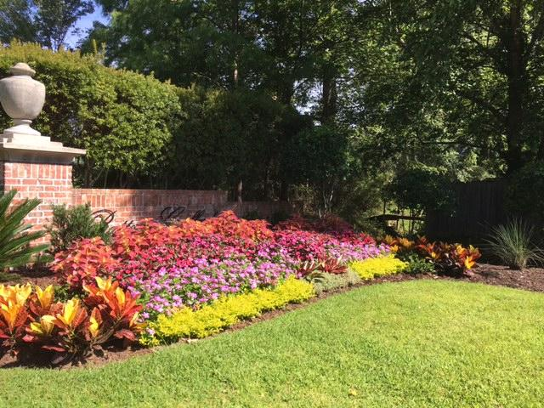
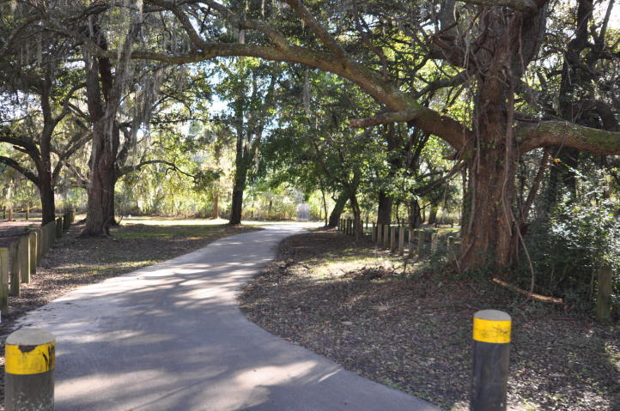
Tidal Creek - Owner Financing
2215 Arthur Gaillard Lane
Battery Gaillard | Charleston, SC 29414
MLS# 19033334 | $199,900
One of the last lots left in Battery Gaillard & it is on Church Creek that leads out to the Ashley River. This is a close in, well developed, custom home neighborhood that is secluded & almost fully developed. This lot provides lovely marsh & creek views & absolutely gorgeous sunsets. Take walks into West Ashley Park (right from this neighborhood) where there are sports activities & lots of space to walk. Enjoy the community dock where you can crab & fish. This beautiful neighborhood has a true family feel & is a great place to build the home of your dreams. You can also enter the neighborhood from Magwood onto Ashley crossing & avoid Hwy 61. Come walk this lot and the neighborhood and you will fall in love with both.
Owner financing available with acceptable terms & 5% down.
Fudgy Brabham
(843) 568-1241
fudgy@hbrtwn.com
www.hbrtwn.com
Harbourtowne Real Estate
672 Marina Drive, Ste 110
Daniel Island, SC 29492
Harbourtowne Real Estate | 672 Marina Drive, Ste 110 | Daniel Island, SC 29492

