Slide 1

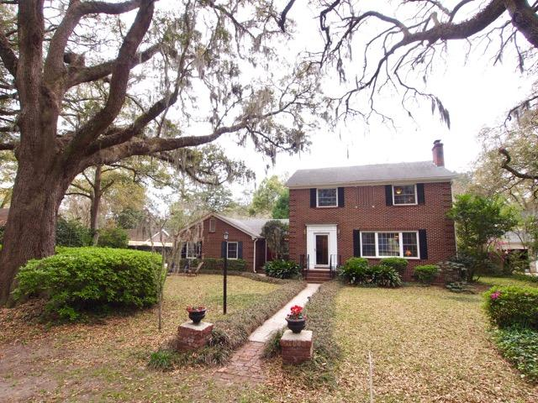
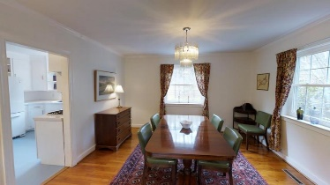
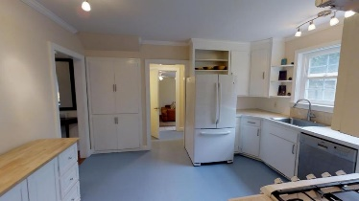
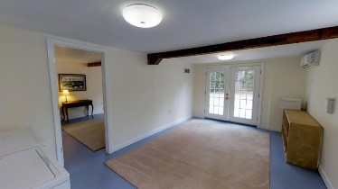
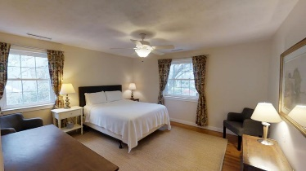
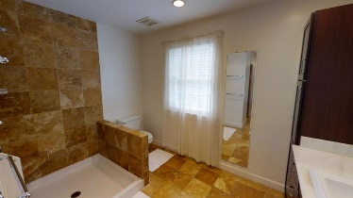
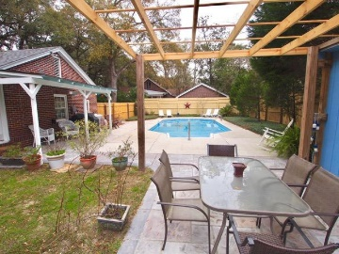
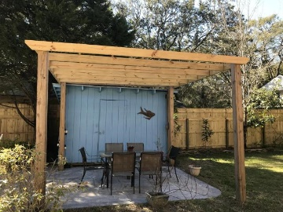
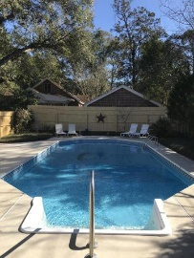
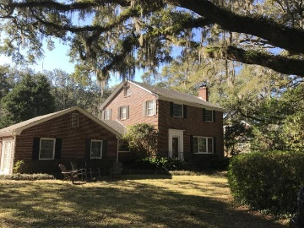
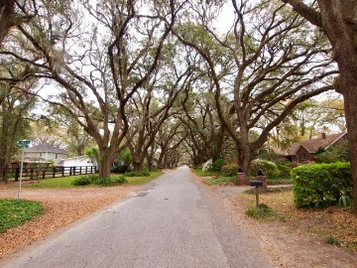



Open House - Saturday 1-4
2217 Wappoo Drive
Riverland Terrace
Charleston, SC 29412
MLS# 17006626 | $700,000
4 Bedrooms :: 3½ Bath :: 2,550 sf
4 bedroom 3.5 bath brick home nestled under the canopy of large grand oak lined street!
New roof, new windows, newer HVAC, new salt water pool liner, new pumps and filters! True 1 bed 1 bath mother in law suite, with extra sitting room! (Air B&B anyone?) Hardwood floors, fireplace, travertine counter tops, save thousands on insurance: NOT in a flood zone!
Neighborhood boat landing, kids play park, 3 ball fields, community garden, walk to the farmers market or the Terrace Theater. Patio, Shed, pergola. Shade trees! Avenue of Oaks! LowCountry Gem...setting is spectacular!
Eric Draper
(843) 442-7118
eric.draper@gmail.com
Jon Moore
(843) 732-3365
jonathanwyattmoore@gmail.com
www.charlestonrealestategroup.com
Charleston Real Estate Group | 792 Folly Rd. C1 | Charleston, SC 29412

