Slide 1
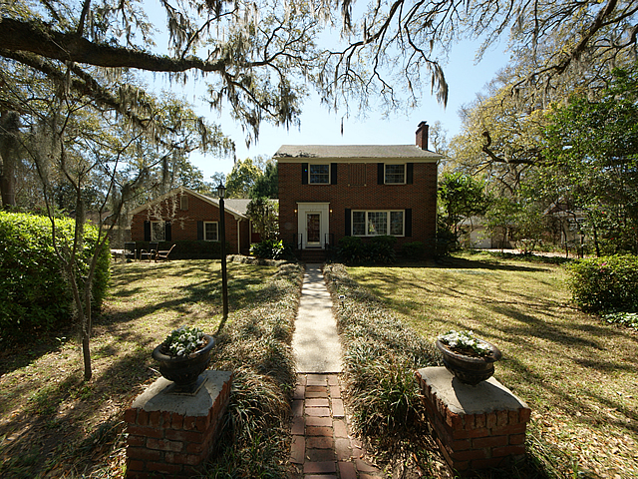

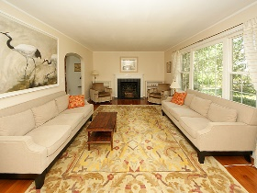
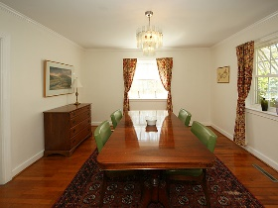
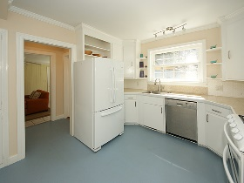
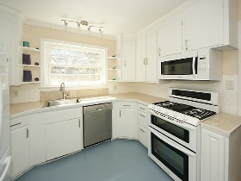
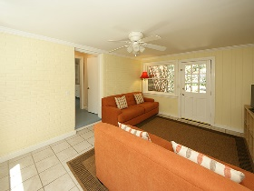
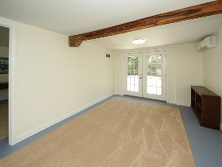
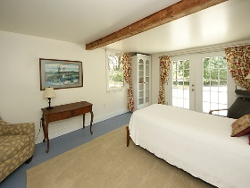
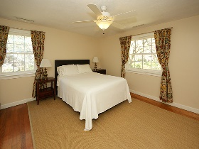
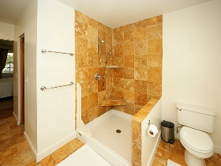
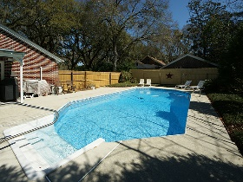
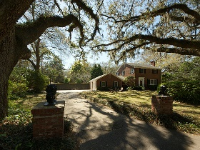
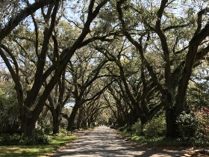



Rare Find In A Spectacular Setting!
2217 Wappoo Drive
Riverland Terrace
Charleston, SC 29412
MLS# 17006626 | $659,000
4 Bedrooms :: 3½ Bath :: 2,550 sf
Looking for a "GONE with the Wind" southern feel, complete with an ancient avenue of oaks? This is it! On the Riverland Terrace Gem!
Warm, inviting brick home nestled under a grand canopy of live oaks on the most desirable street on James Island! Half block from the Stono River, with gorgeous sunsets and south westerly breezes. Quiet, natural setting, yet 10-minute walk to popular Riverland Terrace restaurants and theater. Rejuvenating, low-maintenance in ground saltwater pool with new liner and pump! Ground level 1 bed 1 bath mother-in-law-suite with a bonus room.
Save thousands on insurance: NOT in a flood zone, NOT in windpool! Hardwood floors, fireplace, double gas oven, travertine counter tops. Neighborhood boat landing, play park, farmers market. Dual zone HVAC (1 year old)! Newer roof and windows.
Eric Draper
(843) 442-7118
eric.draper@gmail.com
Jon Moore
(843) 732-3365
jonathanwyattmoore@gmail.com
www.charlestonrealestategroup.com
Charleston Real Estate Group | 792 Folly Rd. C1 | Charleston, SC 29412

