Slide 1

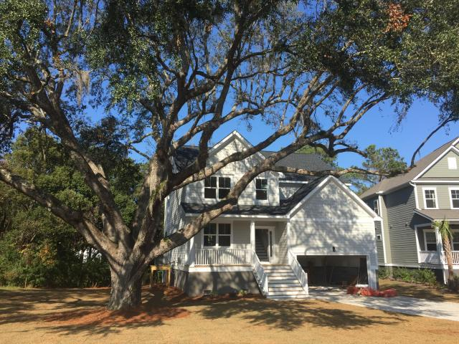
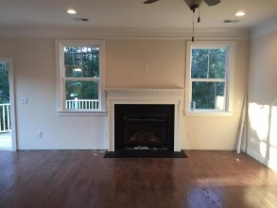
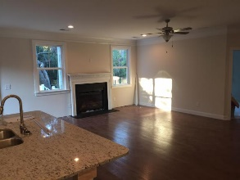
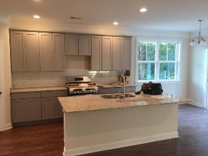
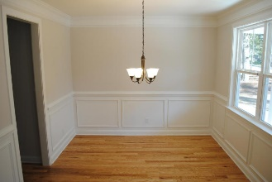
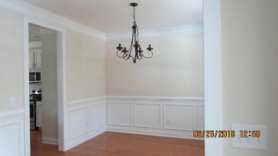
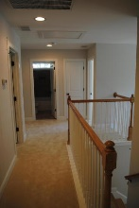
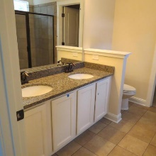
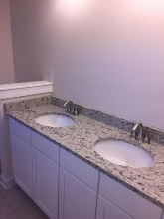
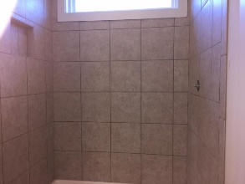
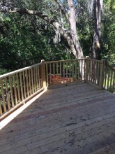
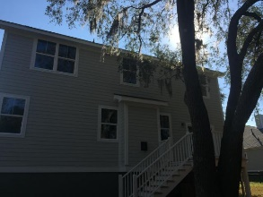
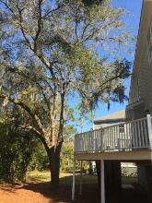


$10,000 Agent Bonus For A Contract That Closes By 12/31/16
2218 Sunstone Court
Island Shores
Charleston, SC 29412
MLS# 16028290
$479,500
2,450 SF
5 Bedrooms :: 2½ Bath
Beautiful new construction 5BR home by Rolina Builders, conveniently tucked away on James Island. Hardwood floors through out downstairs living area. Kitchen has granite counter tops w/ subway tile black splash. Stainless steel appliances. Stainless gas range, gas heat and gas fireplace. the cabinets are a shaker style with soft close, ''no slam'' doors. Tankless water heater. Large rear deck overlooks large, private back yard. Beautiful grand live oak trees grace the front lawn and entrance way as well as the back deck. Exterior siding is cement plank. Centrally located 5 minutes to downtown downtown, less than 10 Folly Beach, or 2 minutes to the trendy restaurants, and shopping at the Terrace Shopping plaza. This is a must see! Seller will provide buyer with a 1 year warranty. Pictures are from same or very similar house plan and may not accurately reflect the specific finishes on this build. Please contact list agent with specific questions.
Eric Draper
(843) 442-7118
eric.draper@gmail.com
www.charlestonrealestategroup.com
Charleston Real Estate Group | 792 Folly Rd. C1 | Charleston, SC 29412

