Slide 1

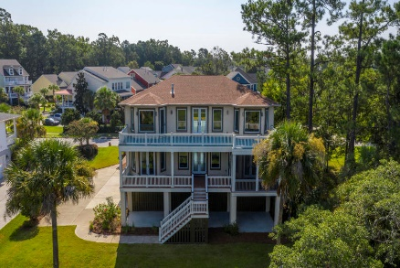
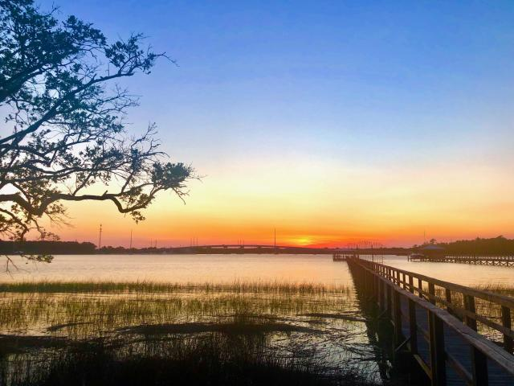
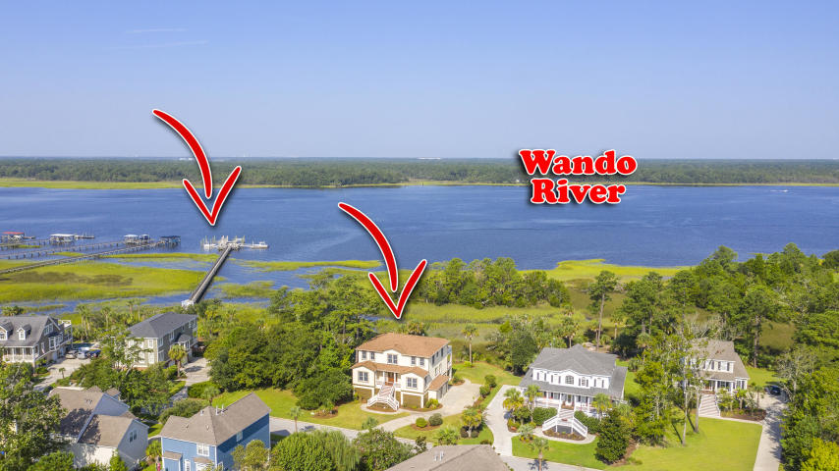
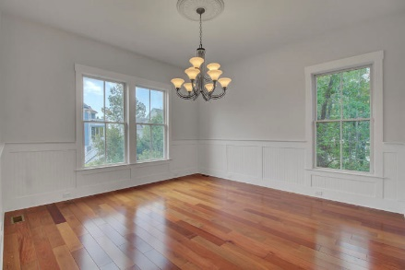
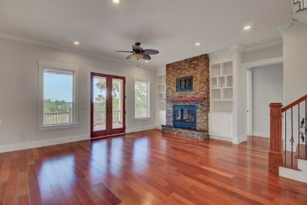
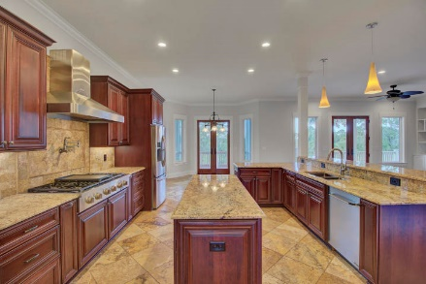
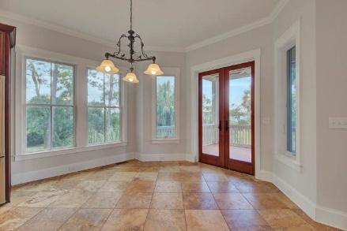
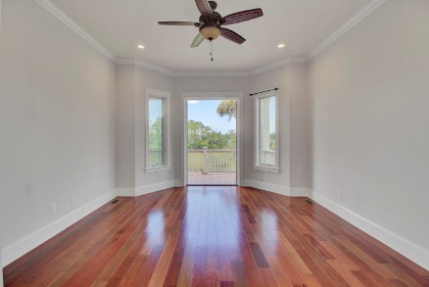
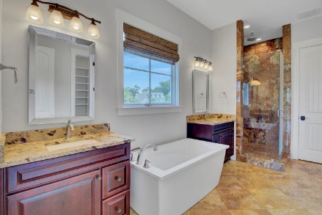
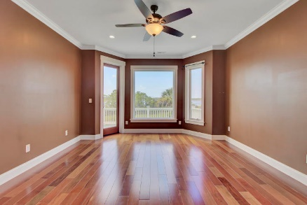
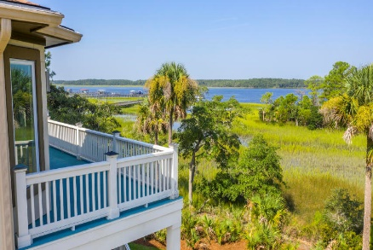
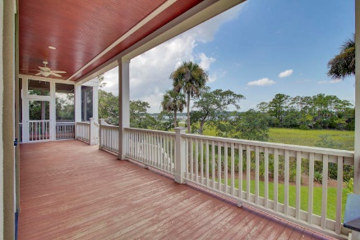
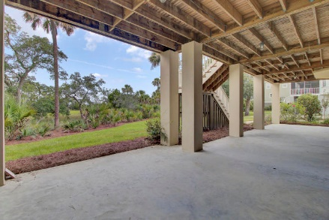


2219 N Marsh Drive Rivertowne On The Wando Mount Pleasant, SC 29466 MLS# 20024820 | $1,275,000
Price Adjustment
Wando River
Custom Home
Nestled into a lush landscape of palmettos, live oaks, and spartina grass, this elegant custom home is perched directly on the waterfront and enjoys stunning views over the marsh of the Wando River and its gorgeous sunsets. The Mediterranean villa styled exterior welcomes guests up onto the front porch and into a grand entry foyer. Custom details abound and are sure to impress - from the Brazilian Santos Mahogany hardwoods and Turkish Scabos travertine tile floors to the barrel ceiling treatment to the intricate millwork, this home is filled with upgraded finishes and special designer touches, including eight foot solid core doors throughout the main floor.
This dream home is one of a few select residences that include a deeded boat slip on the Wando River. Just a short stroll down the pier, behind a private, gated section of the community dock and you'll be enjoying water sports, sunset cruises or fishing the open Atlantic within minutes of leaving your dock! All of this and located in the prestigious Rivertowne on the Wando Neighborhood with three community docks for fishing, boating or just to relax and watch the amazing Wando River sunsets. Enjoy golf at Rivertowne Country Club's Arnold Palmer Signature Course then meet friends at the club for dinner. Additional amenities include neighborhood pool, tennis courts, walking trails and play park all conveniently located to beaches and the world class dining and shopping of historic downtown Charleston.
Don Dawson 843-514-0452 ddawson@carolinaone.com Carolina One Real Estate • 2713 Highway 17 North • Mount Pleasant, SC 29466
www.TeamDawsonSC.com

