Slide 1
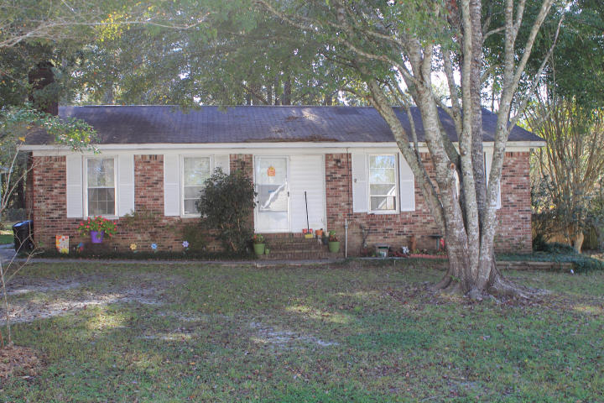
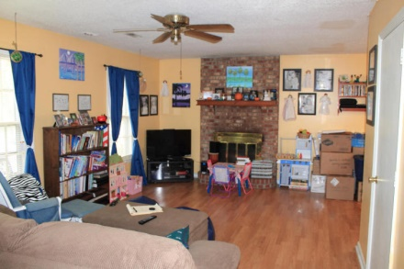
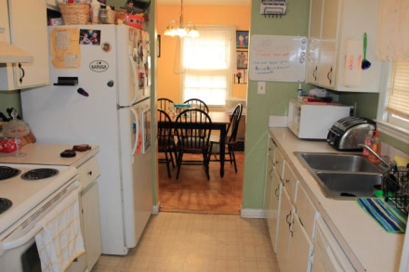
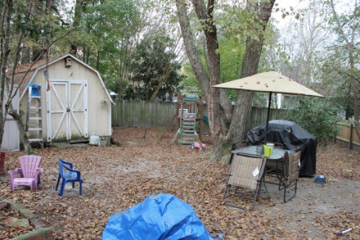
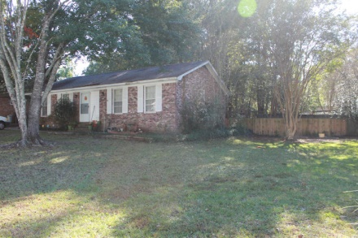
GREAT INVESTMENT PROPERTY!!
221 E Edgefield Dr
Crestwood
Summerville
MLS# 14028206
$94,900
Wonderful single story brick ranch with large fenced in yard. BRAND NEW 30 YEAR ARCHITECTURAL ROOF!! Inside, there is the living room/dining room combo with great looking hardwood laminate and parquet flooring, accompanied by wood burning fireplace. Vinyl flooring in kitchen and laundry room is also BRAND NEW!! The backyard has expanded patio with storage shed and wood/metal fenced in yard. Lowboy water heater replaced in 2007. Tenant Occupied
Sean Harrington
Office: 843-821-1111
Cell: 843-226-9652
sean@milerproperties.com www.milerproperties.com

