Slide 1
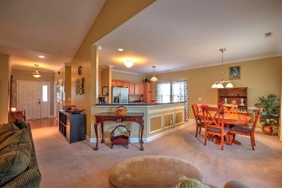
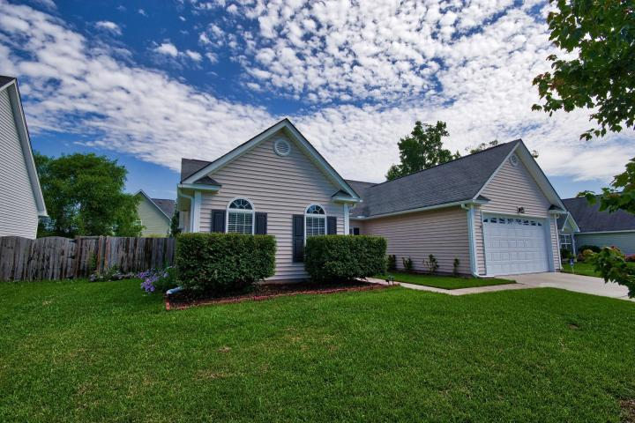
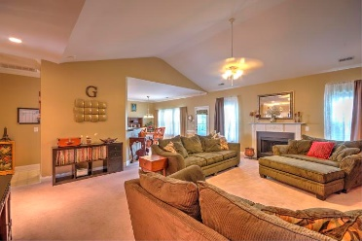
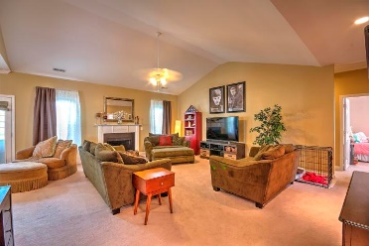
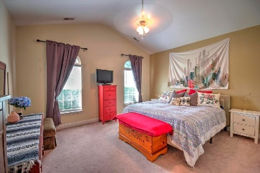
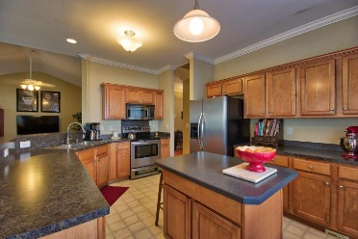
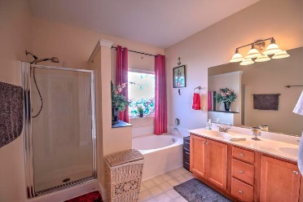
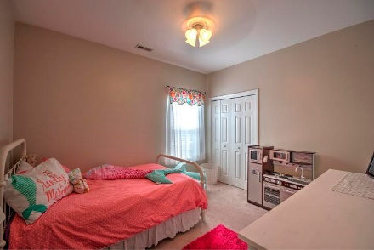
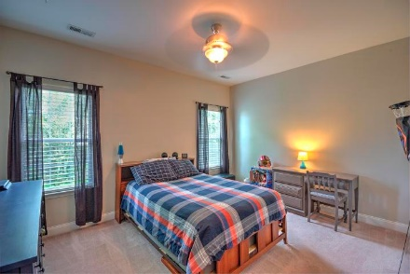
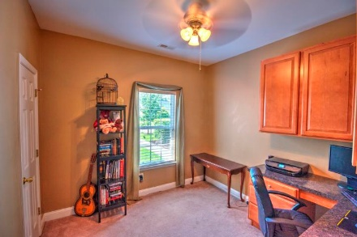
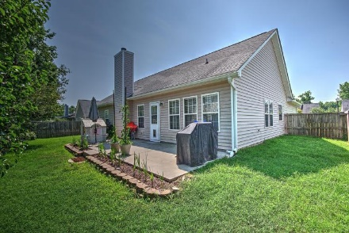


Now Priced At $228,000! Largest Floorplan In The Neighborhood!
Starbucks card to first 10 agents
221 Equinox Circle
Heatherwoods ~ Ladson, SC 29456 ~ MLS# 18015647 ~ $228,000
Beautiful one story 4 bedroom, two bath home with an open floor plan in coveted Dorchester 2 School District! Walk into a foyer that leads a huge living room with a wood-burning fireplace and vaulted ceiling open to the dining room and kitchen. Turn left from the foyer to the recessed entry to the master with a large walk in closet, private bath with a garden tub, separate shower and dual vanity. Kitchen has an island and lots of cabinet space. The secondary bedrooms are on the right side of the living room with one being used as an office. Plenty of privacy with good-sized rooms. Two car garage off of the laundry room. The fully-fenced backyard is off of the living room. Choice Warranty provided by seller.
Susan Kraber
(843) 779-9655
susankraber1@gmail.com
The Boulevard Company, LLC | 35 Broad Street | Charleston, SC 29401

