Slide 1
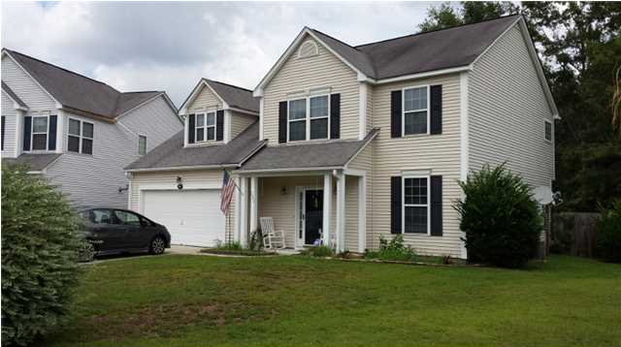
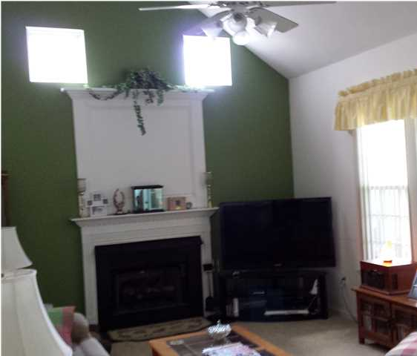
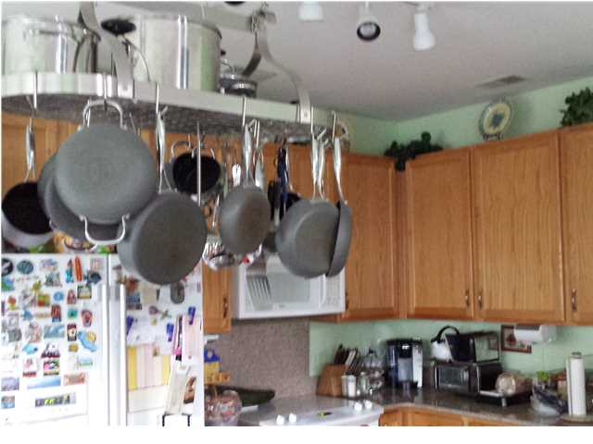
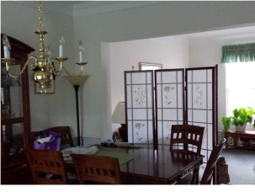
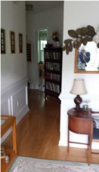


221 EVESHAM DRive gahagan East – Summerville - MLS# 15003331 just rEDUCED TO $190,500
Just Reduced – Great 4 Bedroom!
4 BEDROOMS | 3½ BATHS | 3,600 SQ FT
If location is important then this is the home for you. Perfectly situated in a small quiet subdivision it is close to shopping, major employers and the military base. From the open airy family room with 2 story ceiling complete with gas fireplace to the to the large second floor master bedroom with private bath you will see that this home offers more that you could expect. This home has a fantastic eat in kitchen, large dining room and formal living room. Crown molding and wanes coating greet you as you enter this great family home. The home offers a fenced yard, patio, sunroom and large 2 car garage with side entrance.
Randy Spear
843-568-2800 M
rspear@carolinaone.com
Carolina One Real Estate
1530 Trolley Road
Summerville, SC 29485

