Slide 1
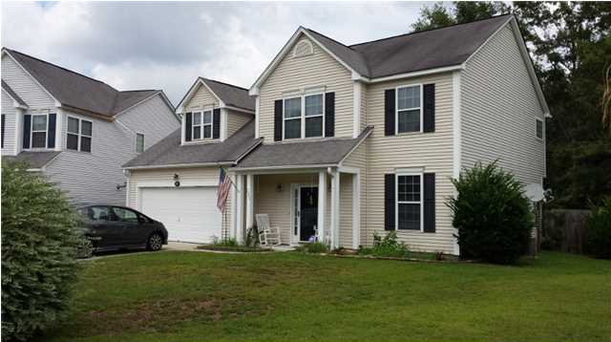
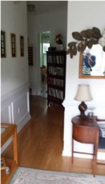
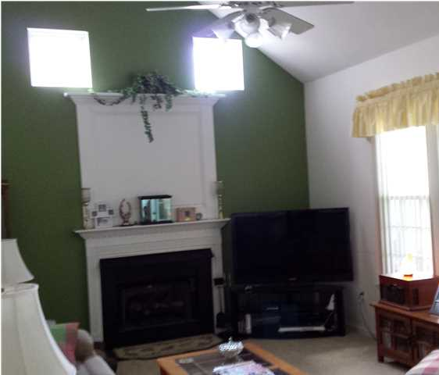
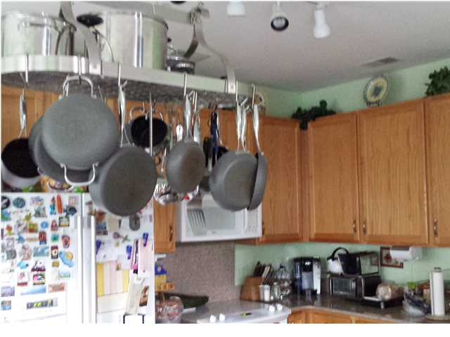
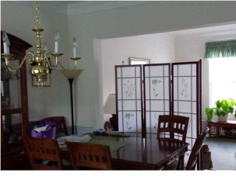


221 EVESHAM DR gahagan East - Summerville MLS# 1419234 REDUCED TO $206,000
Just Reduced!
4 BEDROOMS | 3½ BATHS | 3,600 SQ FT
Great floor plan in this two story home. Formal Living Room open to Formal Dining Room. Large great room with gas fireplace. Ceramic tile in kitchen, eating area and sunroom. Crown molding in the Living Room, Dining Room and hallway. Second floor has 4 bedrooms with one being the master with full bath. This house sits on a short cul-de-sac and has a fenced rear yard.
Randy Spear
843-568-2800 M
rspear@carolinaone.com
Carolina One Real Estate
1530 Trolley Road
Summerville, SC 29485

