Slide 1
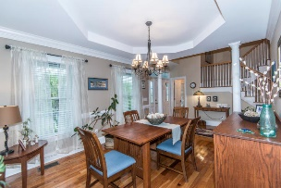
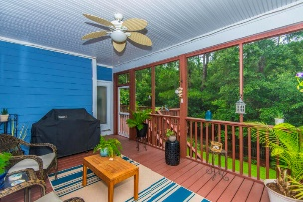
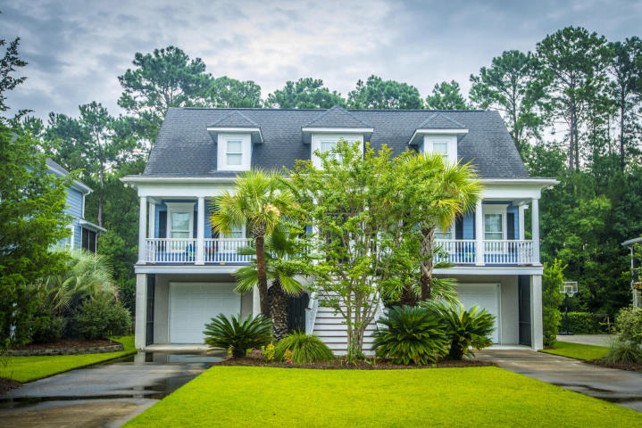
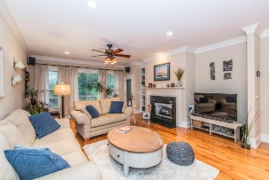
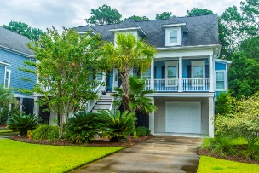
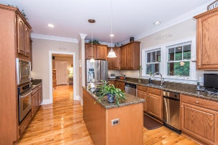
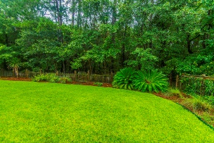
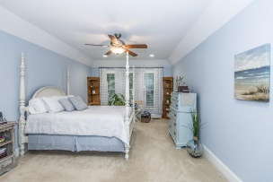
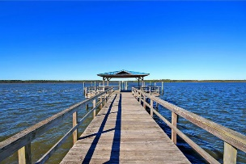


2220 Branch Creek Drive
Rivertowne Country Club ~ Mount Pleasant
MLS# 17020312 ~ $605,000
$35,000 PRICE REDUCTION
$5,000 CLOSING COSTS
$2,500 AGENT BONUS
4 BEDROOMS | 3½ BATHS | 3,600 SQ FT
Fantastic opportunity to buy this custom built lowcountry home located in The North Creek subsection of Rivertowne Country Club w/golf, tennis, pool, play parks in an excellent school district. One owner that have been meticulously cared for this home inside & out. Situated on a nice lot that backs up the woods buffer with mature landscaping & beautiful sunset views from the large front porch. Downstairs master bedroom w/ en suite bath. Large garage + flex enclosed room with HVAC for workouts + workshop. Gorgeous open foyer entrance way, large dining room & a grand family room, wonderful kitchen with stainless steel appliances, 9' ceilings, private screened in porch & separate deck perfect for entertainment. Flood insurance is only $308 per year-transferable. Drive-under parking provides ample space for multiple autos, boats, storage, and a workshop. This home is located in Rivertowne Country Club, a premier Mount Pleasant Golf & Country Club neighborhood. Rivertowne feeds into Mt Pleasant top ranking public schools. Rivertowne neighborhood amenities include a fantastic community dock on the Wando River with room for several boats and offers a great place for fishing, an "Arnold Palmer Signature" golf course, clubhouse, pro shop, two bars and restaurants, pool, play park, clay tennis courts, a basketball court and a community BBQ area. Your neighborhood HOA fee covers use of all the amenities. Private Golf Country Club membership is available. The beaches on the Isle of Palms and Sullivan's Island are 20 minutes away. Historic downtown Charleston and the airport are both approximately 30 minutes.
$2300 available toward buyer's closing costs and pre-paids with acceptable offer and use of preferred lender!!!
Daniel Carabus
843-793-9265 M
dcarabus@carolinaone.com
www.danielcarabus.com
Carolina One Real Estate
195 W Coleman Blvd
Mt Pleasant, SC 29464

