Slide 1
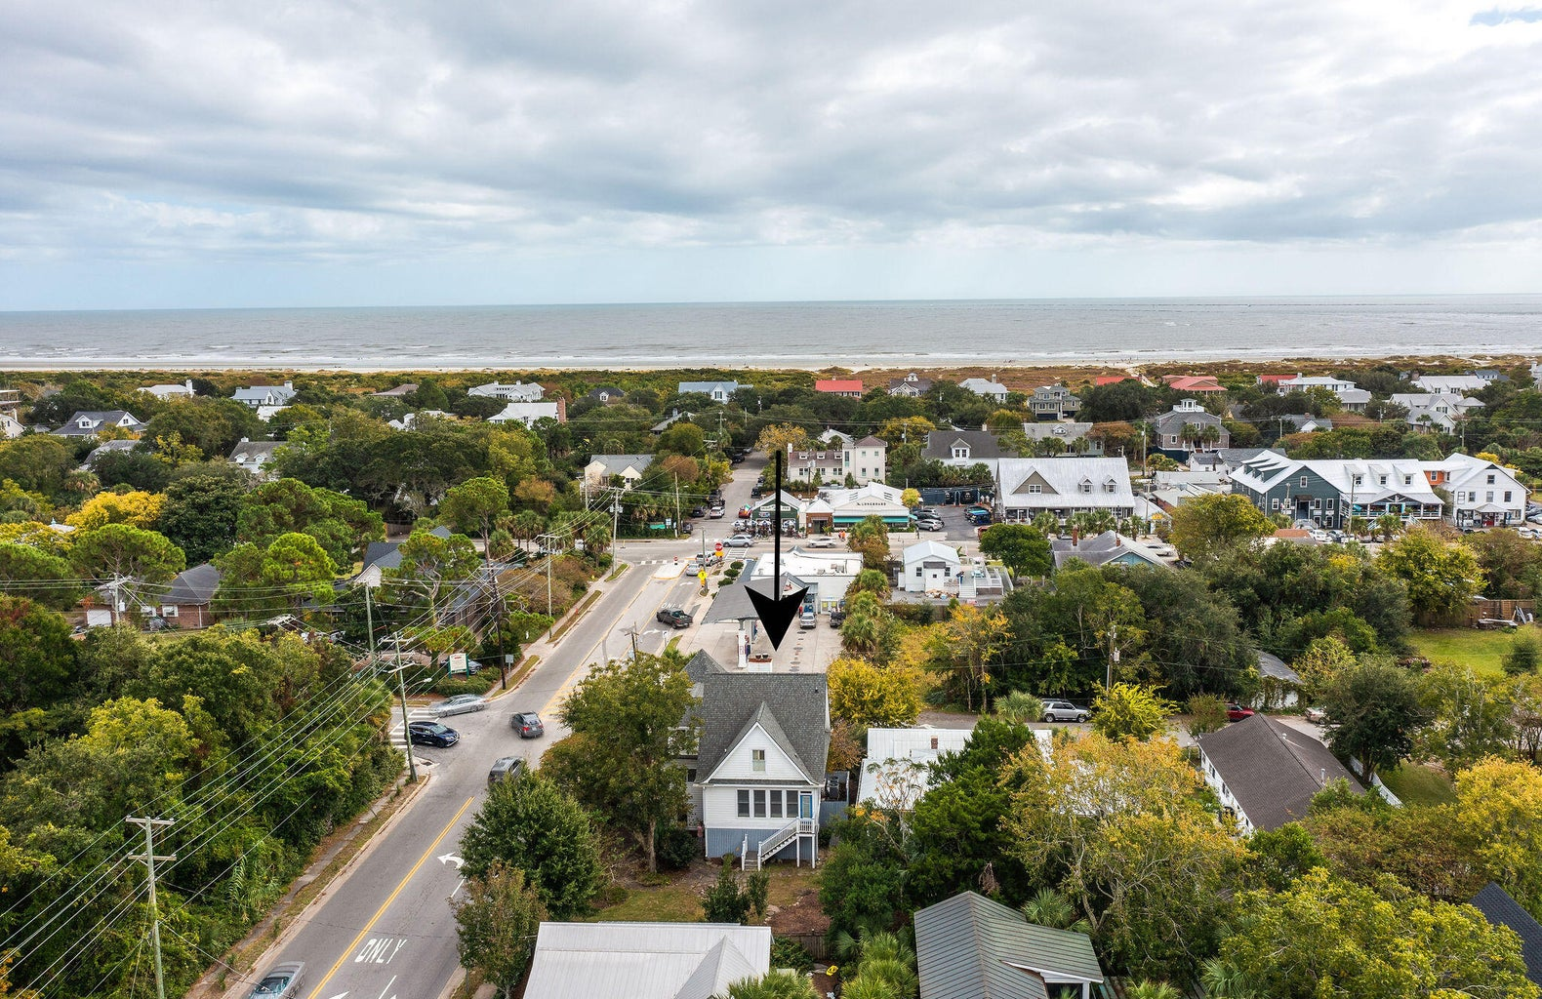
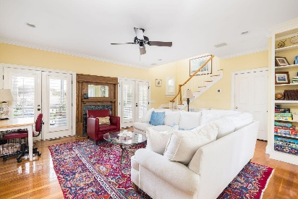
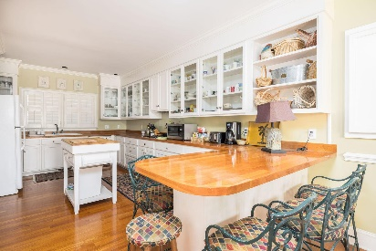
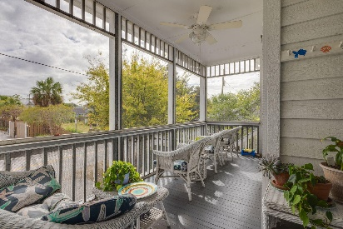

$10,000 Agent Bonus on Top of 3% Buyers Agent Commission
2220 Jasper Boulevard
Sullivans Island, SC 29482
MLS# 24002072 | $2,250,000
We're excited to introduce the only active turnkey listing on Sullivans for under $2,750,000. This home has been well cared for and enjoyed by the current owners for the past two decades. This charming property offers the perfect blend of island tranquility and convenience. It's a leisurely three-block stroll to the pristine shores of the Sullivans Island beach, while a mere one-block walk will place you in the midst of the island's downtown, teeming with restaurants and unique boutiques. For those who enjoy waterway activities, you're just a block away from the intracoastal waterway. You can have easy access to a private boat landing on the island at a discounted membership fee.
Don't miss the opportunity to make this coastal retreat your own. Whether you're looking for a permanent residence or a seasonal escape, 2220 Jasper Blvd offers the perfect canvas for your island dreams. Experience the best of Sullivans Island living in this well maintained home. Schedule your showing today!
Kelly Snyder
843-457-5951
kelly.snyder@agentownedrealty.com
Greg Gelber
843-494-2354
greg.gelber@agentownedrealty.com
AgentOwned Charleston Group | 902 Savannah Hwy | Charleston, SC 29407-7802

