Slide 1
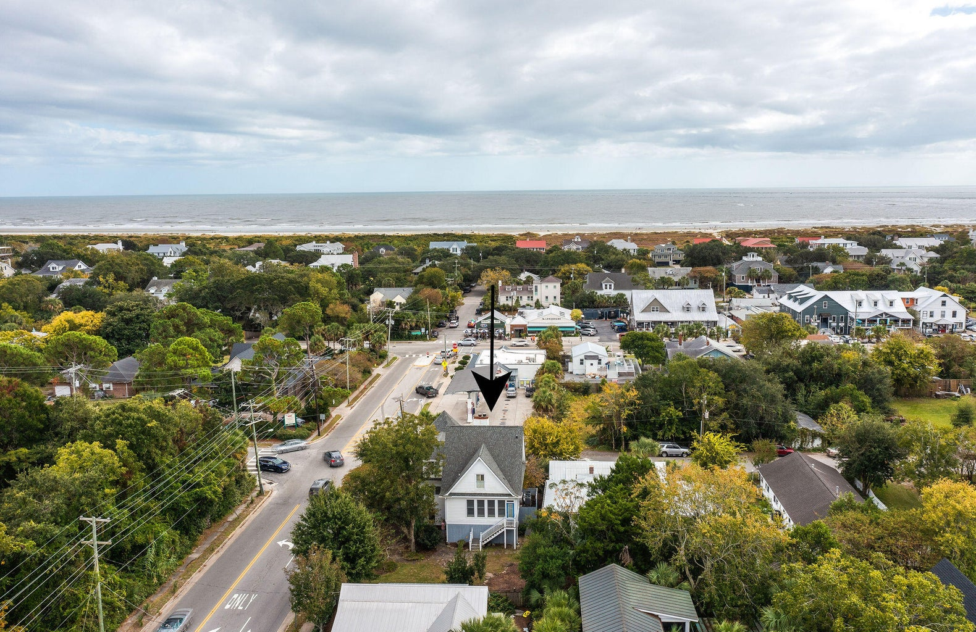
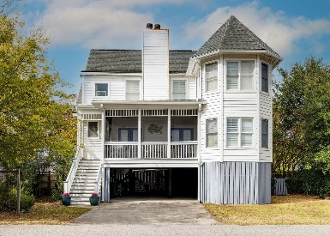
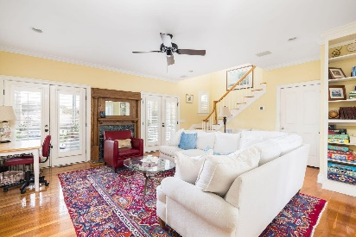
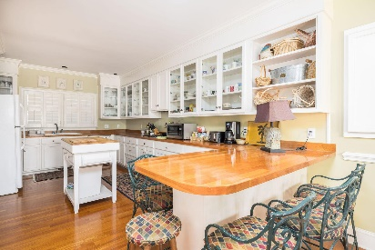
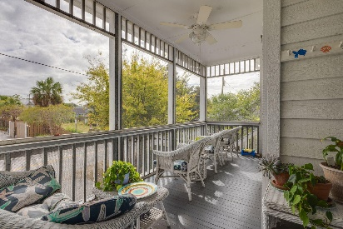

The Best Of Sullivans Island
2220 Jasper Boulevard
Sullivans Island, SC 29482
MLS# 23026769 | $2,490,000
Discover the ultimate island living experience with this magnificent coastal gem situated in the heart of Sullivans Island. Located at 2220 Jasper Blvd, this charming property offers the perfect blend of island tranquility and convenience. Just a leisurely three-block stroll will lead you to the pristine shores of the Sullivans Island beach, while a mere one-block walk places you in the midst of the island's vibrant downtown, teeming with restaurants and unique boutiques. For those who enjoy waterway activities, you're just a block away from the intracoastal waterway. You can have easy access to a private boat landing on the island at a discounted membership fee.
Boasting 4 bedrooms and 3.5 bathrooms, this elevated construction home offers a spacious 2,338 square feet of indoor living space. Enjoy the island's natural beauty and gentle sea breeze from the large screened-in front porch, providing the ideal spot to unwind and savor the coastal lifestyle. This property features dual owner suites, one on the first floor and another on the second floor. Two large fireplaces add a touch of warmth and coziness, creating an inviting atmosphere. Hardwood floors throughout the home exude a timeless and elegant appeal, while the kitchen showcases beautiful large cabinets, perfect for culinary enthusiasts who need plenty of storage.
Don't miss the opportunity to make this coastal retreat your own. Whether you're looking for a permanent residence or a seasonal escape, 2220 Jasper Blvd offers the perfect canvas for your island dreams. Experience the best of Sullivans Island living in this well maintained home. Schedule your showing today!
Kelly Snyder
843-457-5951
kelly.snyder@agentownedrealty.com
Greg Gelber
843-494-2354
greg.gelber@agentownedrealty.com
AgentOwned Charleston Group | 902 Savannah Hwy | Charleston, SC 29407-7802

