Slide 1
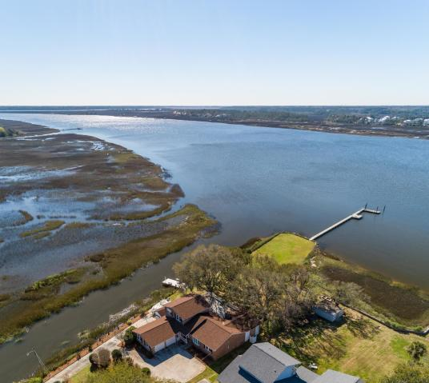
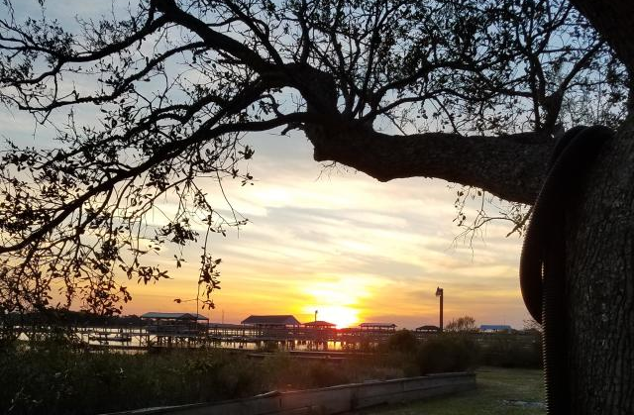
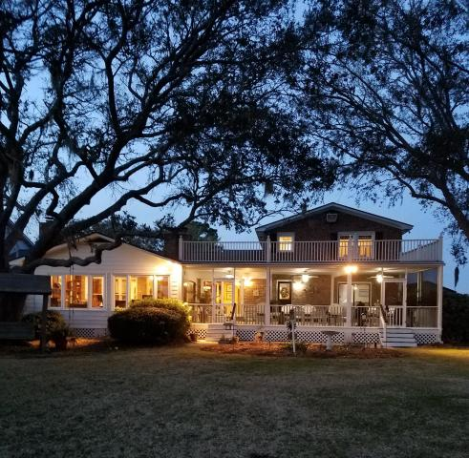
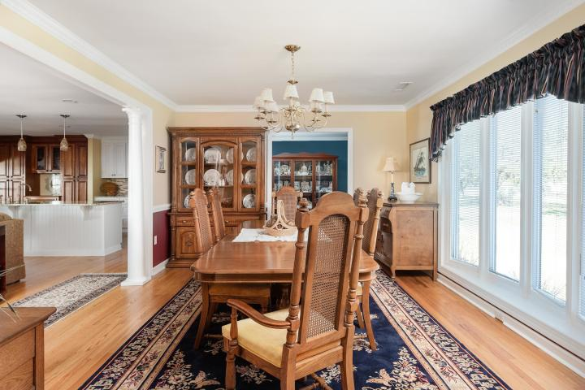
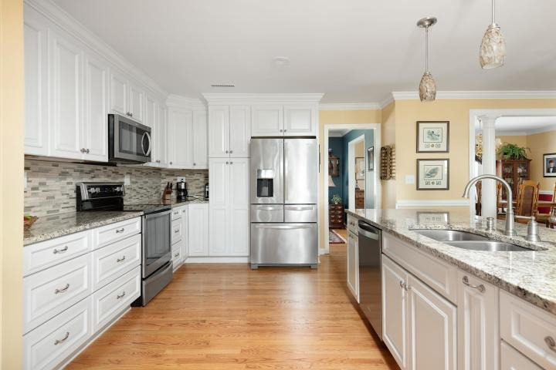
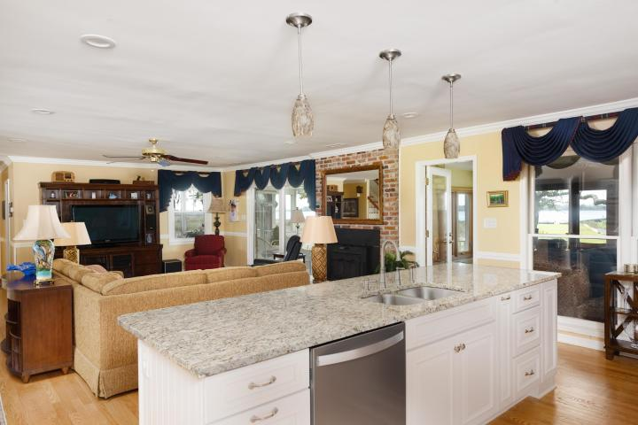
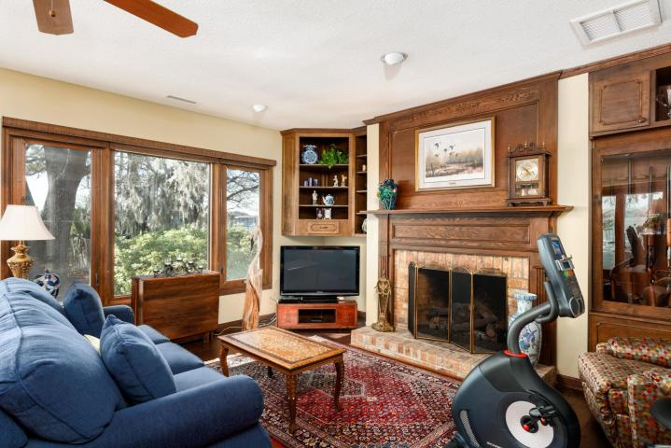
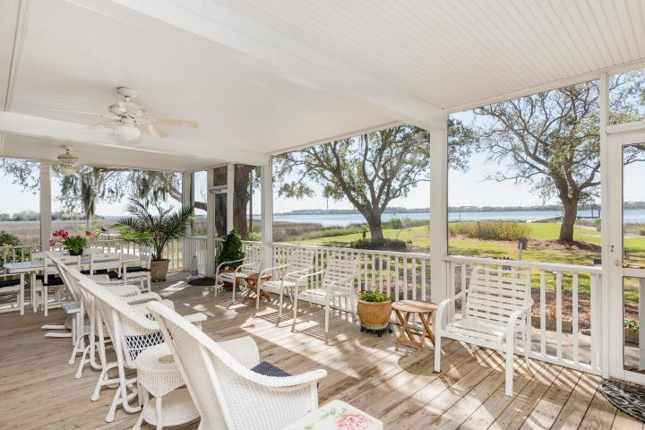
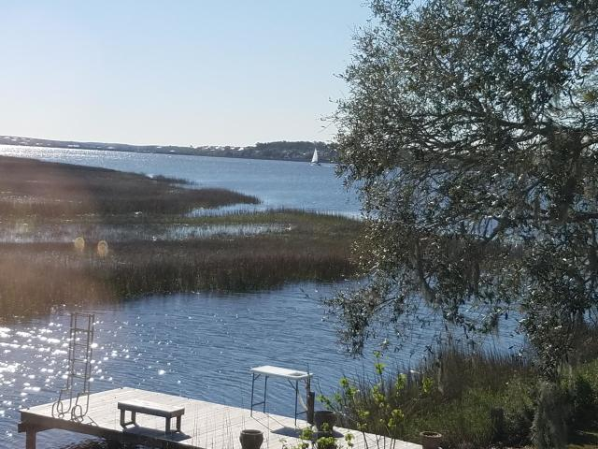
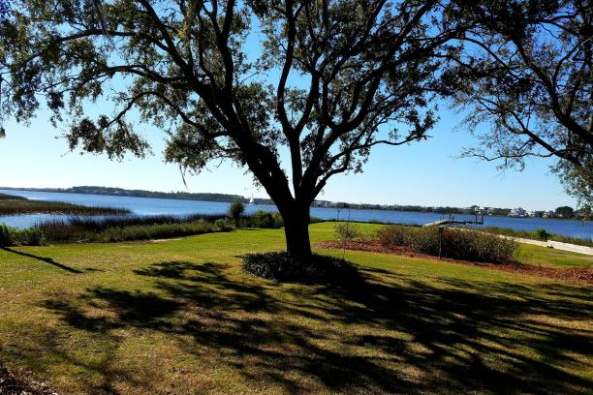
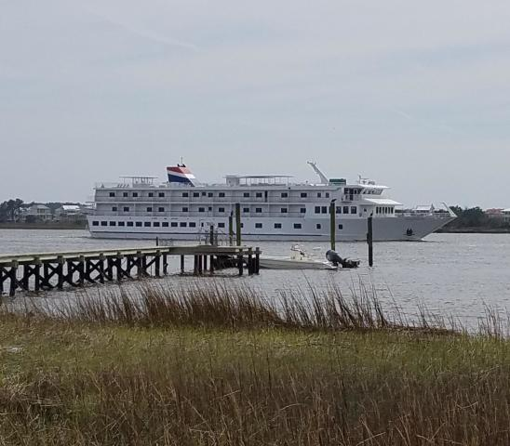
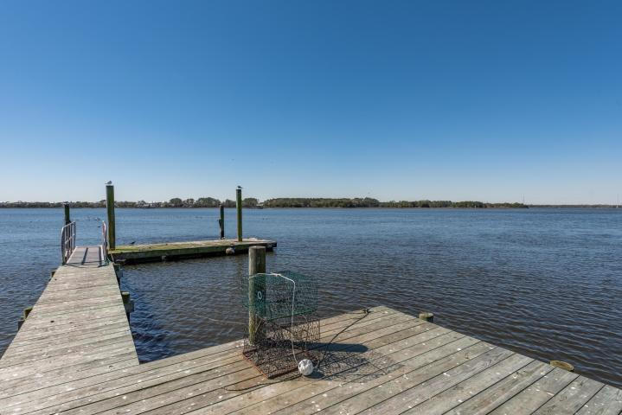
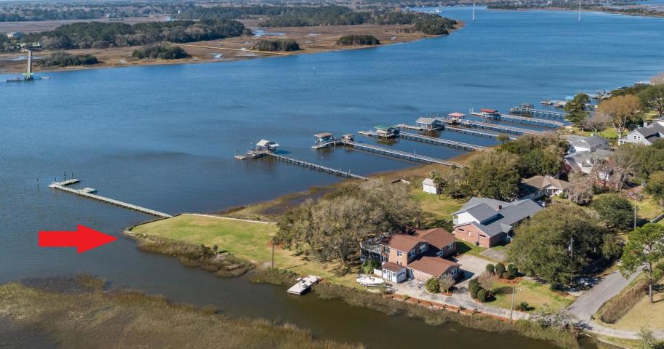


Deep, Deep Water on Stono River
2 Docks, Boat Ramp, 4BR/3BA House, 1.1 Acre West Ashley
REDUCED!!
REDUCED!!
2221 Lazy River Drive
Parkdale | Charleston, SC 29414 | MLS# 19006822 | $1,675,000
Deep, Deep Water on the Intracoastal Waterway..2 Docks..Boat Ramp..1.1 Acre..Only 7 miles to Downtown..4 BR/3BA Brick Home (MBR downstairs)..Stunning New Kitchen~ALL YOU NEED IS JIMMY BUFFET MUSIC AND A BLENDER!!! One-of-a-kind property is situated right on the STONO RIVER with Panoramic Water Views from every room in the house!!! Boater's dream: 16' x 16' pier head, aluminum gangplank to a 10' x 30' floating dock..outside mooring pilings on the ICW with 10' of water on mean low tide. The east side of the property borders a tidal creek with another dock measuring 10' x 30' and includes a fish cleaning station. NO HOA so you can keep your boat at home and slip it in the water with your own boat ramp in the yard. Entertainment Central is the 730sf Screened Porch adjoining the Sunroom (has gas log fireplace), Great Room (with wood-burning stove fireplace), Dining Room and FABULOUS KITCHEN with a 10 foot Island..new cabinetry, granite counter tops, stainless steel appliances!!! GORGEOUS!!! Downstairs was recently renovated to an open floor plan. Beautifully refinished Hardwood Floors throughout the home. Roof, HVAC and ductwork all new in 2017. LOW ELECTRIC BILLS!!! Energy efficient windows with high impact glass. Unique property being offered for first time since it was built!!! What a perfect place to enjoy boating, fishing, crabbing, shrimping, swimming, water skiing, or just relaxing as you watch the boats go by in the wide, deep waters of the Stono River! Love where you live...and it's only 7 miles to Downtown Charleston, 9 miles to the Airport, 15 miles to the Beach!
Barbara Harper
843-224-5759
Barbara.Harper@agentownedrealty
www.ISellCharleston.com
The AgentOwned Realty Co. • 902 Savannah Hwy. • Charleston, SC 29407
Real Estate • Mortgage • Insurance

