Slide 1
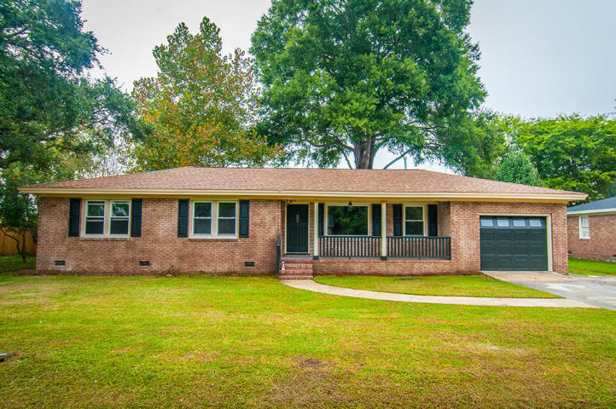
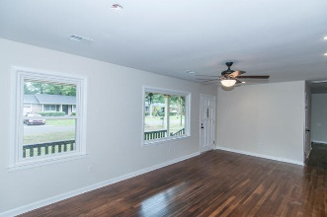
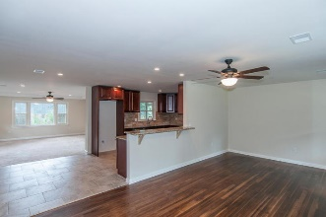
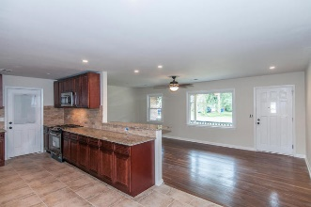
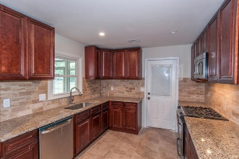
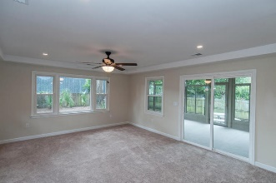
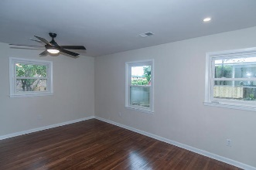
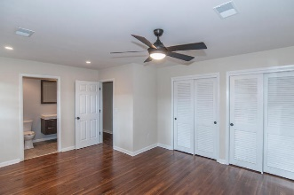
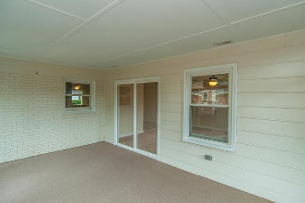
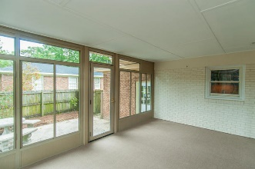
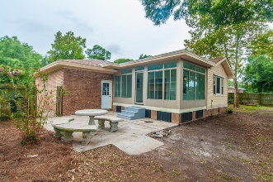
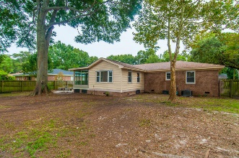

Renovated Top To Bottom!!
Open House Saturday 12-3 Refreshments Provided
2222 N Dallerton Circle
Sylcope :: Charleston, SC 29414 :: MLS# 15024803 :: $299,900
This beautiful brick ranch home is in a great location close to I-526, downtown, the islands, Costco and other grocery shopping etc.** Solid brick house with a great floorplan, large bedrooms, huge family room, NICE Large 200sf Sunroom that is heated and cooled. ** It features a Brand New roof, new HVAC, updated windows (with storm cover inserts), re-finished wood floors throughout most of the house, new carpet in the large family room, tile in the kitchen and baths, new upscale cabinetry in the kitchen, granite counters, travertine backsplash, stainless appliances (gas range), recessed lighting, big front porch, and a large fenced in backyard. This home is move-in ready! Come see it today!
Scott Baskin
843-324-4139 M | 843-972-2400 O scott.r.baskin@gmail.com | www.scottbaskin.com
RE/MAX Advanced Realty
311 Johnnie Dodds Blvd
Mt Pleasant, SC 29464

