Slide 1
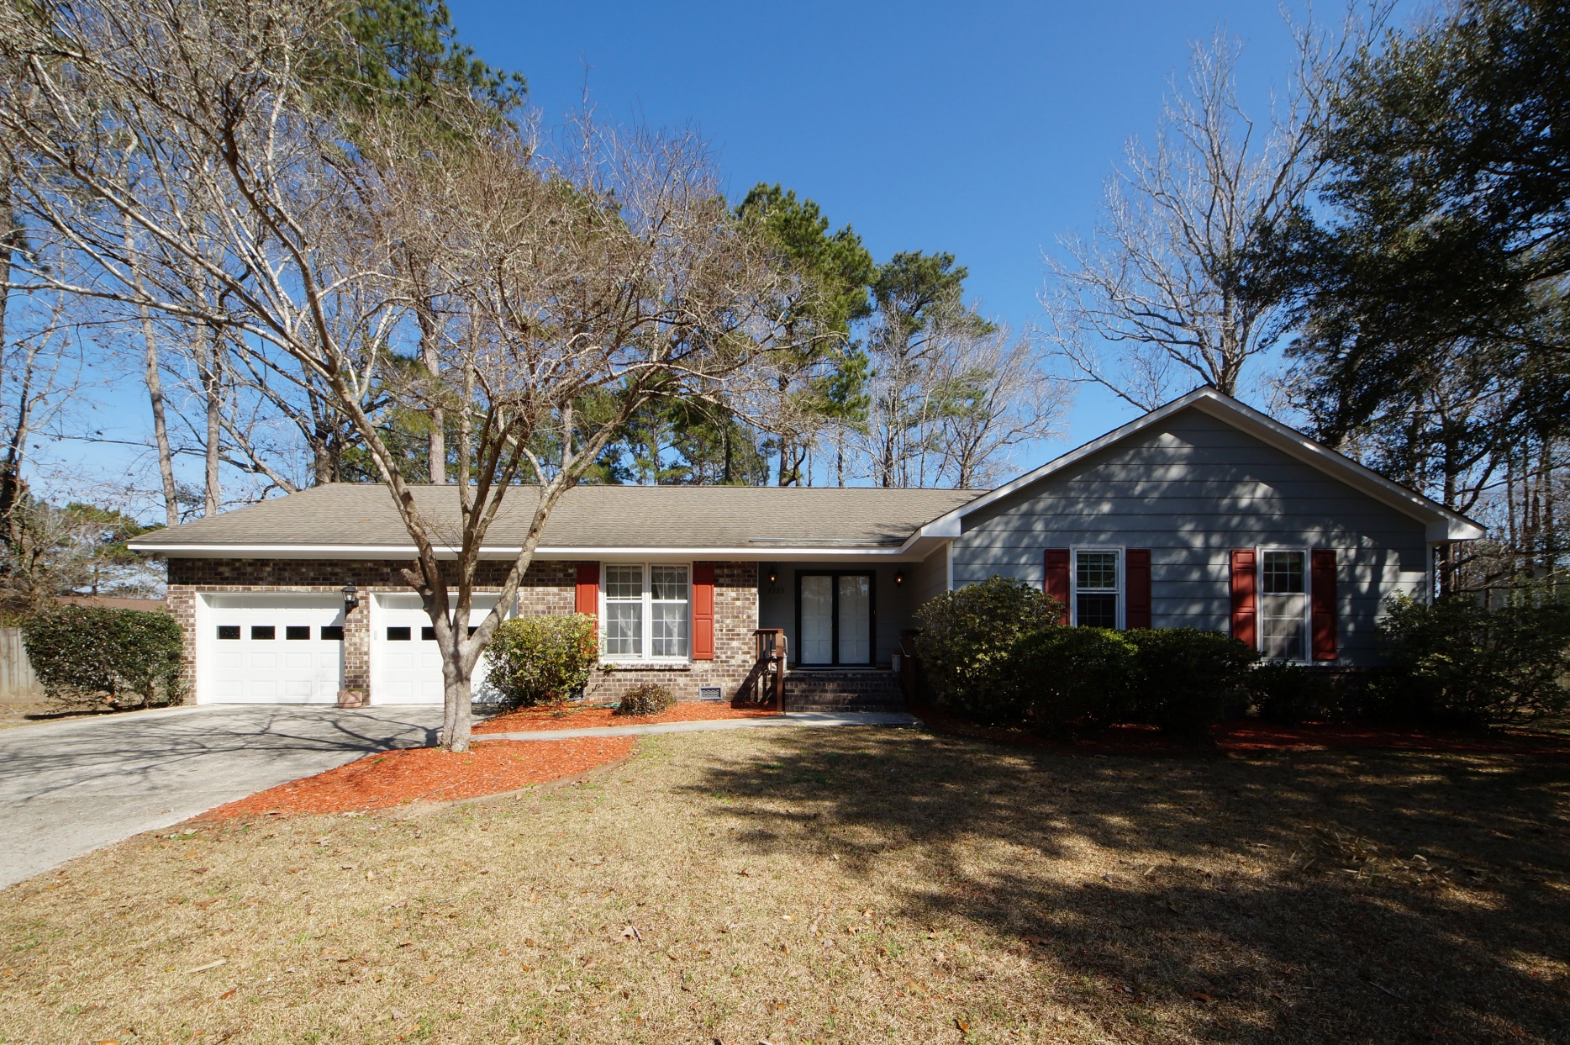
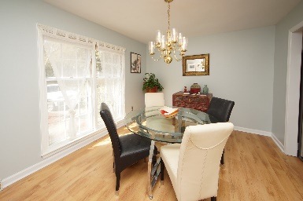
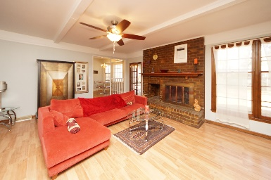
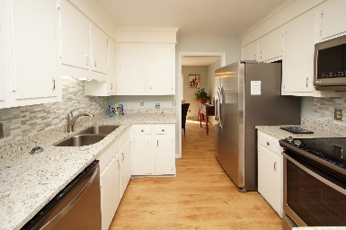
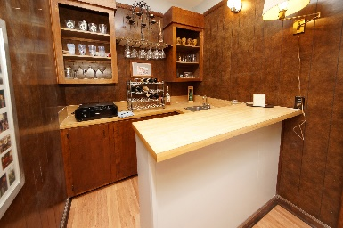
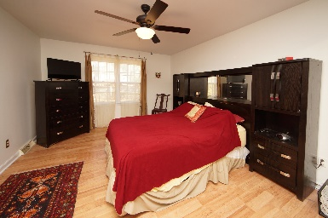
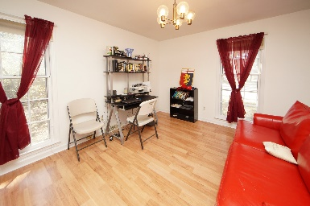
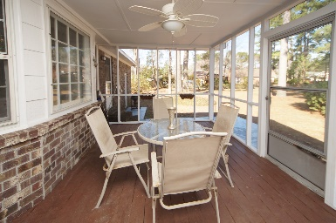
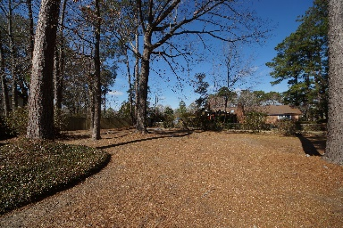

Elegant Home in an Established Neighbourhood
DRAFT
2223 Forest Lakes Boulevard
Forest Lakes ~ Charleston, SC 29414 ~ MLS# 17032145 ~ $309,900
This 2,131 sq. ft. family home, is located on a cul-de-sac in an established neighborhood with beautiful old trees and sidewalks, close to all the amenities in the area. It isThis amazing brick property is a must see, developed on one of the biggest lot in the neighborhood and it is beautifully landscaped. The entire property has been freshly painted with new laminate flooring installed. The elegant double door entry of this newly renovated home, opens to a gracious foyer, a large formal dining room and a precious living room enriched by a brick fireplace, beamed ceiling, a a new ceiling fan, a built-in bookcase and an elegant wet bar ideal for entertaining. And there is so much more to explore about this home. Check out the tour to see it all!
Marco Rivetti
(843) 817-4934
marco.rivetti@libero.it www.southernlivingre.com
Southern Living Real Estate
2249 Salt Wind Way, Mt. Pleasant, SC 29466

