Slide 1
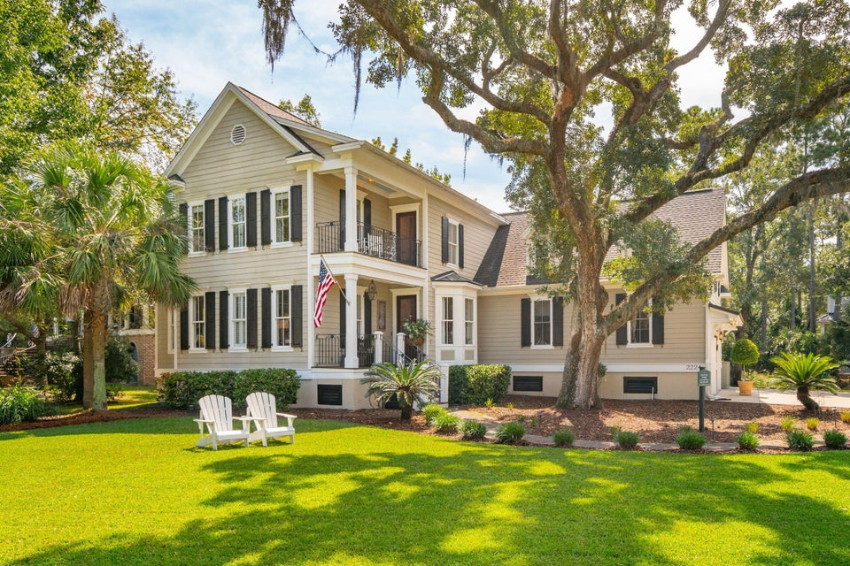
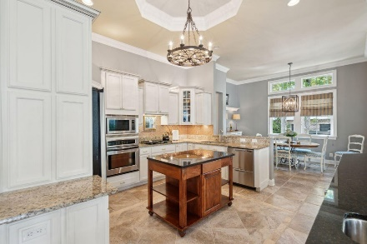
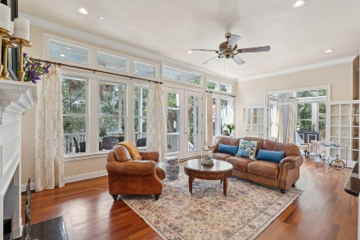
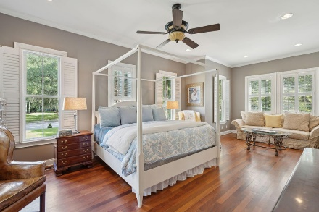
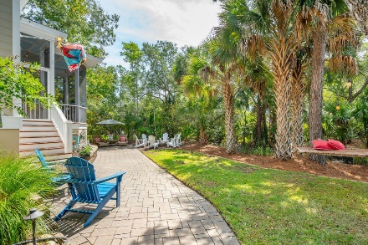


BROKER OPEN HOUSE | THURSDAY, OCTOBER 17TH | 10-12
2224 Beckenham Drive
Park West · Mount Pleasant, SC 29466 · MLS# 24018777 · $1,449,000
Beautiful Lowcountry Classic Home in the prestigious Masonborough section of Park West! This quality built home offers all the space you need with 5 bedrooms, 4.5 baths, open living areas, multiple flex/office spaces, and great outdoor living area! Custom features include teak wood floors throughout the downstairs, 11.5' ceilings, heavy moldings, and upgraded lighting and fixtures. The spacious great room has a gas fireplace and opens onto the screened porch and private backyard. The island kitchen features an abundance of beautiful cabinetry, granite countertops, tray ceiling, tile backsplash and stainless steel appliances. Primary suite is on the first floor and offers a sitting area, walk in closet, dual vanity sinks, jacuzzi tub and separate shower. Upstairs are 3 additional bedrooms, One of which has its own private bath to serve as a second master suite. Another stairway leads to the huge private bonus room, also with its own full bath. Perfect for an additional master suite, media or game room.
Park West's resort-style amenities includes a clubhouse, 2 pools; one is zero entry, sand volleyball court, 6 tennis courts, walk/jog trails and play park. Award winning public schools are within the neighborhood as well as shopping, dining, recreational fields, professional offices, grocery, and a gym. Downtown Charleston and the beaches are only 20-25 min away.
A $2,500 lender credit is available and will be applied towards the buyer's closing costs and pre-paids if the buyer chooses to use the seller's preferred lender. This credit is in addition to any negotiated seller concessions.
The Ed Hunnicutt Team
Ed | 843-270-0292 | ed@edhunnicutt.com
Georgieann | 843-425-6772 | georgieann@edhunnicutt.com www.EdHunnicutt.com
195 West Coleman Blvd
Mt. Pleasant, SC 29464

