Slide 1
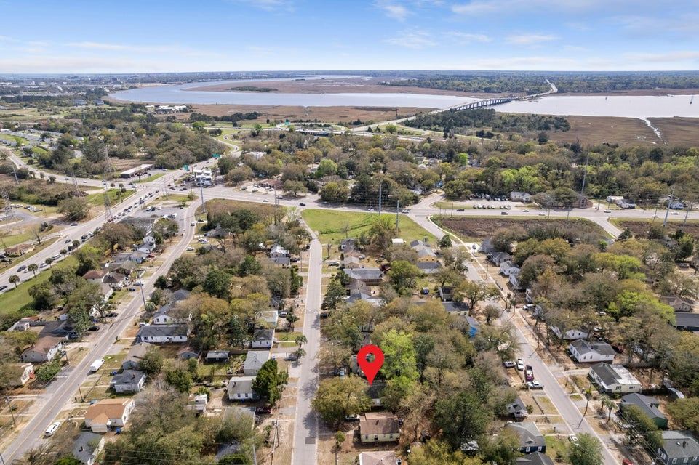
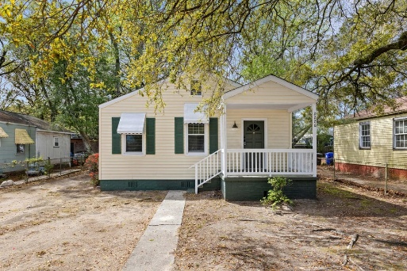
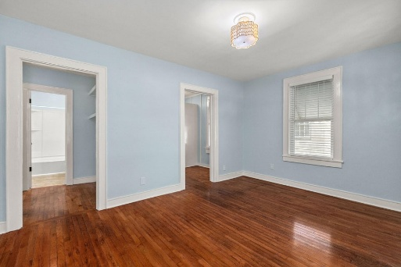
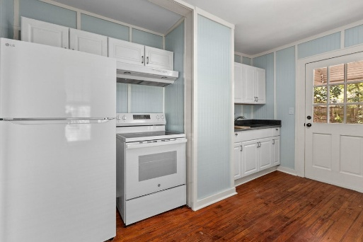


Move-In Ready | Close To Everything!
2226 Suffolk Street
Dorchester Terrace | North Charleston, SC 29405 | MLS# 26007667 | $198,500
Well maintained and thoughtfully updated home in an extremely convenient location close to everything. Oak hardwoods throughout the home, fresh leathered granite countertops and appliances within the last year, newer HVAC and roof in great shape. Tankless hot water heater and fully fenced yard as well. Fresh paint throughout home. Under ten minutes to both Park Circle or peninsula Charleston, and also close to both 526 and 26. Home lives bigger than its size with eat in kitchen and good sized living room. No flood insurance required. All this for under $200,000, not something you see every day.
Justin Natale
843-437-9739 | jnatale1982@gmail.com
www.theblvdcompany.com
The Boulevard Company, LLC | 806 Johnnie Dodds Blvd Ste 100 | Mt Pleasant, SC 29464

