Slide 1
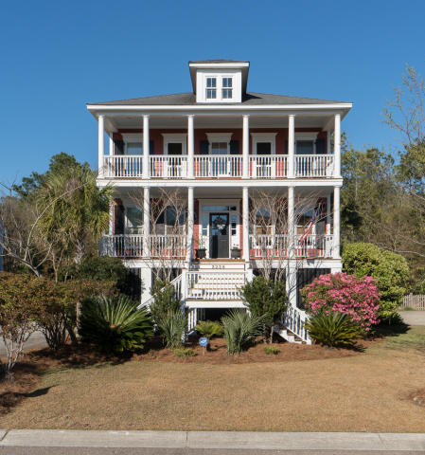
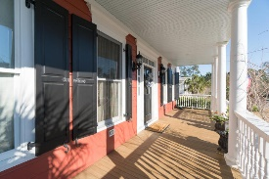
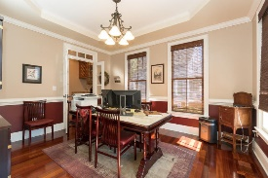



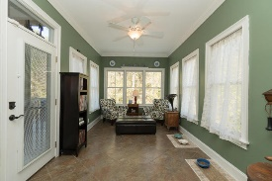


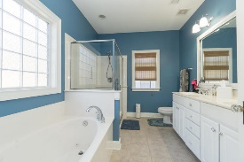


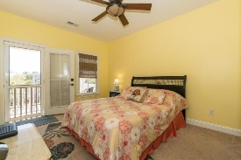
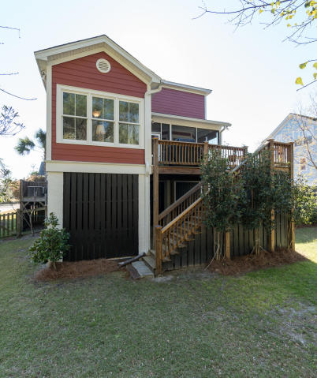

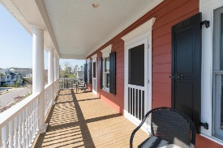
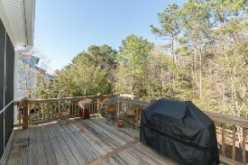


2228 Branch Creek Drive Rivertowne Mount Pleasant, SC 29466 MLS# 17008285 $599,000
Double Porches With Cool Wando River Breezes
Fantastic Executive home in beautiful North Creek at the Point in Rivertowne Country Club.
Come see this lovely home with so many upgrades! Huge open and workable kitchen with gas cooktop. Floor plans flows very well for parties and offers enjoyable living in a bright, cozy, and warm home. Wonderful fenced lot with woods and marsh view. You will be excited with the elegant Brazilian hardwood floors, 9 ft. ceilings, spacious entrance hall, inviting double front porches, great sunroom and deck areas for viewing. Bay window in great room. Screen porch. So many window and porches to see and enjoy the wildlife. Large master bedroom offers a walk-in closet, tray ceiling, ceiling fan and large master bath with garden tub and shower. This home is situated on a quiet street in a lovely subdivision. Great place to raise your family or to retire and relax. Home has a home warranty and a home inspection (in fantastic shape).
Come see before it's gone...
Frank S Collins
EPRO, REALTOR
(843) 327-3292
frankscollins@gmail.com
www.carolinareal.com
Coldwell Banker Residential Brokerage | 1127 Queensborough Blvd. 103 | Mt Pleasant, SC 29464

