Slide 1
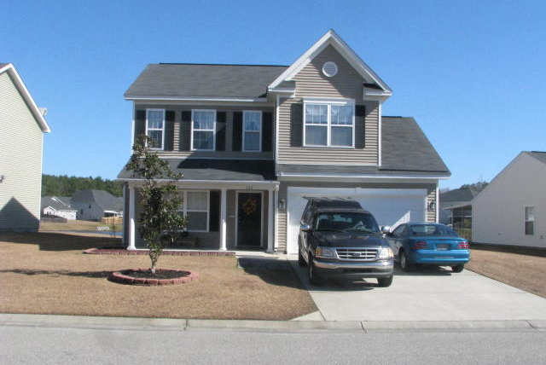
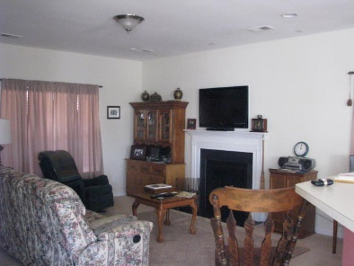
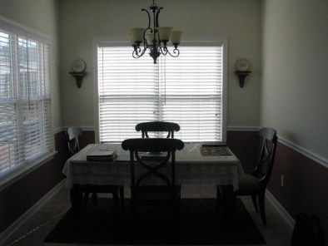
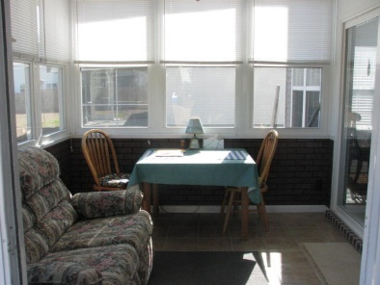
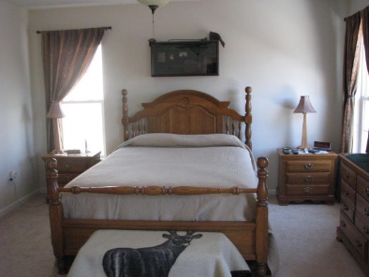
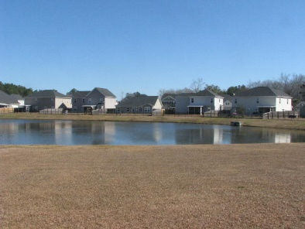
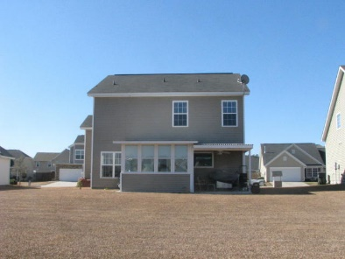
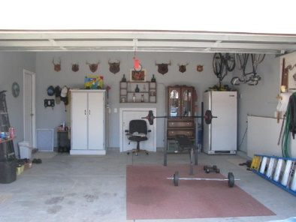

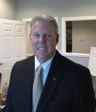
222 Market Hall St Spring Grove Moncks Corner MLS# 16002665 $199,900
Like New ~ Don't Wait On New Construction!
Beautiful home in near perfect condition. Home owner spends time away and this home has barely been lived in. Upgraded lighting and built in surround sound included. The back sun room and covered patio make a wonderful place to enjoy the pond and relax. Nice sized yard and great view with no neighbors directly behind you. Kitchen is spacious and opens up to the family room. The master bath has a garden tub and the linen closet has been plumbed so a stand up shower could be added. The laundry room has been plumbed to add a utility sink. Off the laundry room is a nice sized finished storage area, small office or kids play area. In the finished garage is a nice storage area under the steps You have to see this home to appreciate the upgrades and meticulous care this home has received.
Michelle Riser & Bob Glover
843-860-1229 (Michelle) | 843-693-1837 (Bob)
mriser@ccim.net | bobglover08@gmail.com
Matthew Ryan Company, 104 Berkeley Square, PMB 59, Goose Creek, 29445

