Slide 1
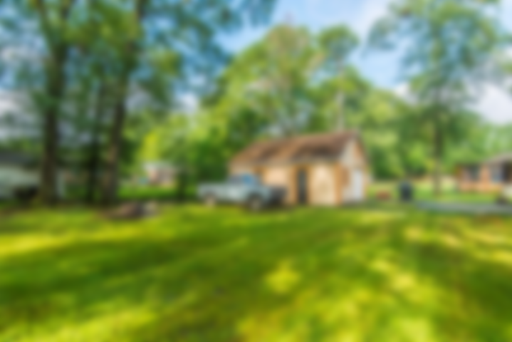
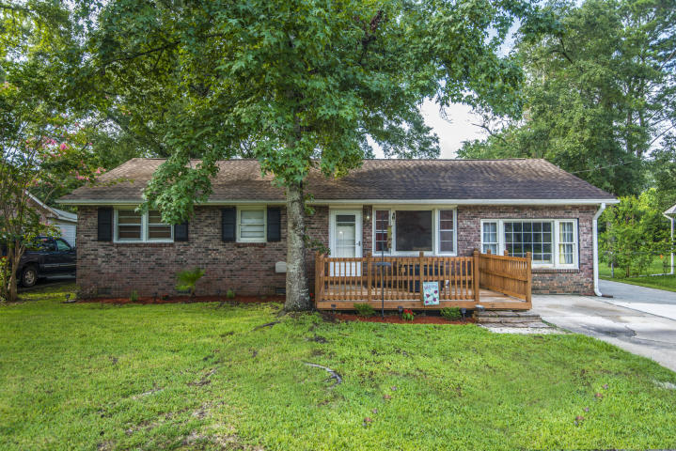

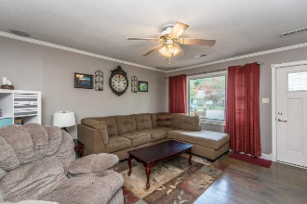
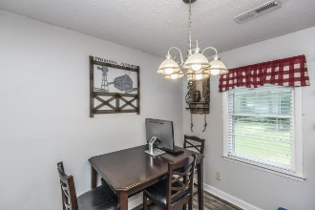
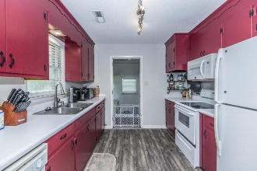
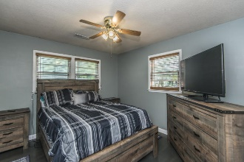
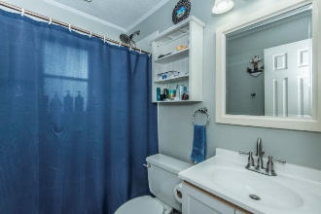
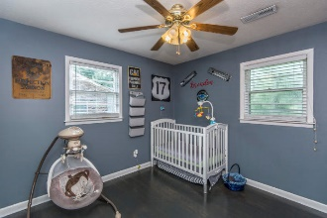
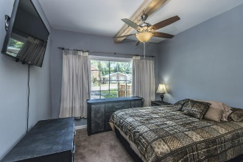
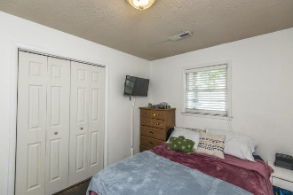
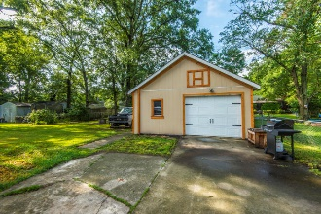
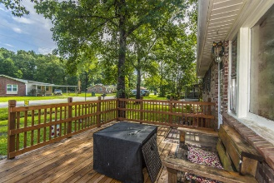


222 N Pandora Drive Goose Creek, SC 29445 ~ MLS# 19020209 ~ $185,900
Just Listed in West Greenview Acres Looking for a move in ready home, no HOA, and a large spacious yard?
Look no further, this well maintained, 4 bedroom 2 bath brick ranch is the one you have been waiting for! When pulling up you'll notice great curb-appeal. The front deck welcomes you home. As you enter, you'll be greeted by gleaming hardwood floors. The eat in kitchen boasts a dishwasher, built-in microwave electric oven, abundance of cabinets and lots of counterpace. Off to the side is the laundry room that has cabinet storage and outdoor access. Master Bedroom is large enough for a king bed and lots of other furniture. It is separated from secondary bedrooms for added privacy. Master Bathroom boasts a walk in shower, vanity and shelving for added storage space. All 3 secondary bedrooms are spacious. Fenced in back yard with large 480 sq.ft. detached garage with space to park two cars. Also can be used as a workshop or as extra storage for toys, machinery and equipment. (Your choice) Just some of the updates and upgrades are a completely re-wired service entrance and re-wired electric in garage. Re-finished wood floors in living room and secondary bedrooms. Newly laid laminate wood floors are in the hallway, kitchen and laundry room. Freshly painted and more. A $1000 Lender Credit is available and will be applied towards the buyers closing costs and pre-paids if the buyer chooses to use the seller's preferred lender. The credit is an addition to any negotiated seller concessions. Located in one of the most convenient areas of Goose Creek, moments from everything and priced to sell so do not delay as this home won't last long!
Asking $1,200,000
MLS# 17023051
3,692 SqFt
4 Bed/3½ Baths
Short Drive to Historic Downtown Charleston & Beaches
Jacqui Swain (843) 295-9484 jacqui.swain@carolinaone.com www.jacquisellscharleston.com
Carolina One Real Estate
1530 Old Trolley Road
Summerville, SC 29485

