Slide 1
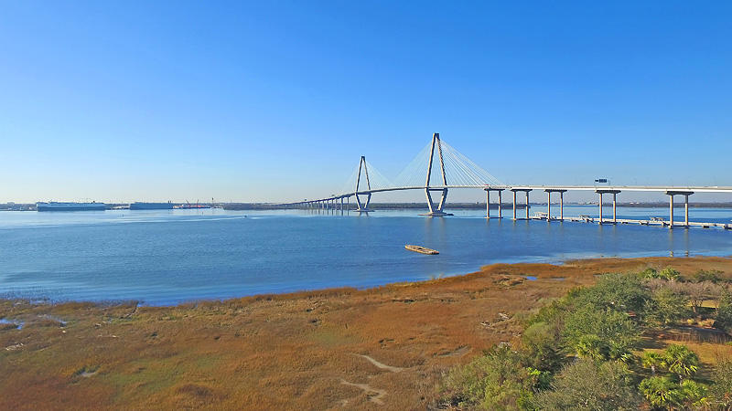
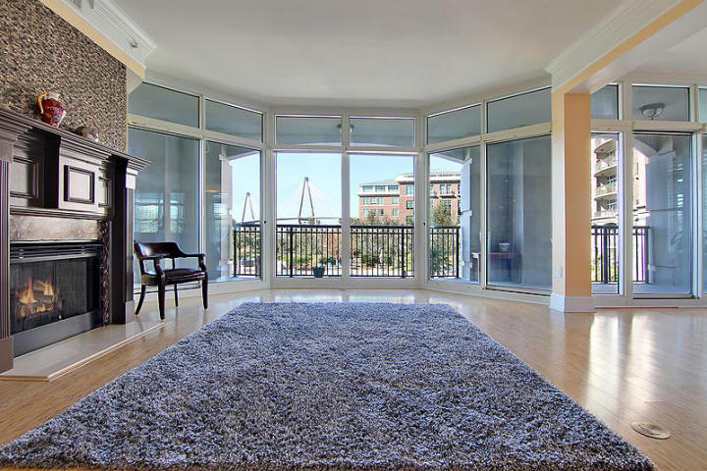
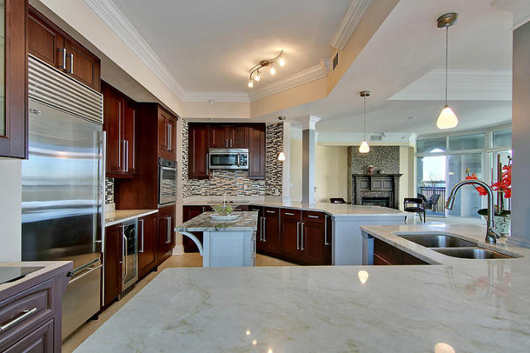
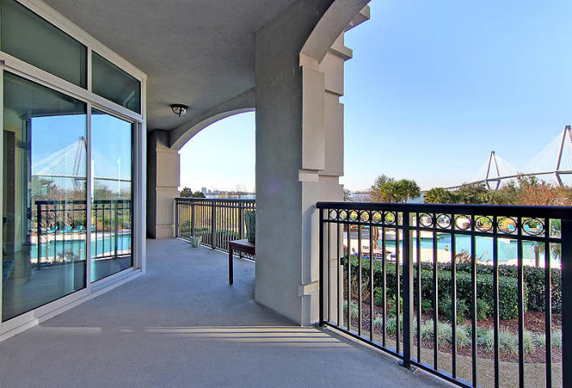
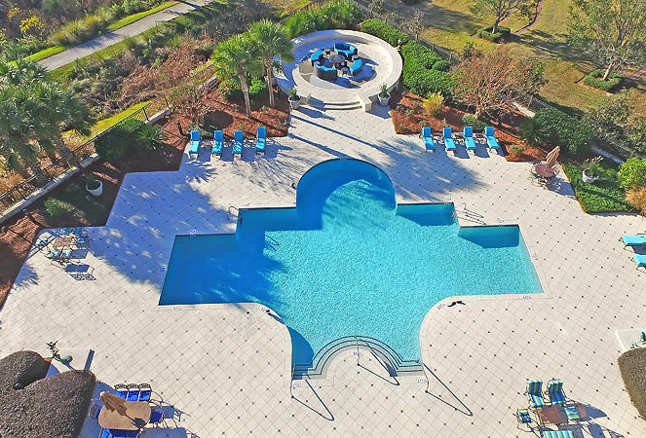
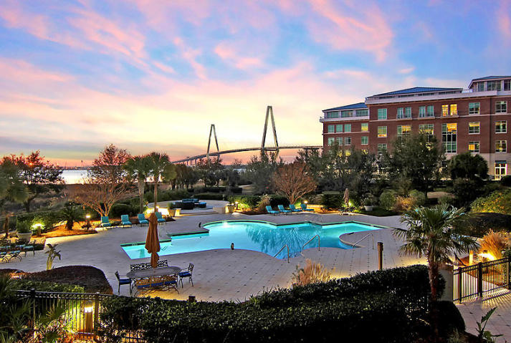
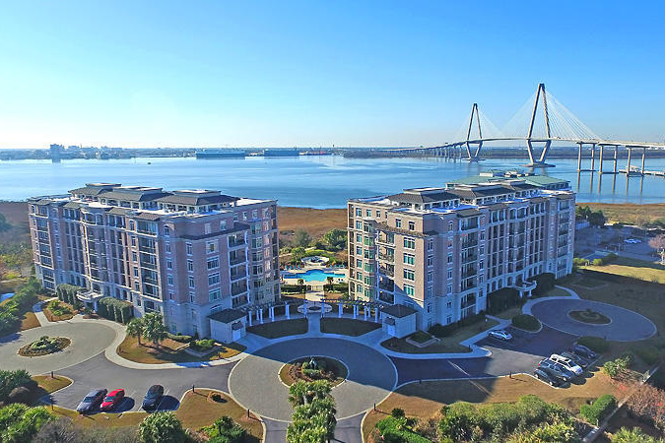

SUPER VALUE FOR SPECTACULAR WATER VIEWS!
SUPER VALUE FOR SPECTACULAR WATER VIEWS!
222 S Plaza Court Renaissance On Chas Harbor
MLS# 16031954 ~ $929,000
3 Bedrooms ~ 2½ Bathrooms
MULTI MILLION DOLLAR VIEWS- BARGAIN PRICE! Since words cannot articulate the spectacular views afforded by this luxury condominium please check out the photos. If Donald Trump decided to live in Charleston instead of the Trump Tower in Manhattan or Mar-a-lago in Palm Beach, THIS is very likely where he would live. River and ocean views beautiful beyond description, privacy, luxury at the highest level, security, convenience and elegance are just a few words that one can attempt to use to describe life here. This condo has an ultra wide-open floor plan that affords unobstructed Harbor views from virtually the entire living area. A Gourmet kitchen with gleaming stainless appliances, huge cabinet and counter space, walk-in closets galore, a spa-like master bath and granite countertops, mammoth extra storage space and safe, protected 2-car covered garage parking, a luxurious club room, gymnasium and glorious pool are mere accompaniments to the glory of waking up every morning at one with the deep water and the iconic Ravenel Bridge. This unparalleled home can be yours for the BEST SUPER VALUE PRICE in all of greater Charleston.
Chip Walsh
843-822-4663
chipwalsh@gmail.com
The Boulevard Company, LLC 35 Broad Street Charleston, SC 29401
www.TeamWalshRealEstate.com

