Slide 1
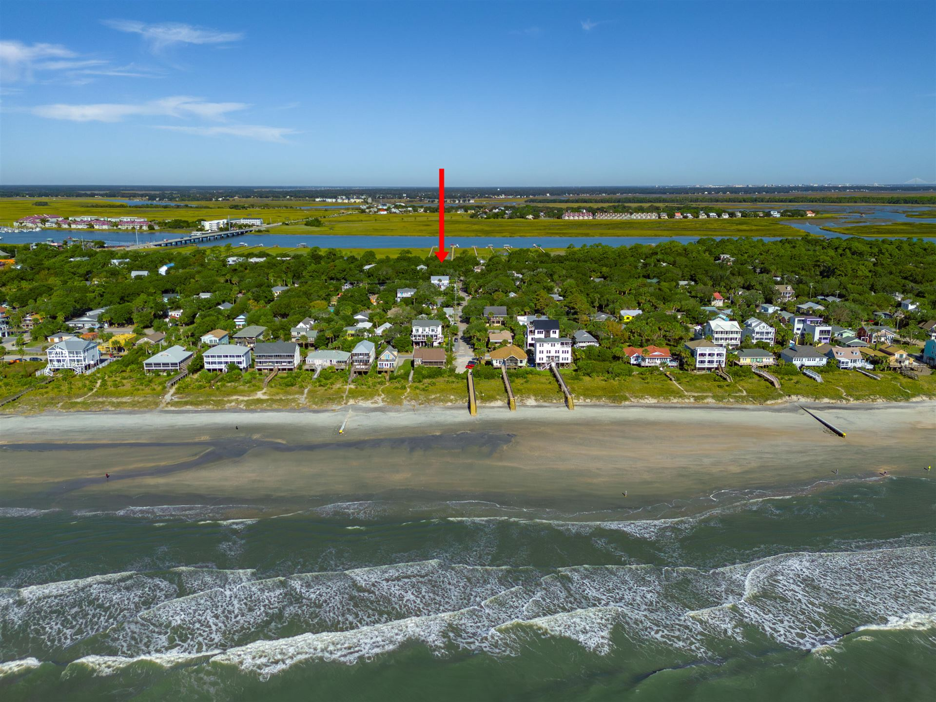
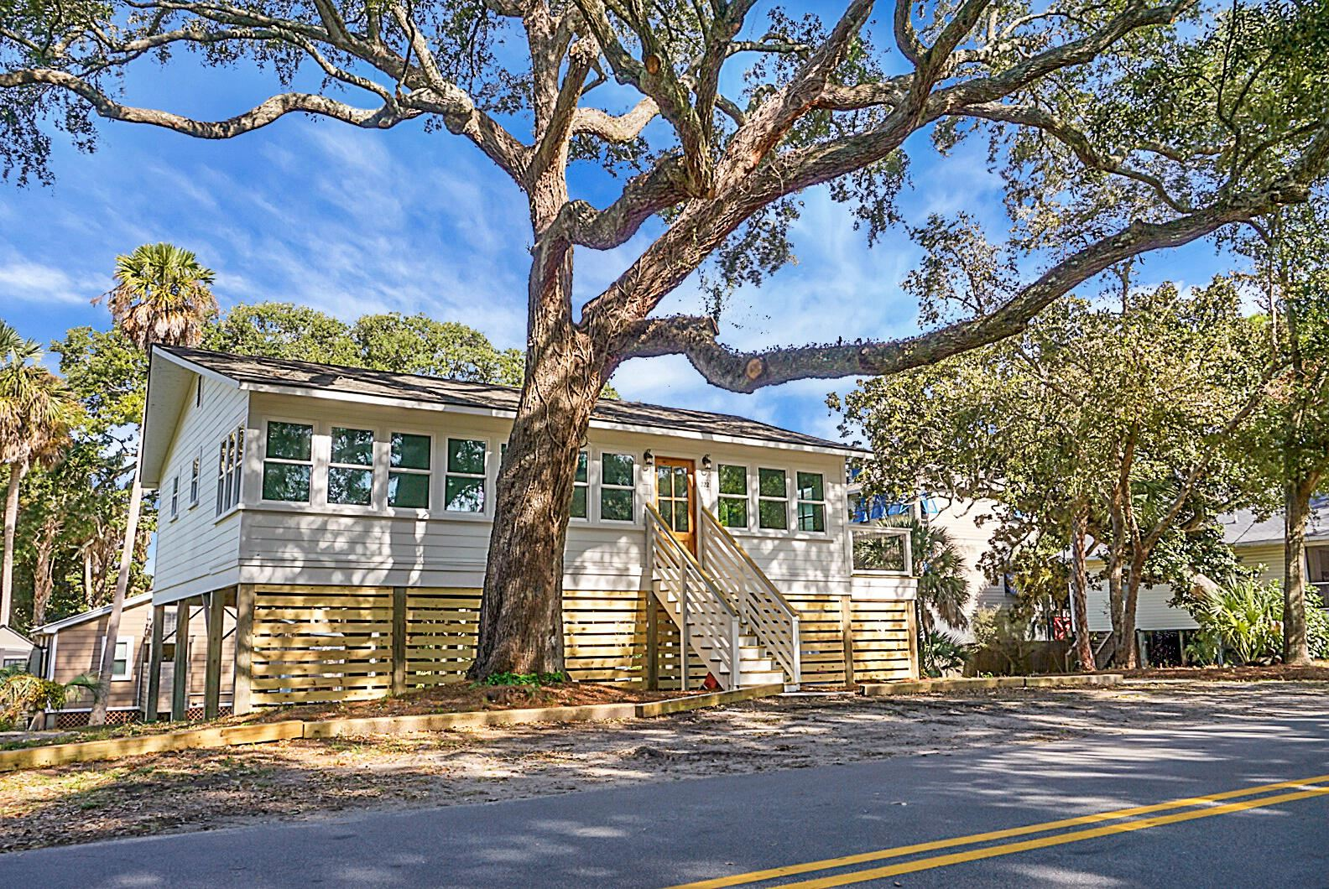
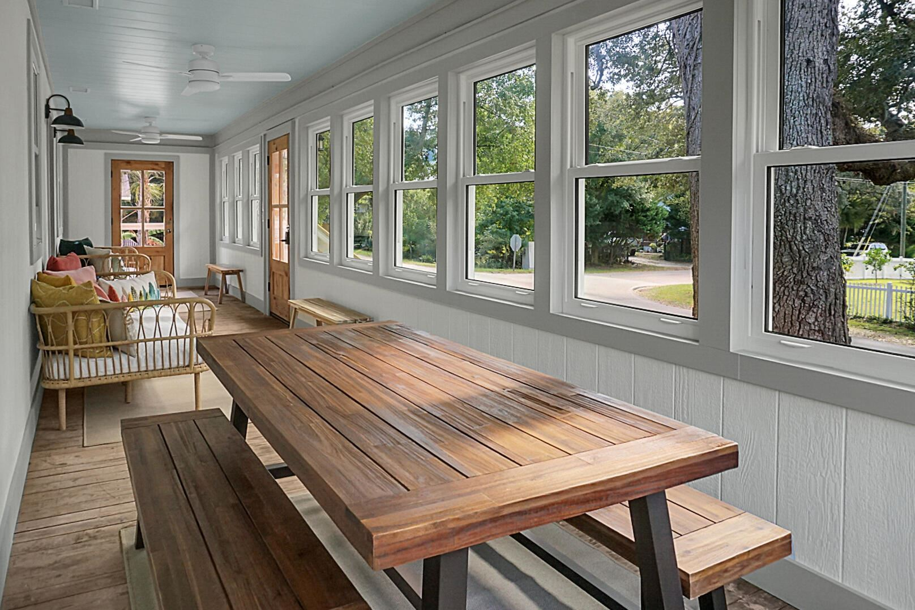
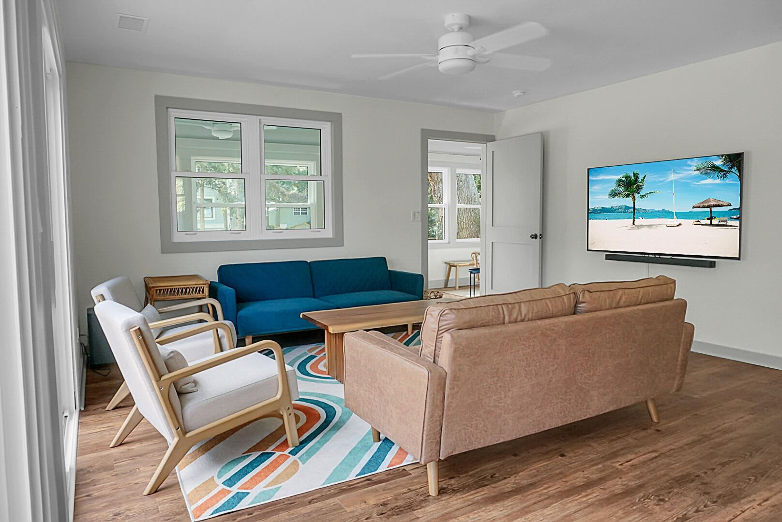
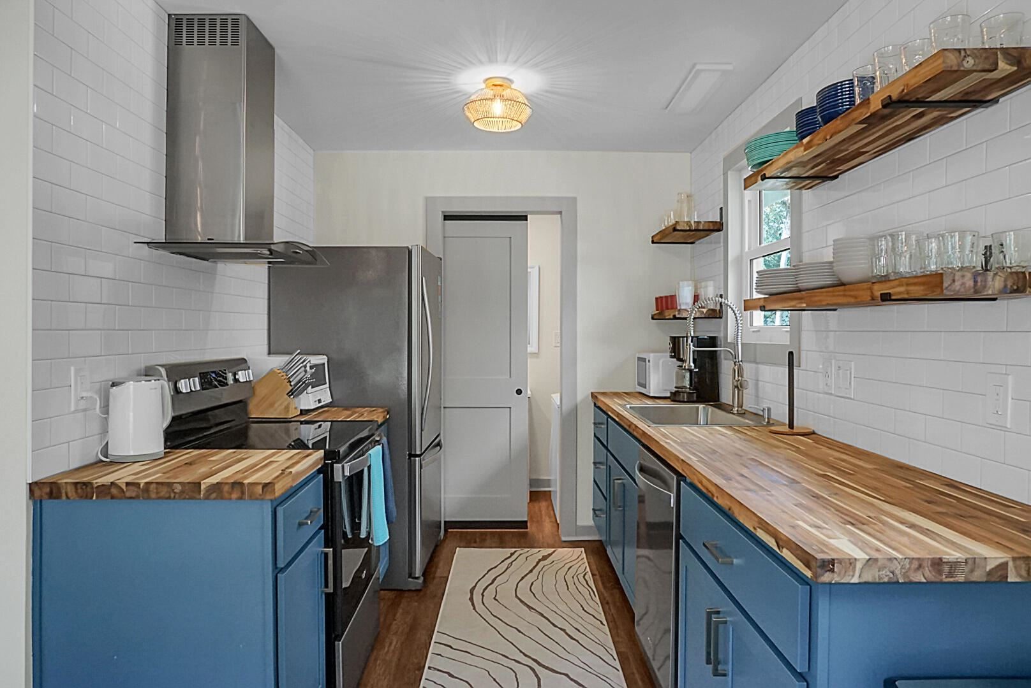
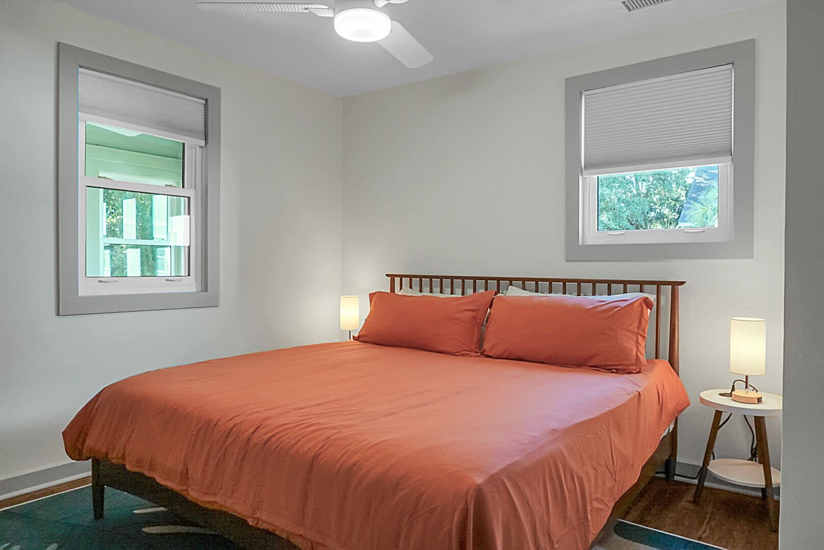



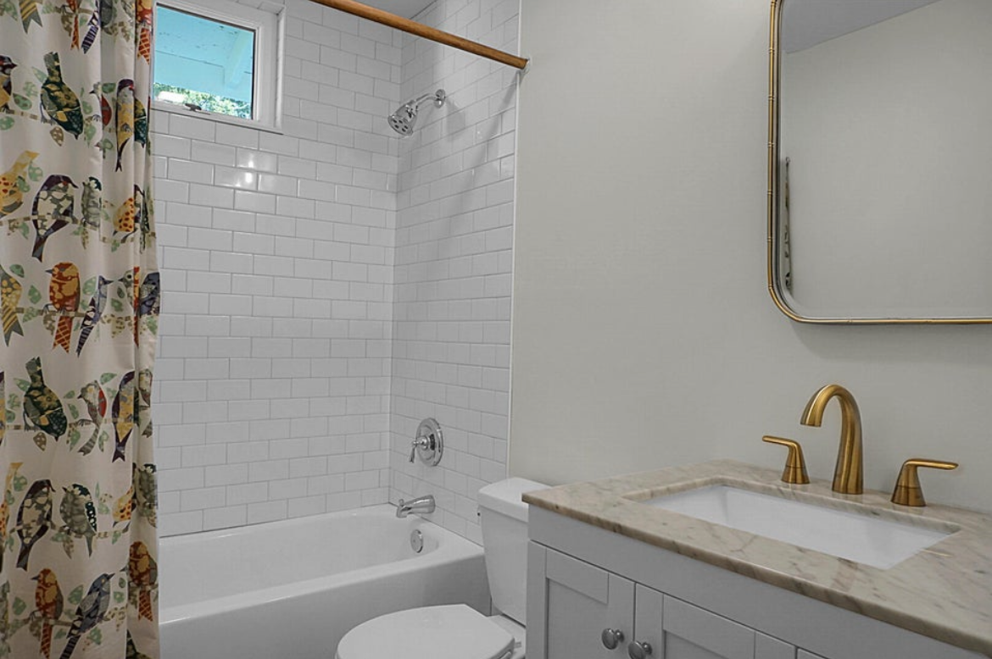
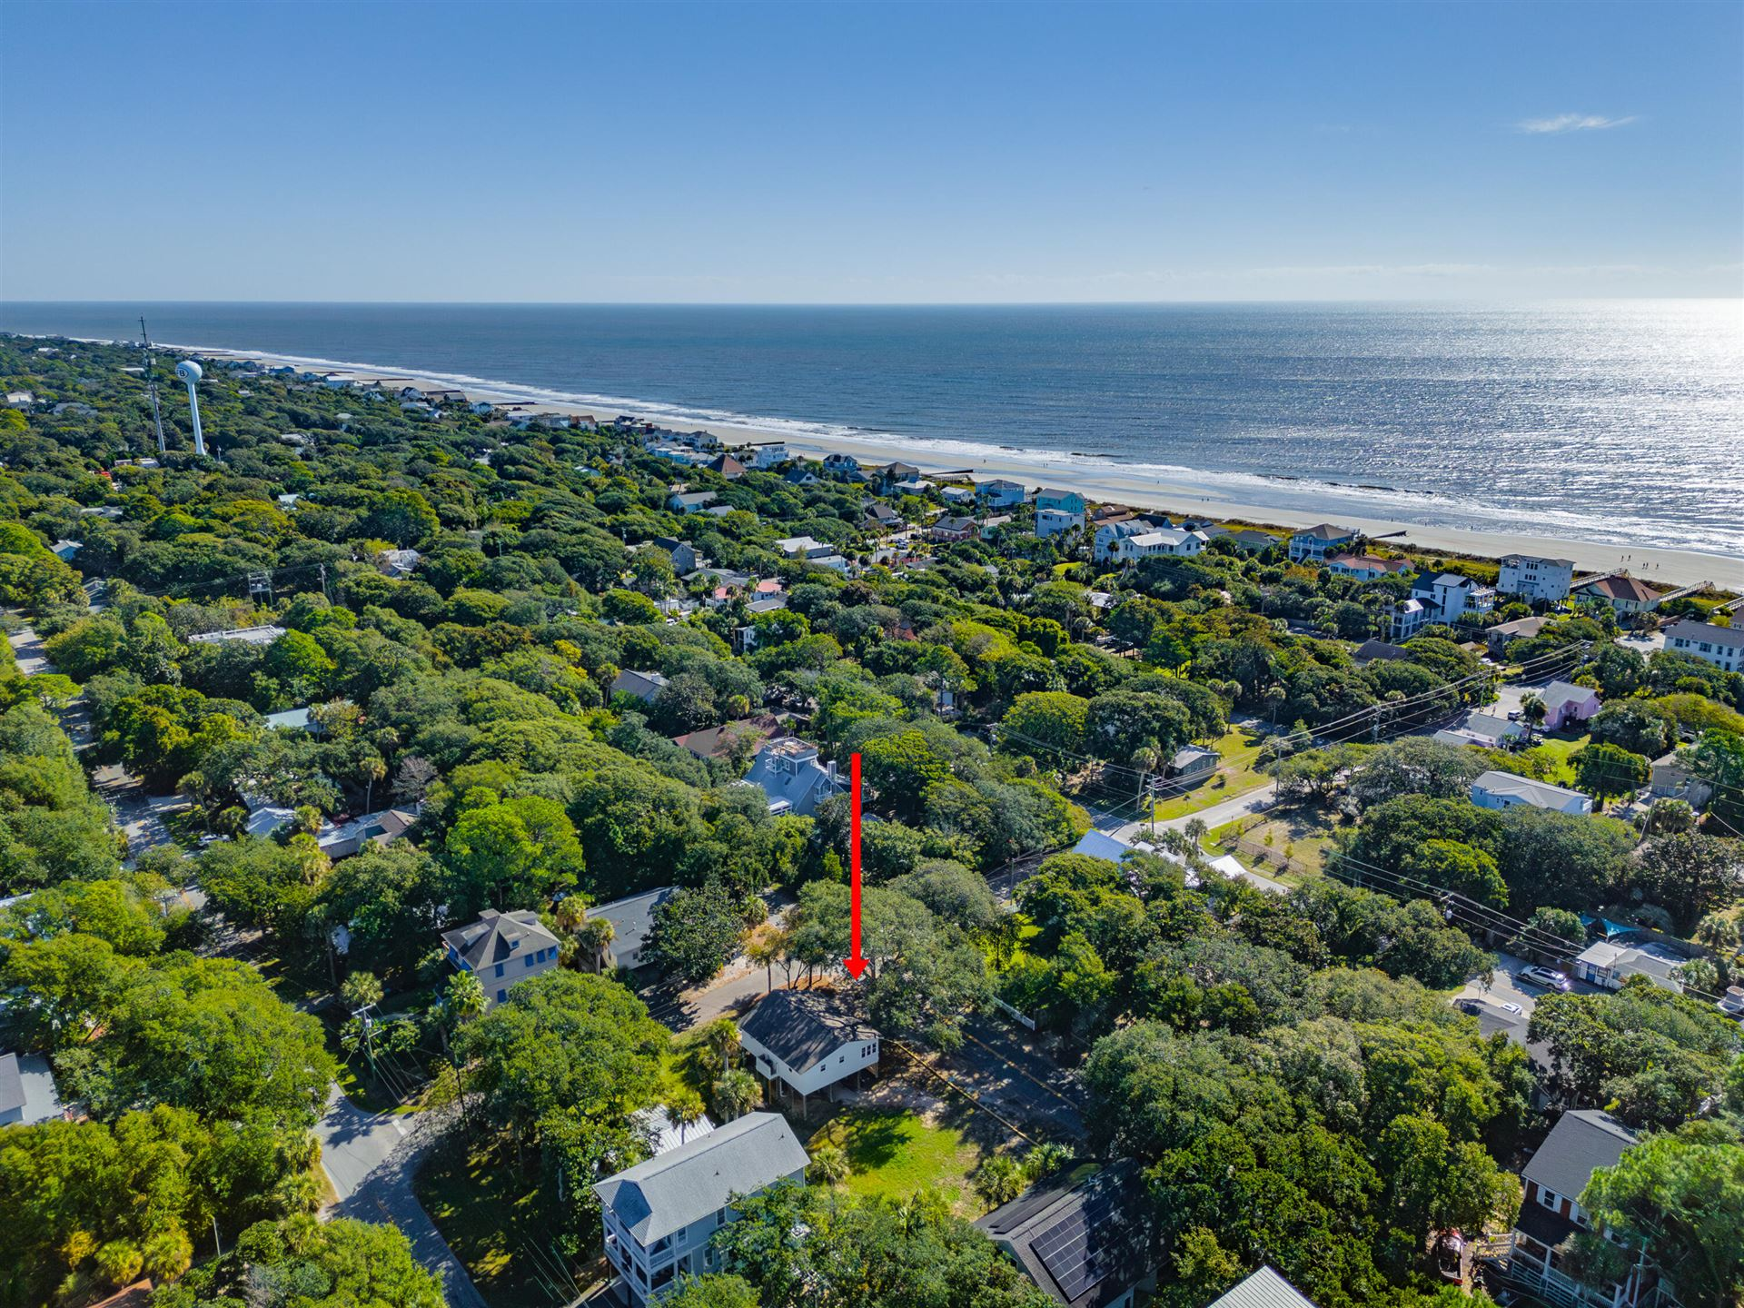


Fully Renovated Folly Beach Home!
This stunning 5br, 4.5ba low country custom built home by Simonini Home Builders has been meticulously cared for situated on a .60 acre heavily treed lot on large pond in private gated community of Popular Grove. This spacious , two story, 4721 square foot home features master bedroom suite on the first level, full front porch, beautiful heart pine wood flooring, large entry foyer which separates the private study from formal dining room, open gourmet kitchen with Wolf 6 burner gas stove, built in SubZero refrigerator/freezer, dishwasher, microwave oven and large pantry. Half bath/Powder room under stairway and large utility room for washer and dryer and deep sink and built in cabinets off hallway. The smaller den with gas log fireplace opens to kitchen and breakfast room. The larger fireplace opens to kitchen and breakfast room and offers expansive views of the water year-round. The living room with its second gas log fireplace is great for entertaining away from dining areas. The large master bedroom suite is located on the first level and has travertine tile flooring in the master bath, his and hers walk in closets, separate vanities, soaking tub, and a large separate shower. There is a game room with separate stairs over the two-car garage large enough for a pool table. The second level boasts 4 spacious bedrooms and three bathrooms. On the rear of home is a large screened in porch and open deck overlooking firepit and pond. To reduce maintenance the exposed wood decking has been replaced with Trex decking and exposed rail caps with PVC. Yard has irrigation system and 120-gallon buried propane tank. Sellers just replaced roof with 50 year architectural shingles with transferable warranty. The two electric water heaters have been converted to a single LP gas fired tankless water heater. New epoxy coating on floors and newly finished walls now in two car garage. Neighborhood amenities include Privacy gate, Boat Ramp, Dock facilities, Exercise area, Pool, RV/boat storage and walking/jogging trails. Don't forget the fantastic equestrian center for your horses!
222 E Hudson Avenue Folly Beach, SC 29439 | MLS#: 23024617 | $1,435,000
HOME + LOT= Value add! This charming Folly Beach cottage has been renovated from top to bottom, keeping everything you love about Folly and bringing in all of the modern details you're looking for. Brimming with personality and just a 5 minute walk to the sand and Center Street's restaurants and shops, prepare to fall in love. Entering from the front door you'll find a climate-controlled sun porch perfect for watching the world go by, curling up with a book, or catching a cat nap. The living room is filled with windows and sliding glass doors, opening into an eat-in kitchen. Two large sliding glass doors let the outside in, and offer a spacious deck perfect for morning coffee or an afternoon sipper. The kitchen is both functional and attractive, with walnut countertops, tile backsplash, plenty of cabinetry, and stainless appliances. There is a powder room and washer/dryer off of the kitchen as well. Three nicely sized bedrooms and a full bathroom with tiled shower/tub combo complete the home. Interested in adding on? Need another structure for your visiting family and friends? Can't stop thinking about a pool? The vacant, cleared lot next to this home is included and has endless possibilities! Renovation was completed October 2023. All top-of-the-line materials were used. High End LED Lighting throughout, solid walnut butcher block countertops, hardi plank siding on exterior, solid wood interior doors, PGT windows and sliding doors, wolf home products cabinetry, and more. A complete list is available upon request. Elevated with golf cart parking and extra storage underneath. This is truly a wonderful Folly Beach home.
4
3
1,844
Claire Porter 843-224-1269
claire@lighthousecharleston.com
www.lighthousecharleston.com

