Slide 1
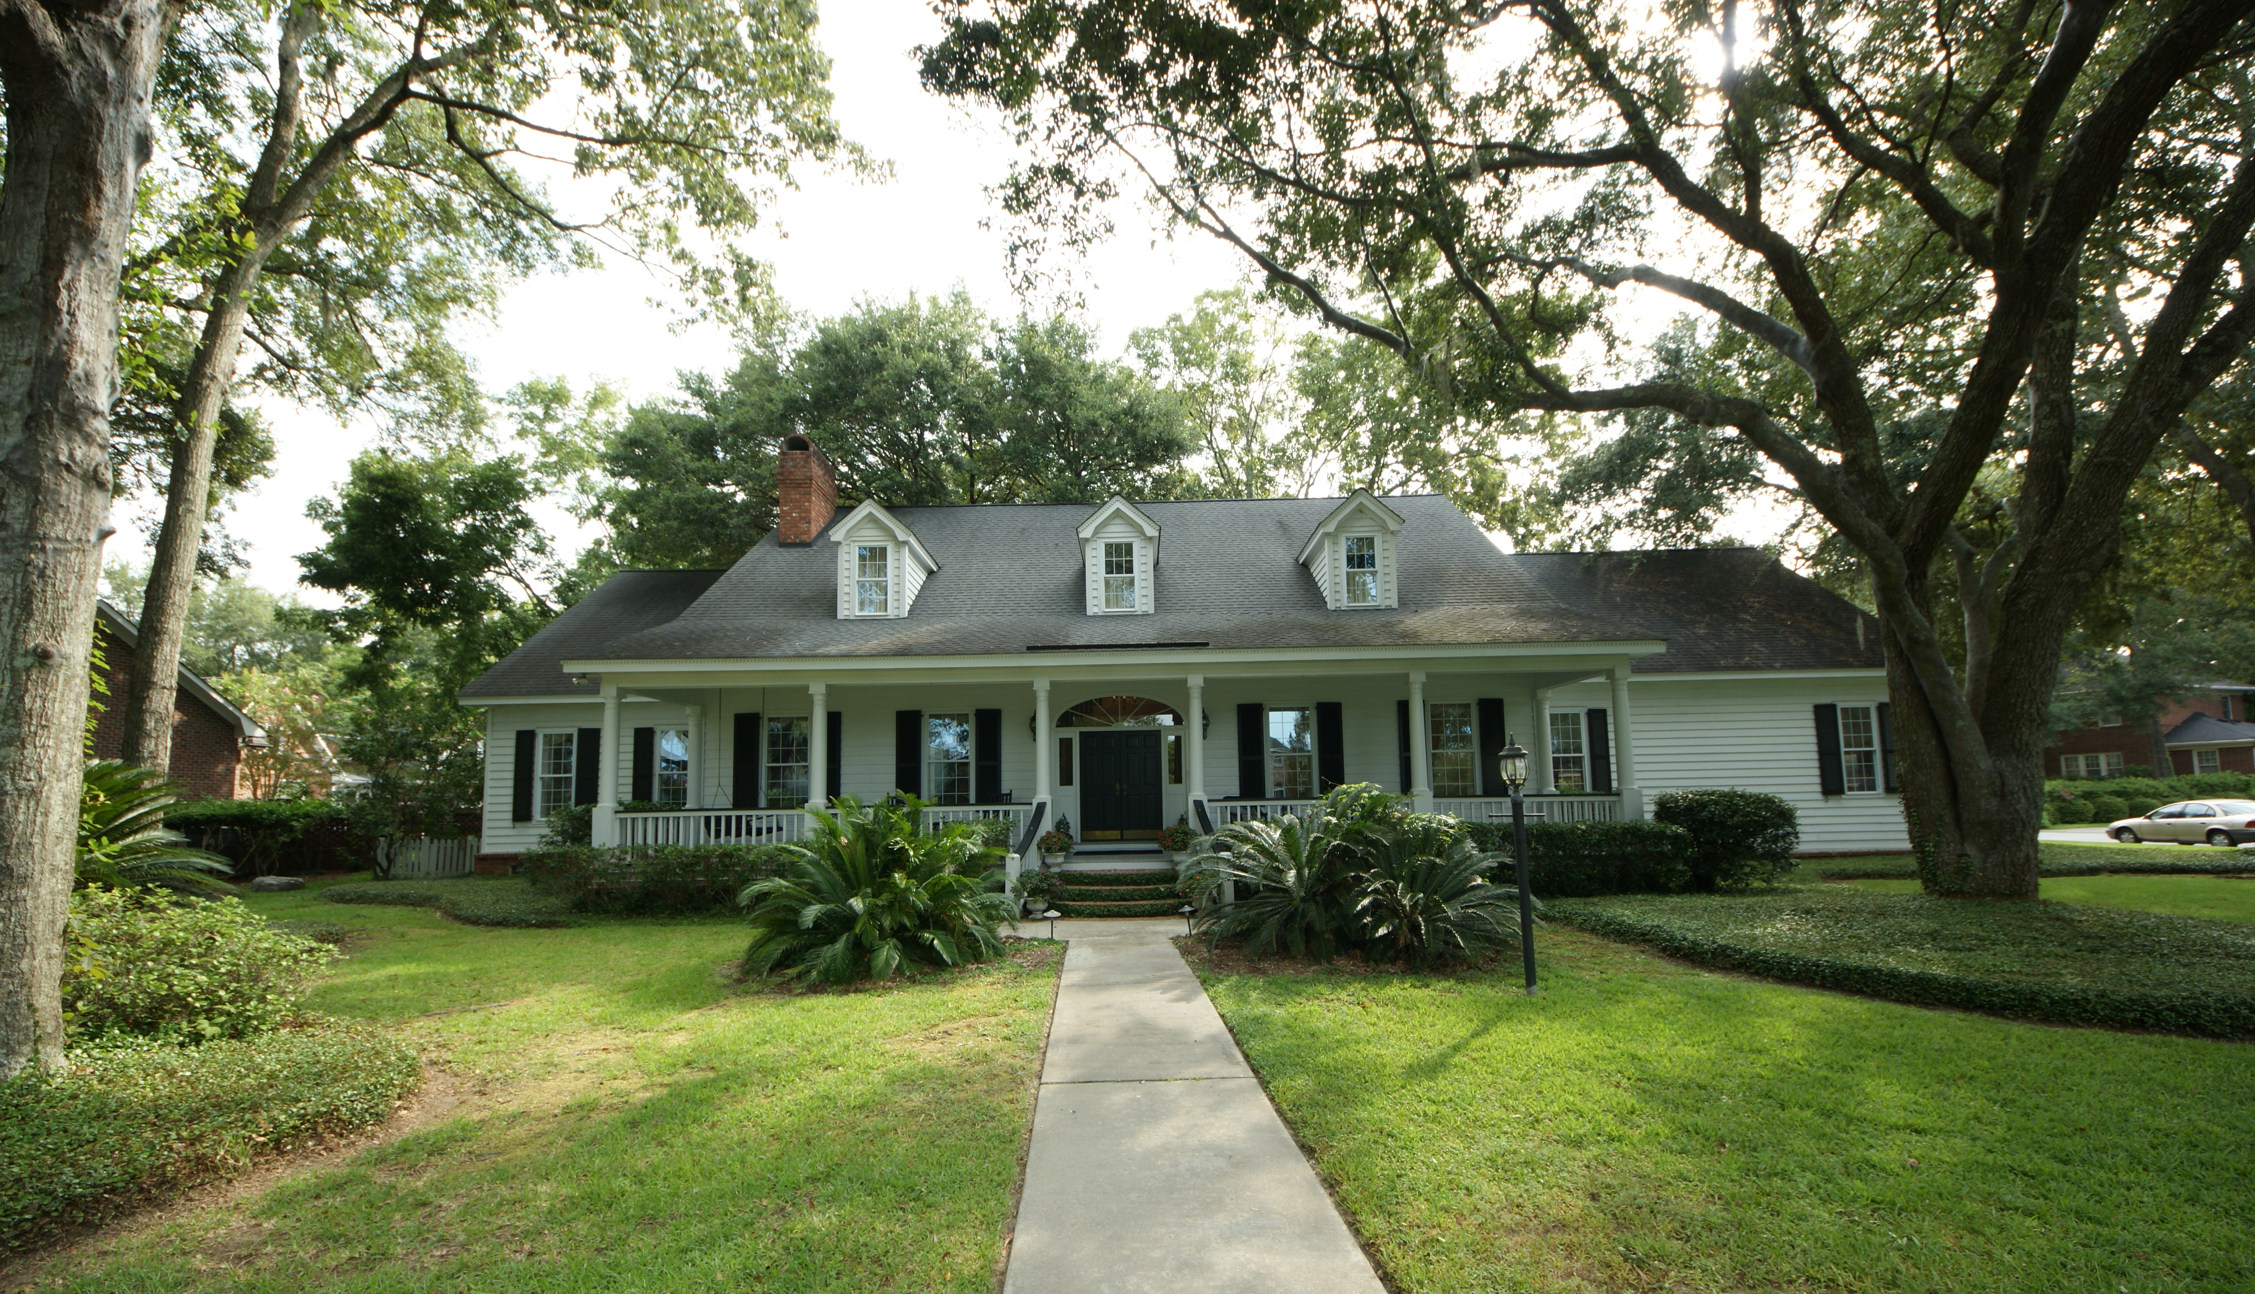
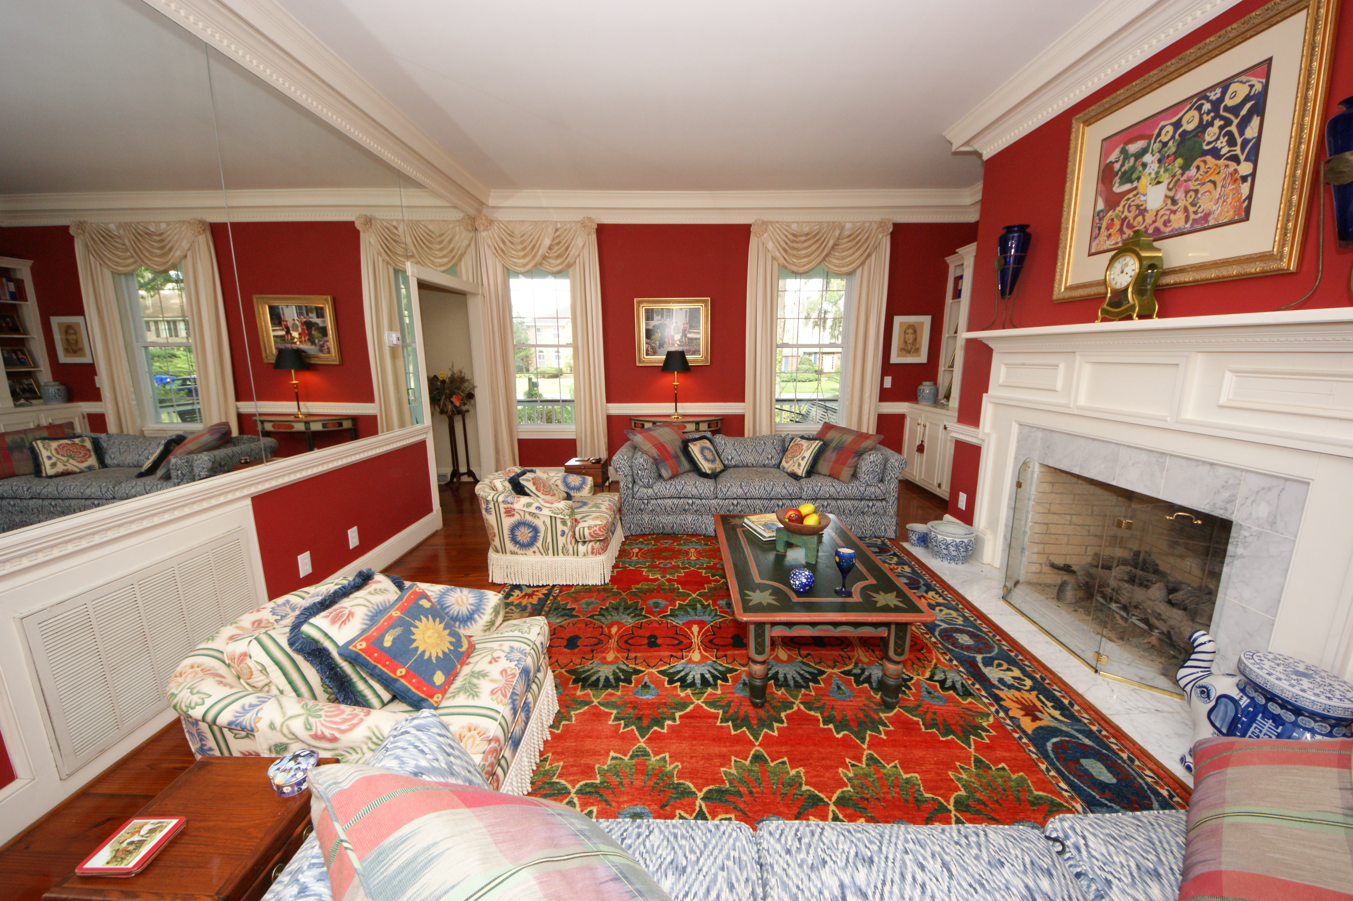
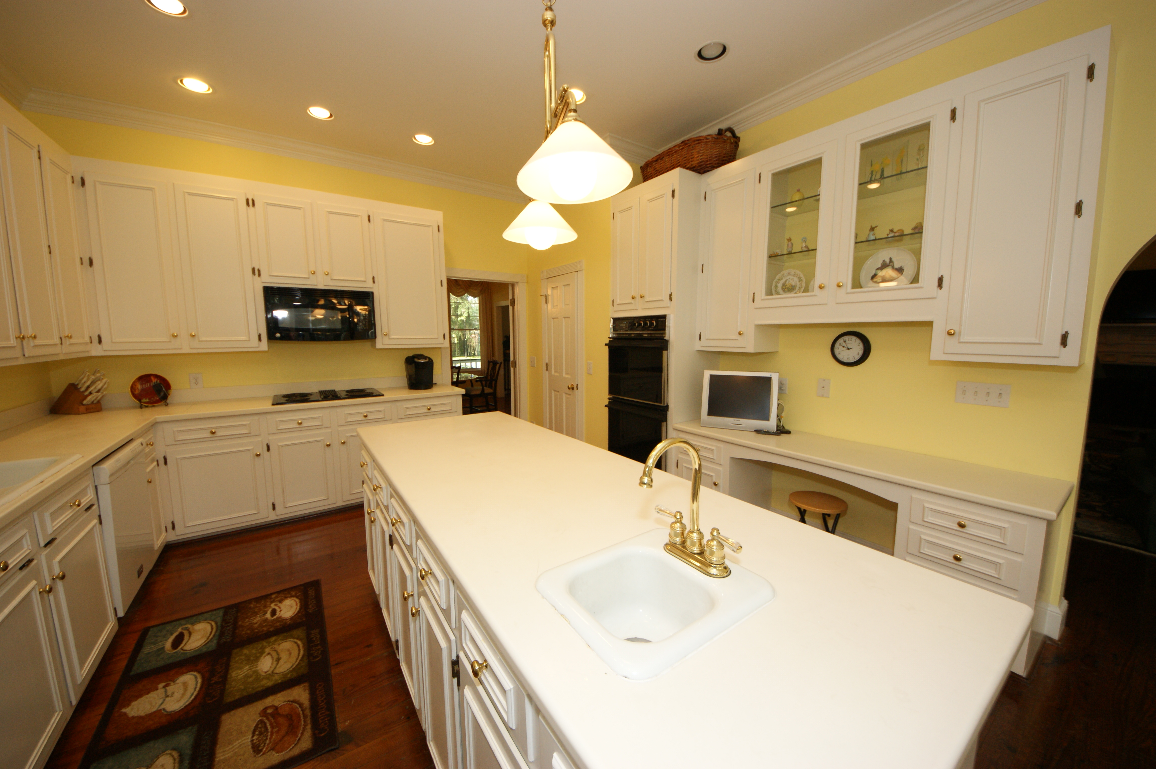
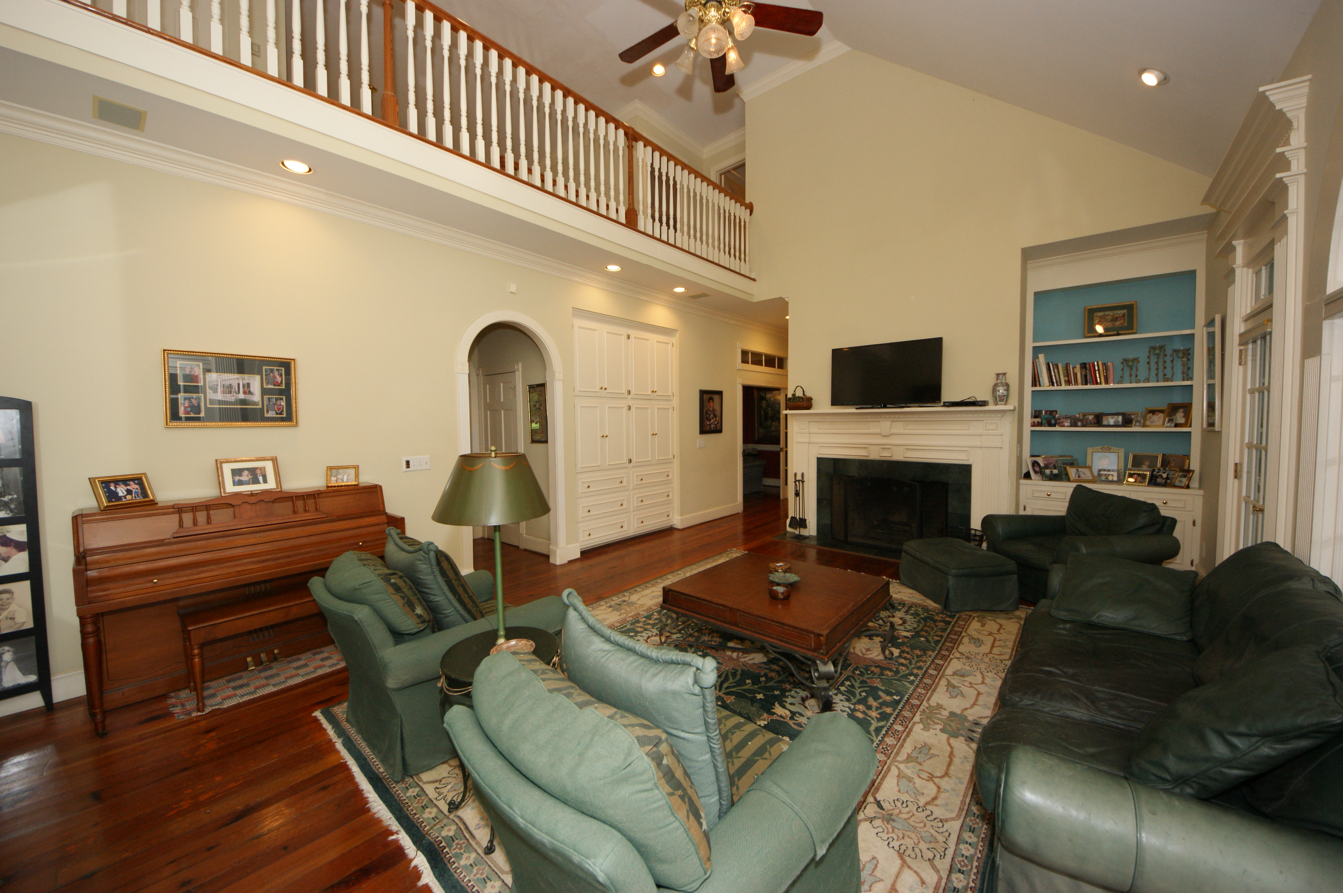
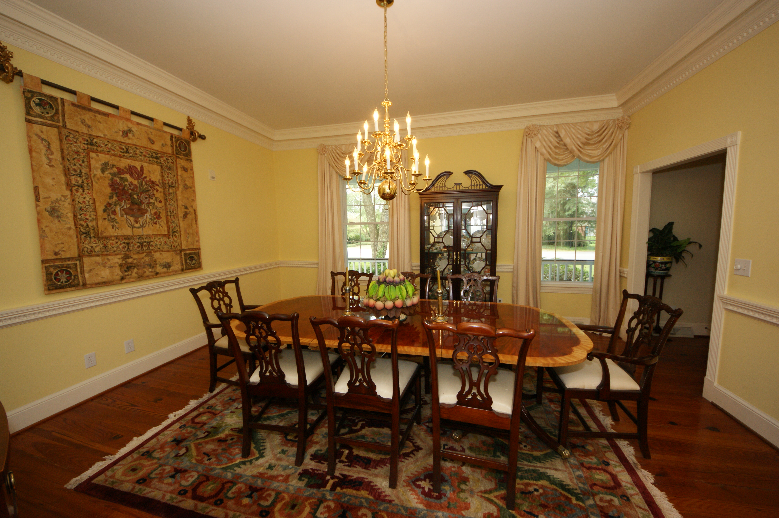
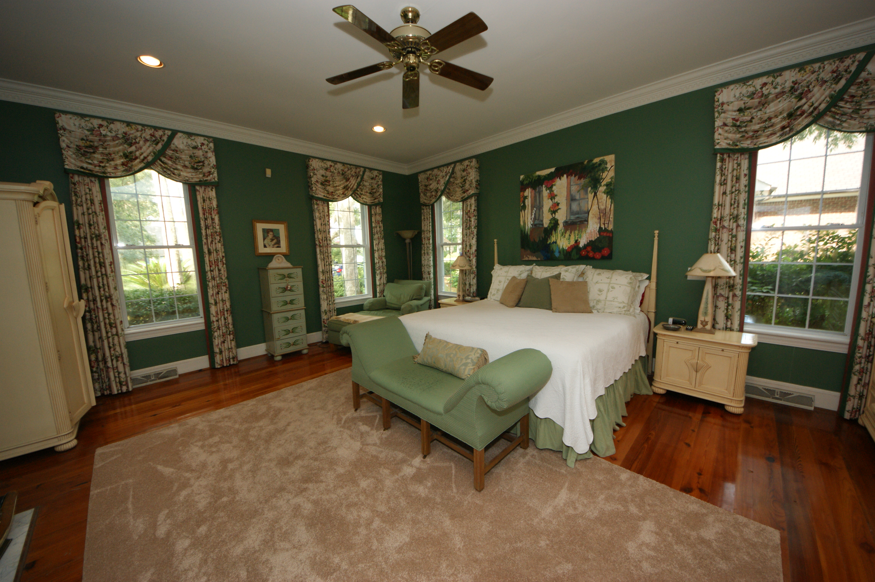
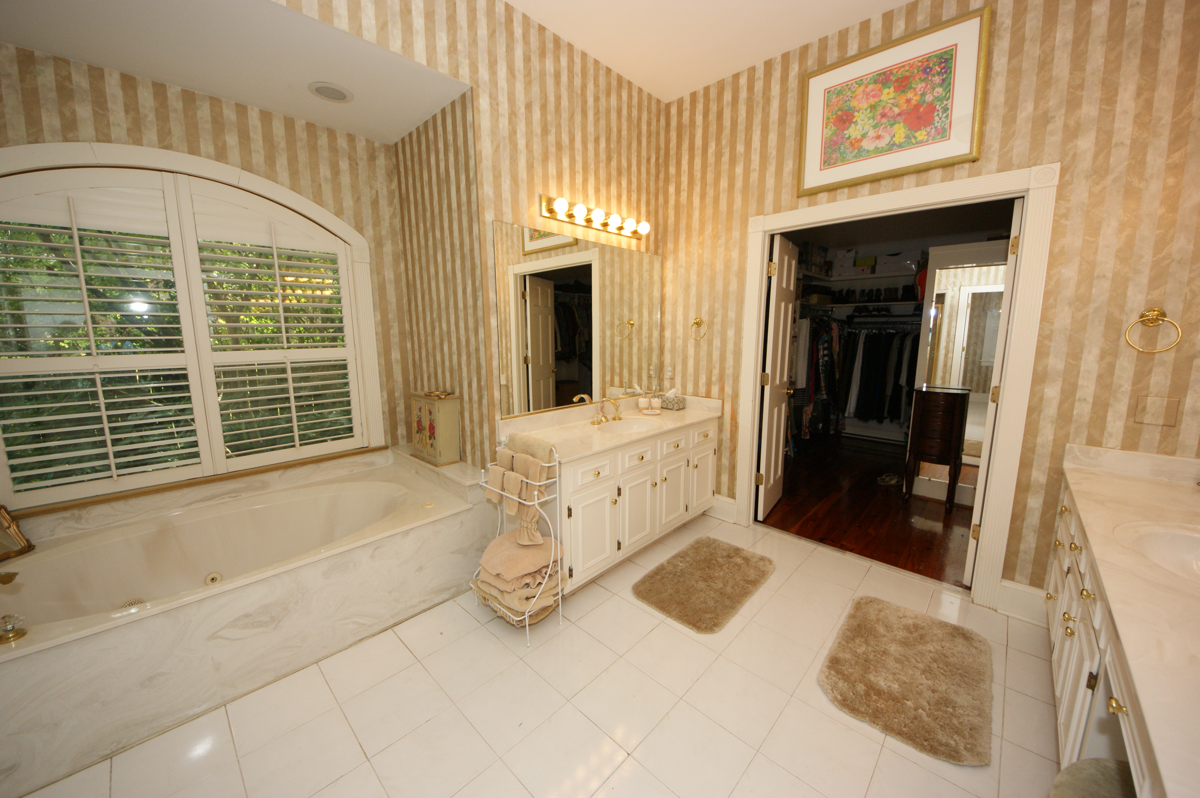
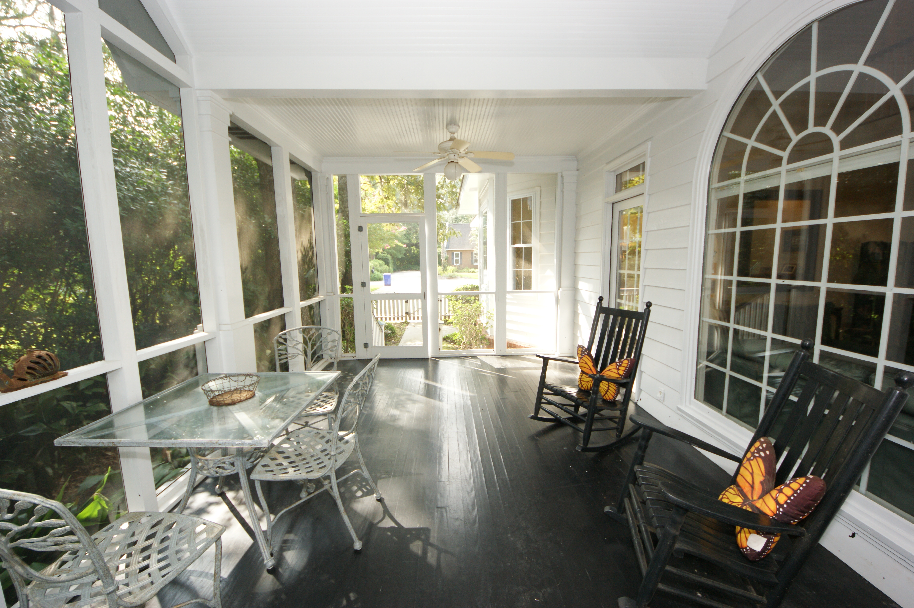
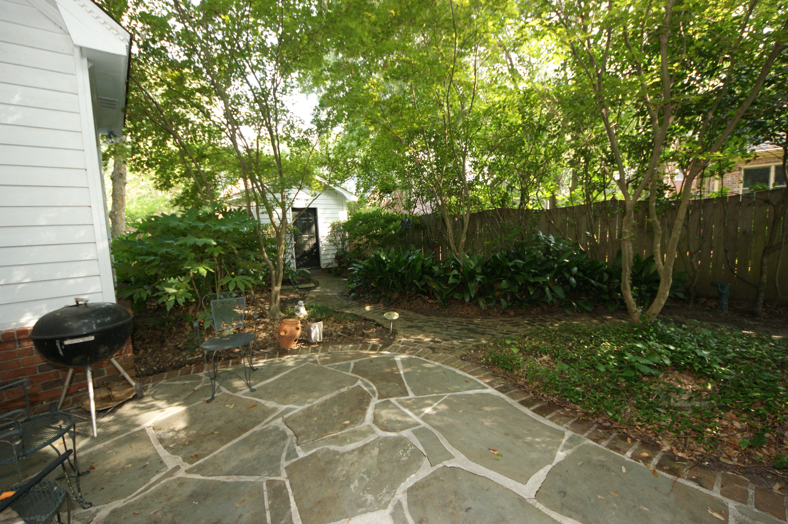


READY TO BUILD! On The Yacht Harbor At Wild Dunes
$10,000 Price Reduction
$2,500 Buyer's Agent Bonus at closing
2230 Portside Way, Charleston, SC 29407 MLS# 15021473 | $765,000
Absolutely stunning Plantation Style home in a lovely setting in Ashley Harbor. When you walk into the Foyer the gorgeous wide plank HEART PINE FLOORS and 10' ceilings will immediately get your attention. Downstairs has a Formal Dining Room and Living Room (LR would make a wonderful study). THREE fireplaces! LR, Family Room and in the DOWNSTAIRS Master Bedroom! The attention to detail in the trim-work and mouldings is evident when you look around. Built-ins throughout the home. HUGE Maser suite and Master Bathroom. Tons of storage. Large sunny kitchen with an eat-in breakfast area. Powder Room and Large laundry room finishes off the downstairs. Upstairs, you will find 3 more bedrooms and 2 more bathrooms. There is also a FROG (being used as a billiards room) that has access from the front stairway or the back one off the kitchen/laundry. This FROG also has a wet bar, fridge and ice maker so could easily be used as a guest suite, teen hangout or a mother-in-law suite. One of the upstairs baths is very near the FROG for easy access. There is a nice screened porch right off the Family Room. The fireplace in the Fam Rm is wood burning but plumbed for gas if you want! The large over-sized double garage is a dream for the handy person. There are cabinets along two walls and a sink for easy clean up. AND still plenty of parking space! The yard is beautifully landscaped and manicured...mature large trees that you don't see as much these days. The large welcoming porches out front will greet you as you come to see this home! The neighborhood has access to a community dock and also has a lighted tennis court.
Susan Weeks
(843) 813-0495
susanweeksdesign@gmail.com
www.agentownedrealty.com
AgentOwned Charleston Group
902 Savannah Hwy
Charleston, SC 29407-7802

