Slide 1
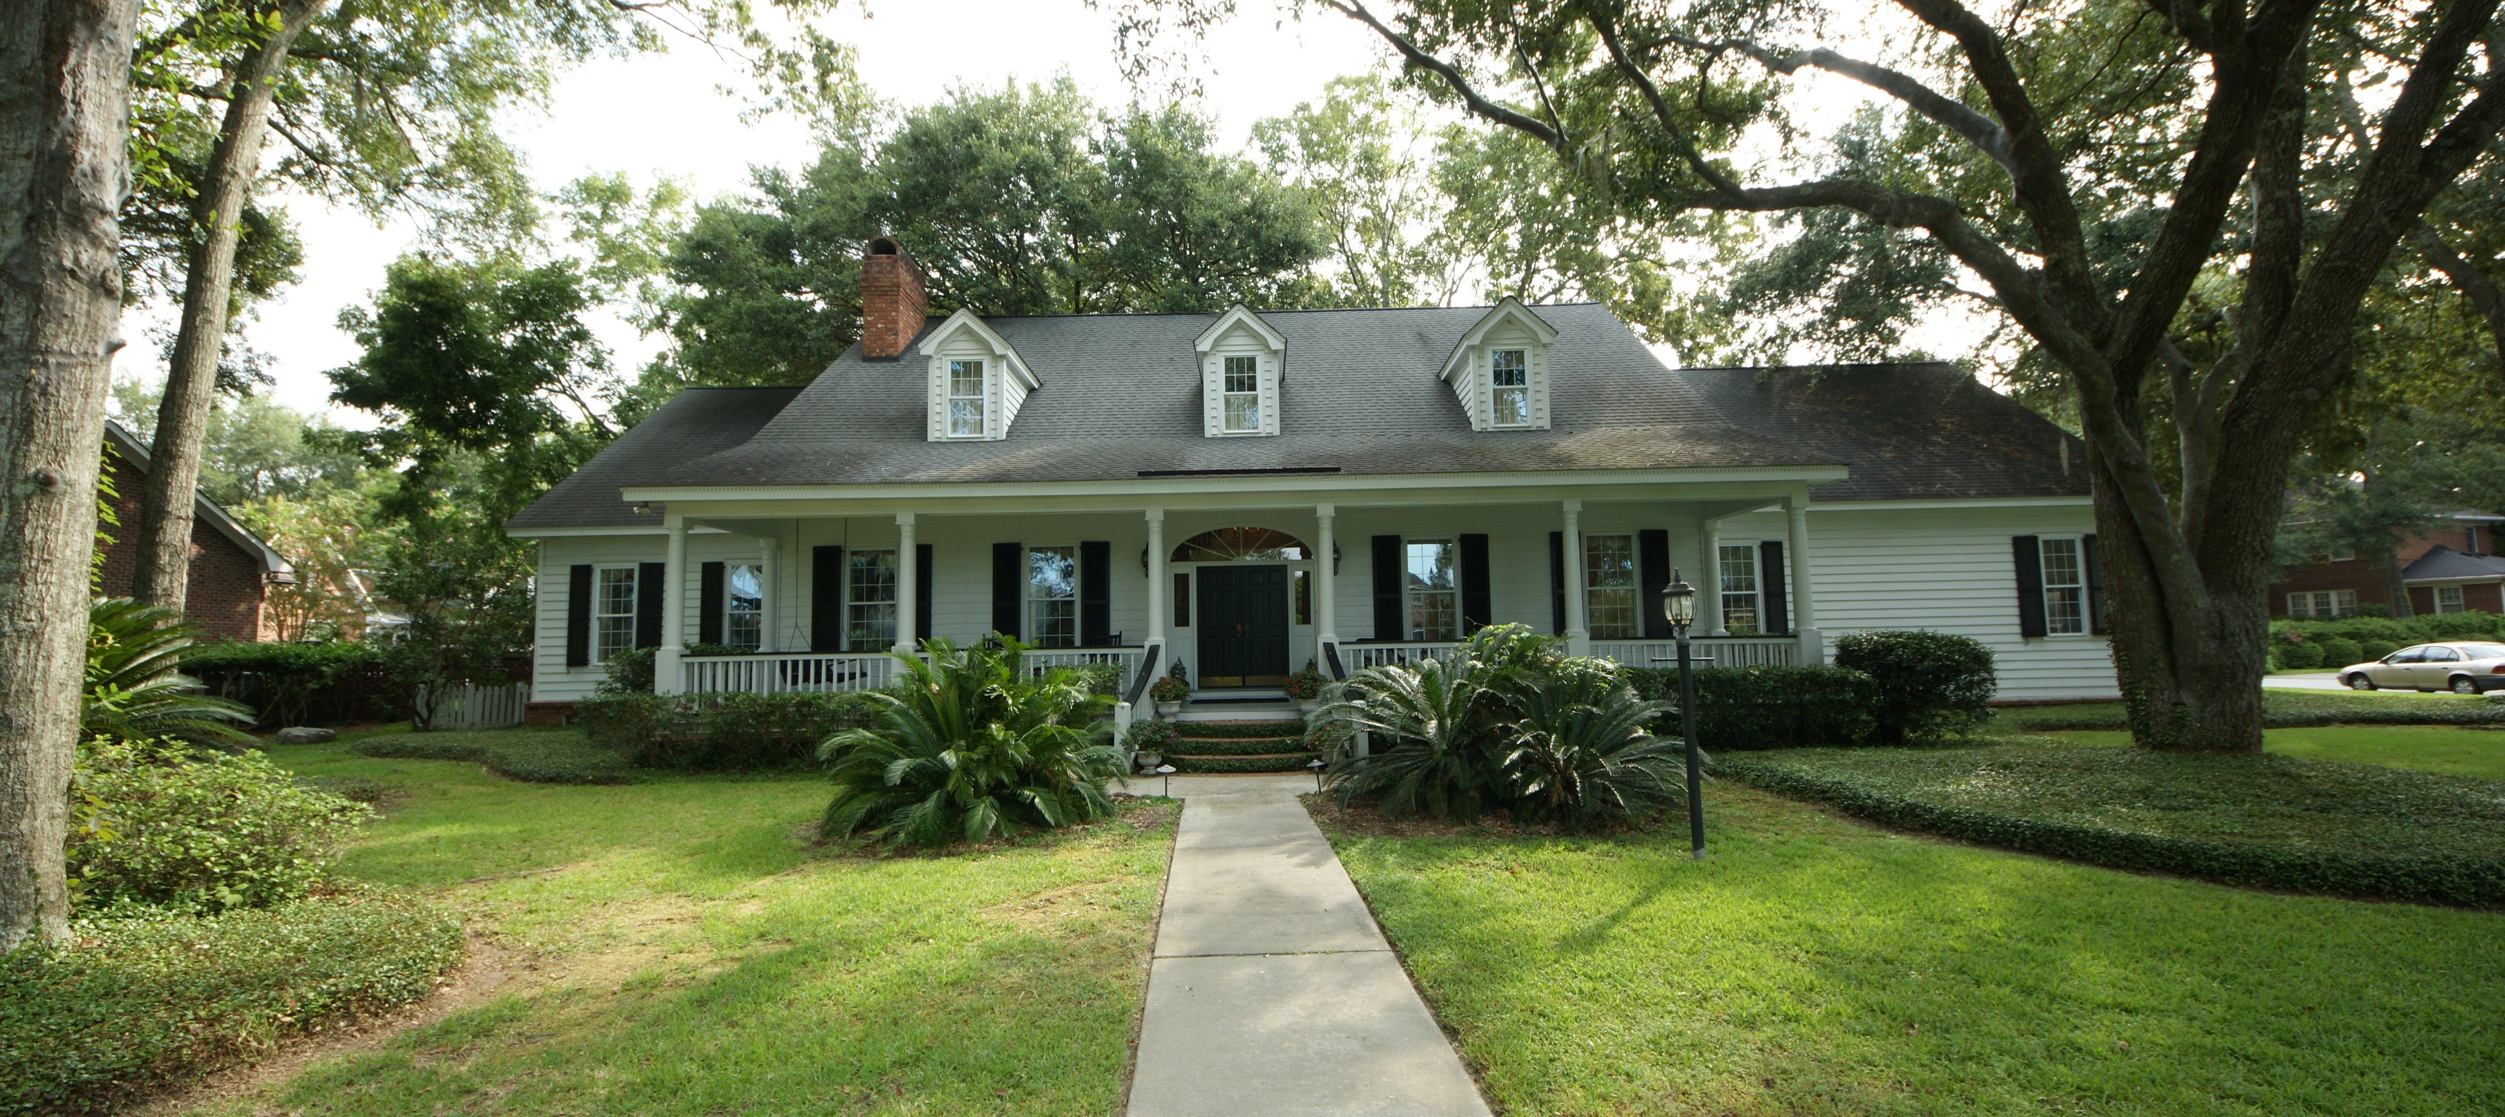
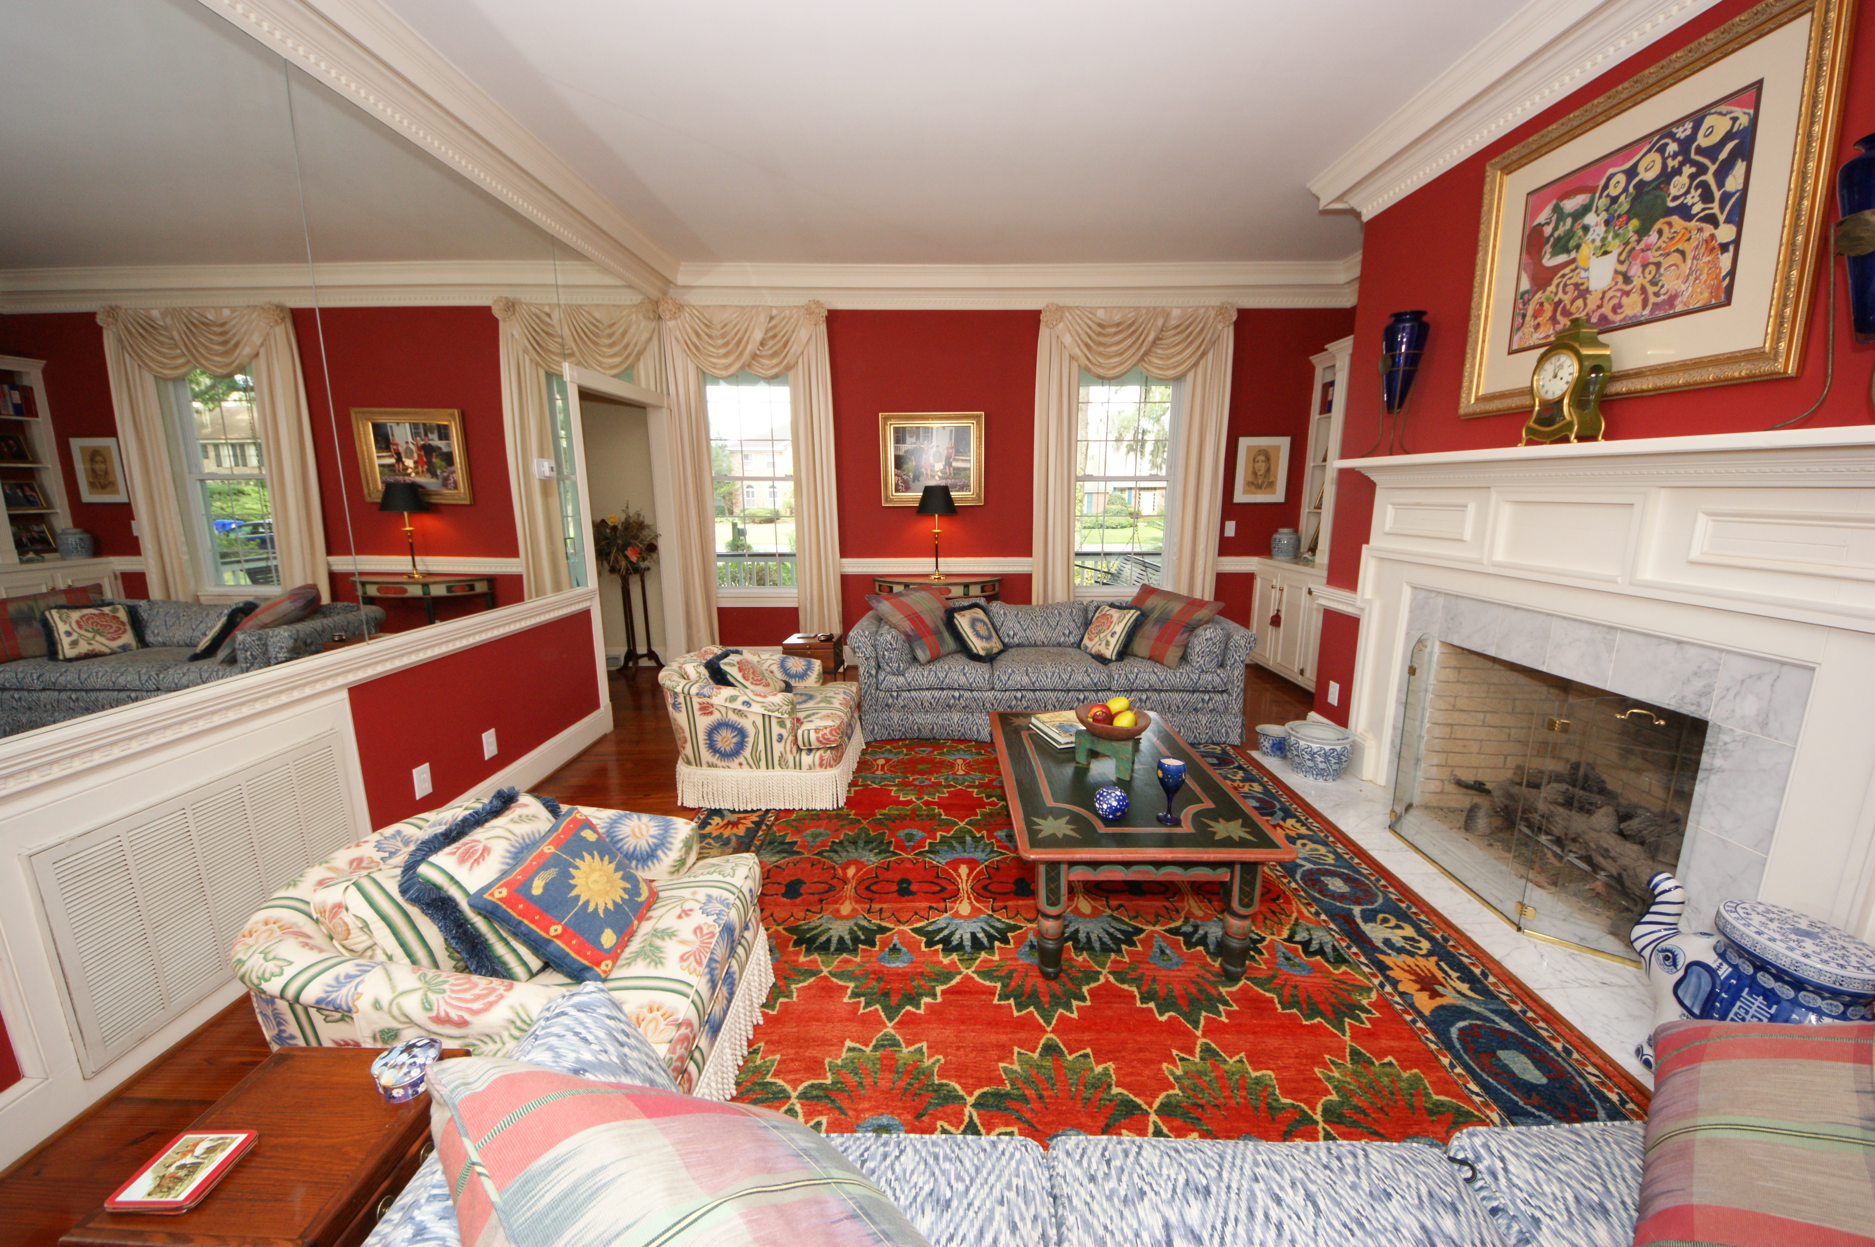
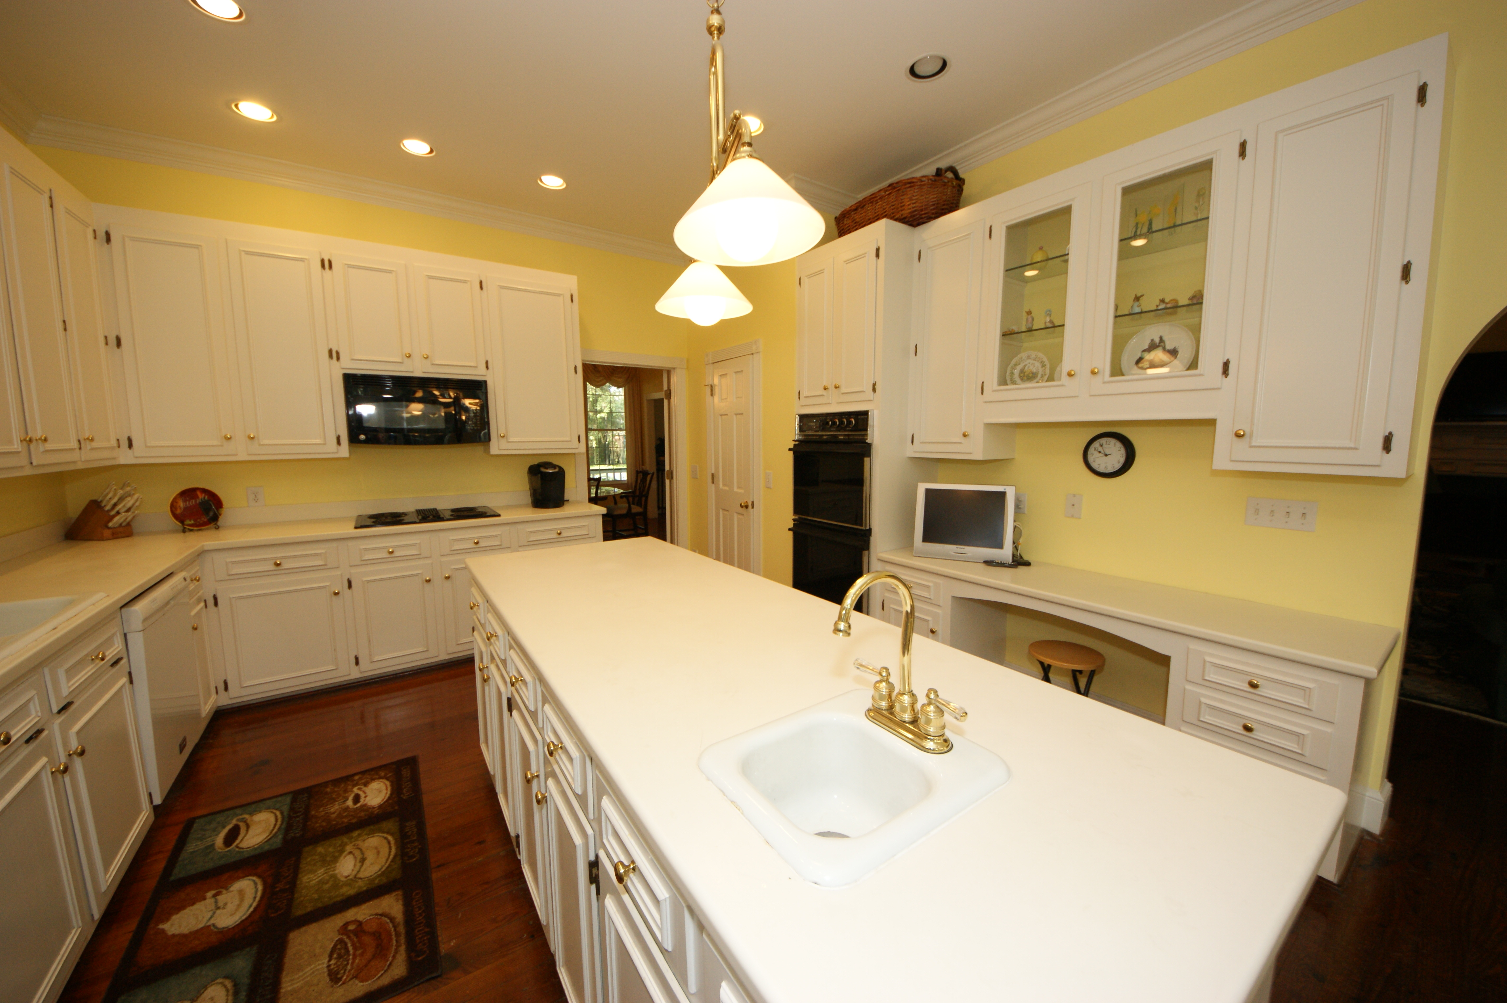
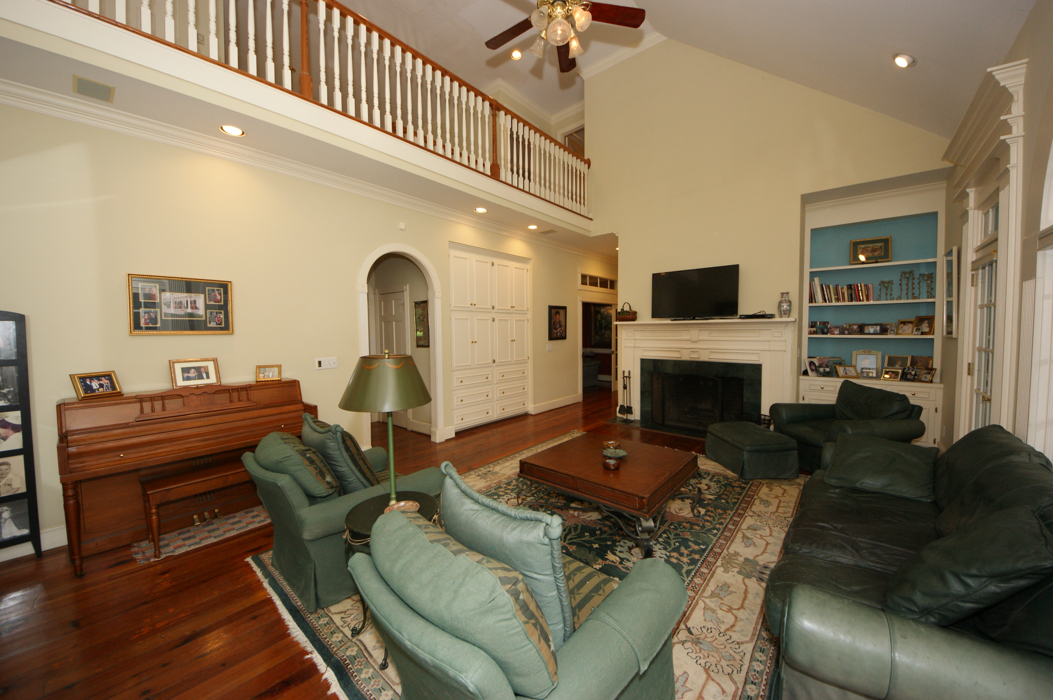
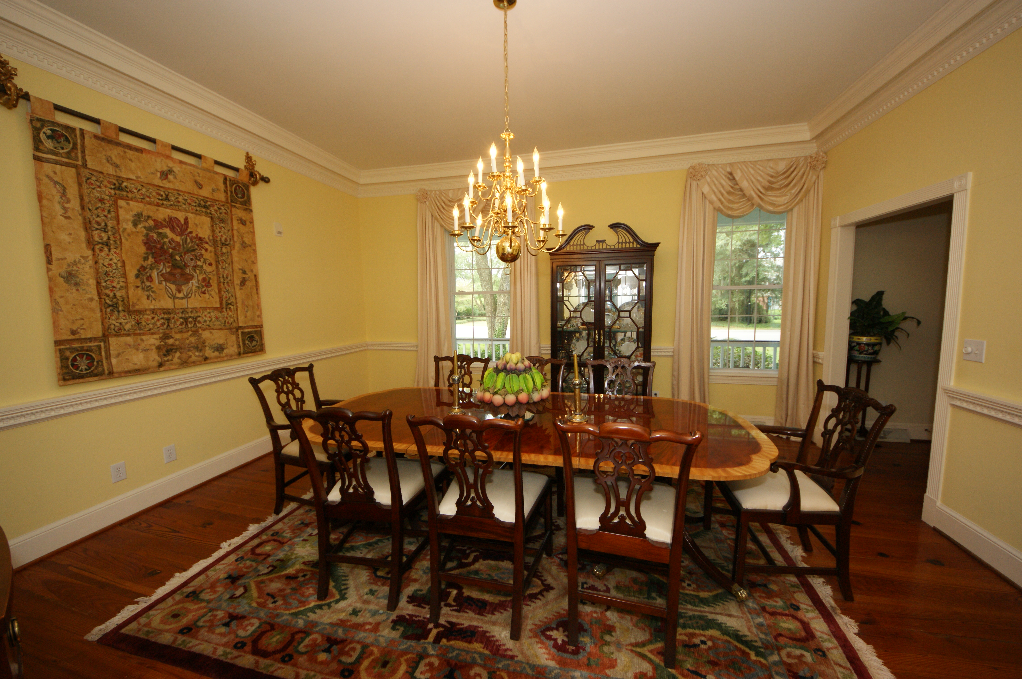
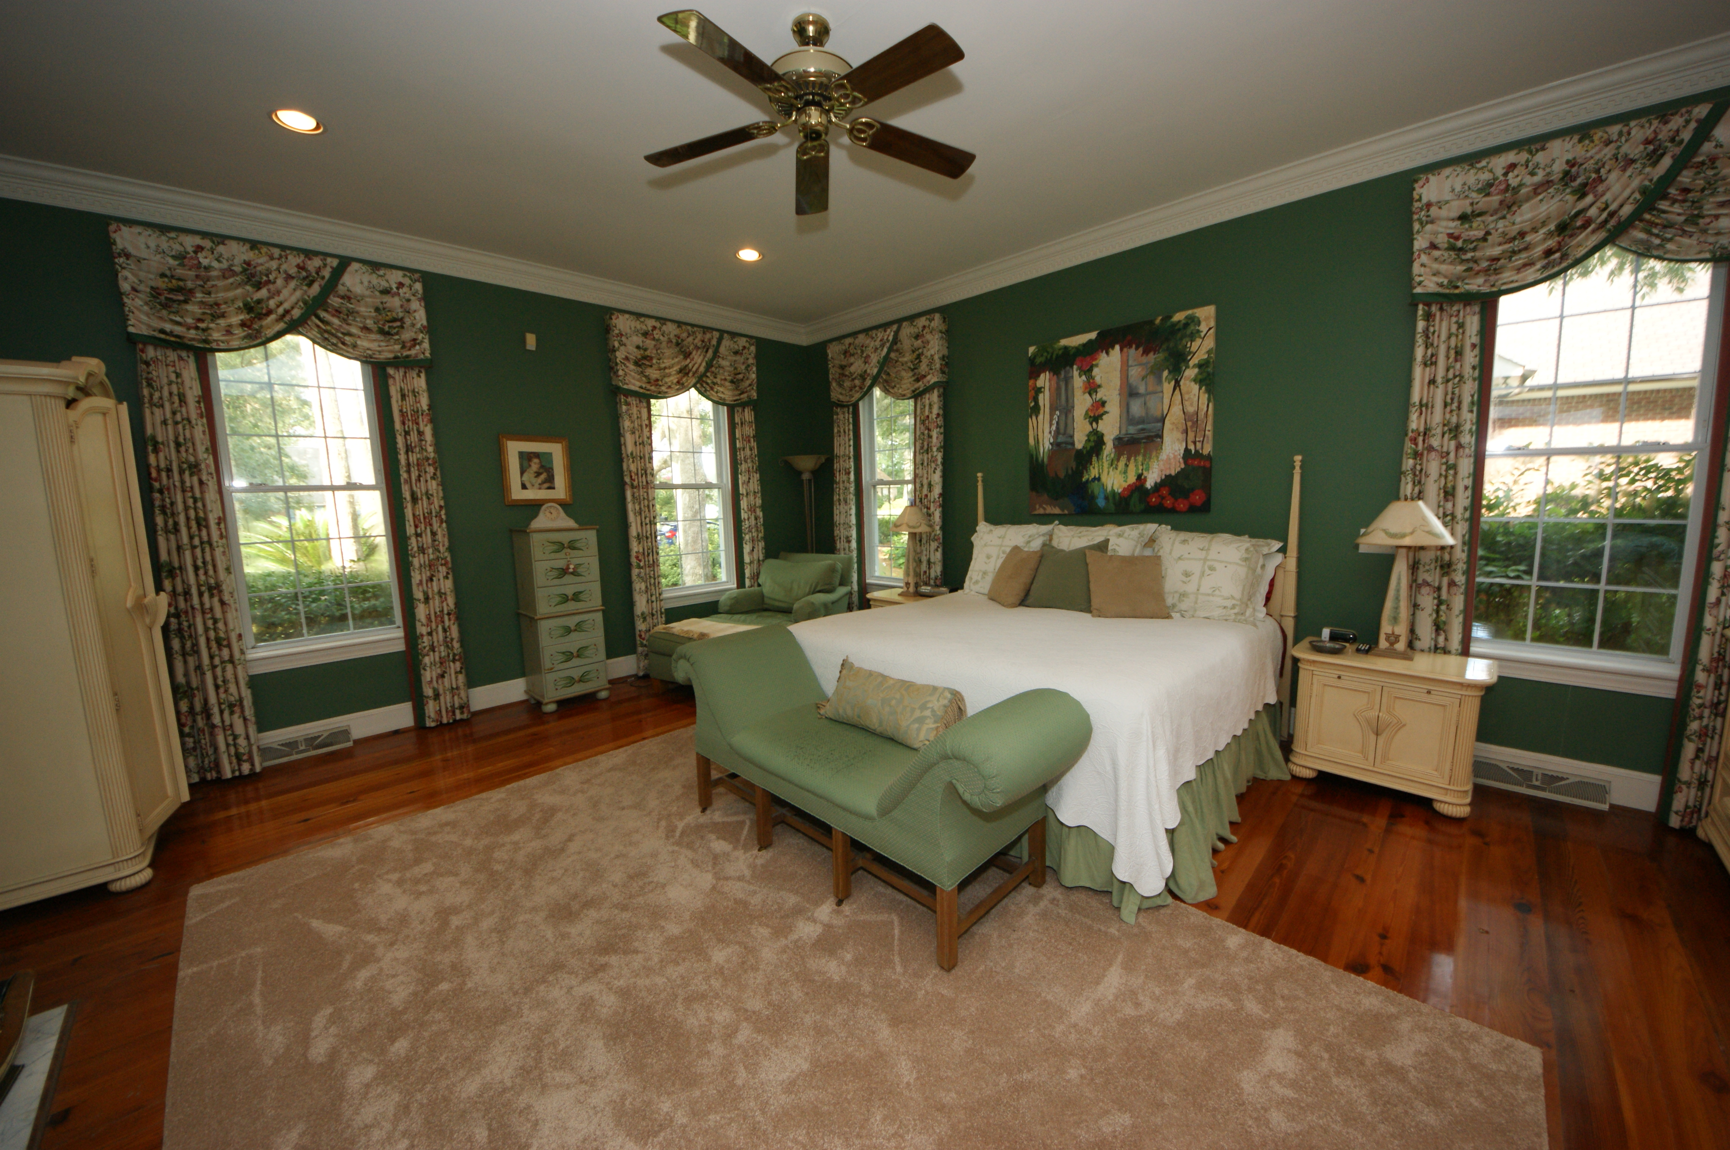
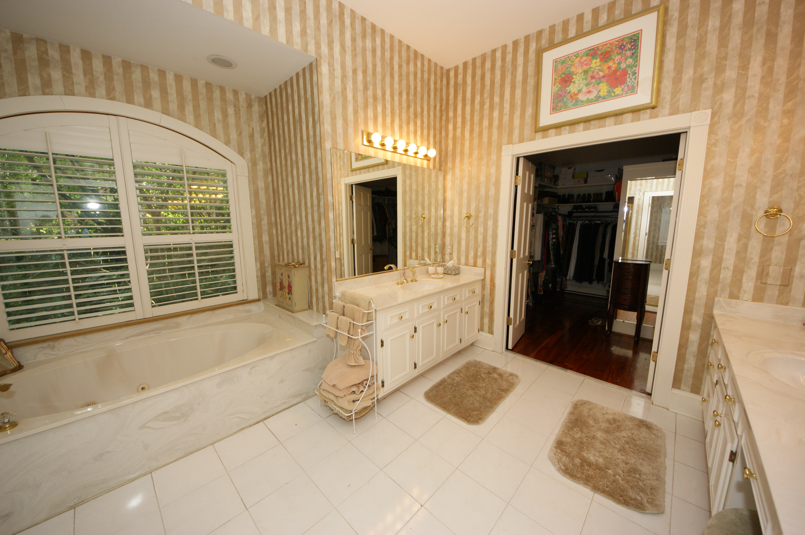
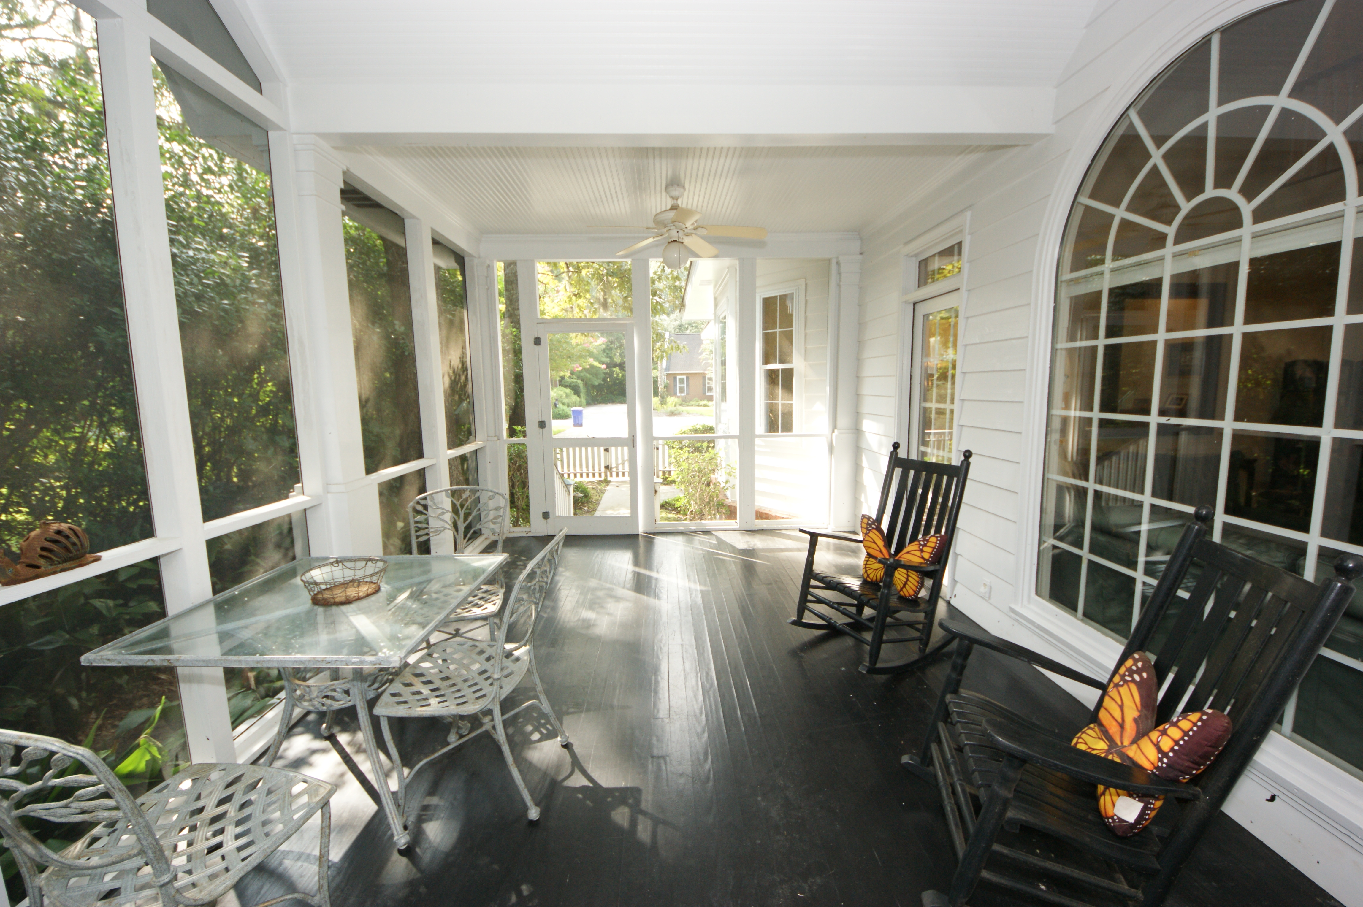
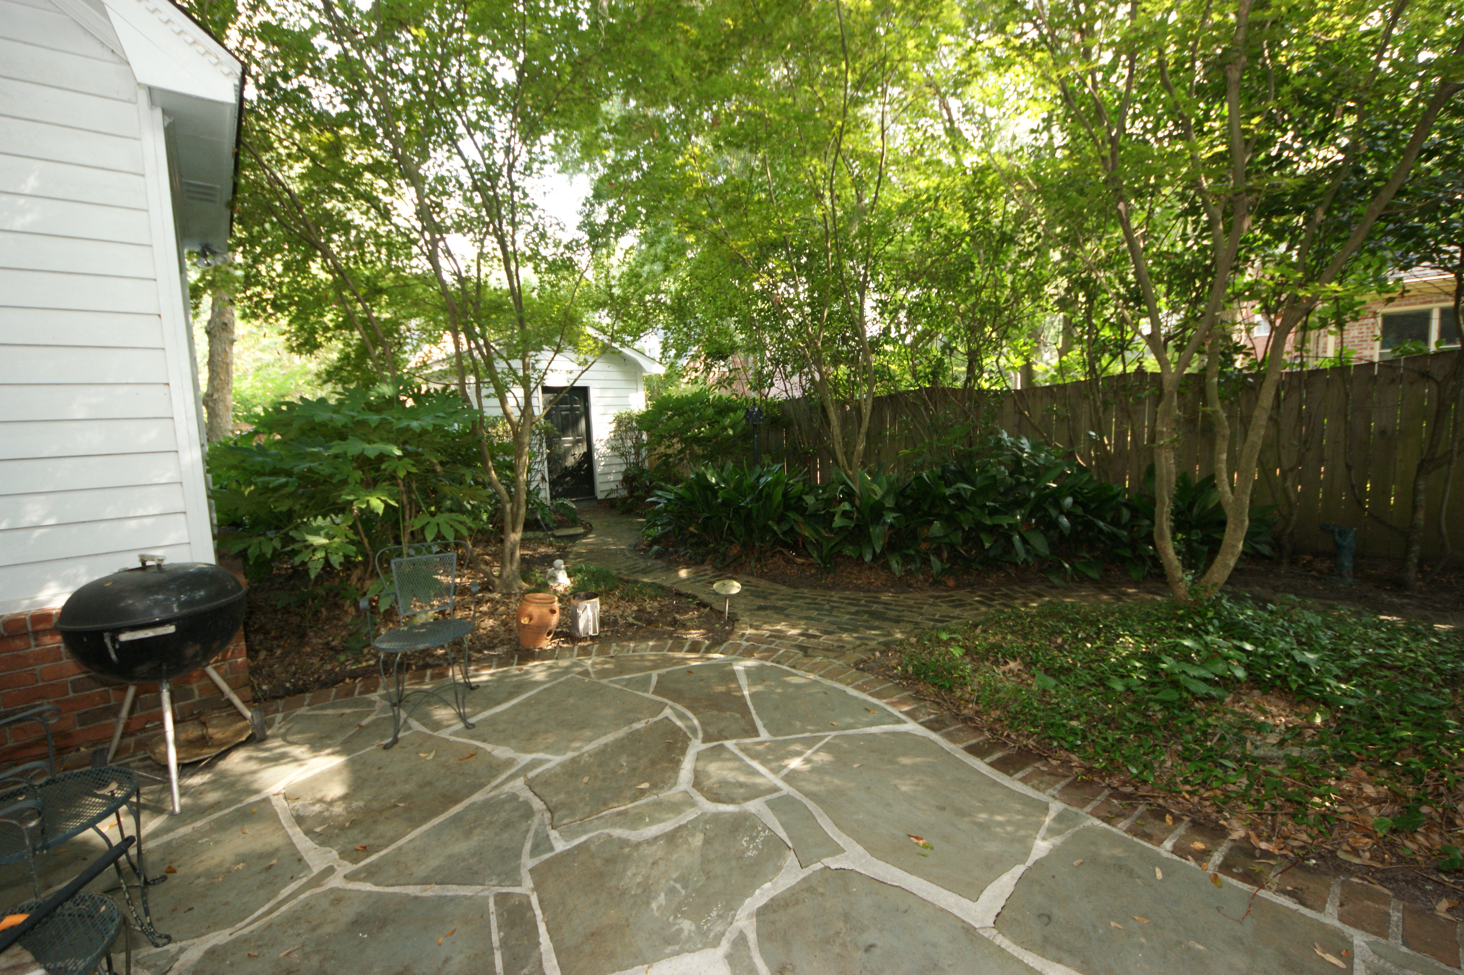


$2500 Buyer's Agent Bonus
For Ratified Contract By 8/31/16
LOWEST Price per SF in Ashley Harbor! In an X Flood Zone!
4-5 Bedrooms + 3½ Baths + 3 Fireplaces
2230 Portside Way, Charleston, SC 29407 MLS# 15021473 | Priced to Sell at $699,000
Absolutely stunning Plantation Style home in a lovely setting in Ashley Harbor. When you walk into the Foyer the gorgeous wide plank HEART PINE FLOORS and 10' ceilings will immediately get your attention. Downstairs has a Formal Dining Room and Living Room (LR would make a wonderful study). THREE fireplaces! LR, Family Room and in the DOWNSTAIRS Master Bedroom! The attention to detail in the trim-work and mouldings is evident when you look around. Built-ins throughout the home. HUGE Master Suite and Master Bathroom. Tons of storage. Large sunny kitchen with an eat-in breakfast area. Powder Room and Large laundry room finishes off the downstairs. Upstairs, you will find 3 more bedrooms and 2 more large bathrooms. There is also a FROG (could be massive 5th Bedroom). The FROG has access from the front stairway OR the back stairs near the kitchen/laundry. This FROG also has a wet bar, fridge and ice maker so could easily be used as a guest suite, teen hangout or a mother-in-law suite. One of the (very large) upstairs baths right outside the door to the FROG for easy access. There are 3 other bedrooms (aside from the FROG) upstairs. Between two of the bedrooms, there is a very large bathroom suite...to include the vanity area, toilet area and tub/shower area. This is a large version of a jack-n-jill bath setup! Perfect for use by more than one person at a time. Great for kids or multiple guests. The third bedroom is on the side near the FROG and the other large bathroom.
There is a nice screened porch right off the Family Room. The fireplace in the Fam Rm is wood burning but plumbed for gas if you want! The large over-sized double garage is a dream for the handy person. There are cabinets along two walls and a sink for easy clean up. AND still plenty of parking space! The yard is beautifully landscaped and manicured...mature large trees that you don't see as much these days. The large welcoming porches out front will greet you as you come to see this home! The neighborhood has access to a community dock and also has a lighted tennis court. Boat storage is available. There is also a swimming dock off the large 'spring fed' lake for residents as well as walking trails....great family fun! This home is in an X FLOOD ZONE!! No Flood Insurance is required. MAJOR PRICE REDUCTION APRIL, 2016 $50k Amazing price for this house! As-Is, Where Is....Come see it today!
Susan Weeks
(843) 813-0495
susanweeksdesign@gmail.com
www.agentownedrealty.com
AgentOwned Charleston Group
902 Savannah Hwy
Charleston, SC 29407-7802

