Slide 1
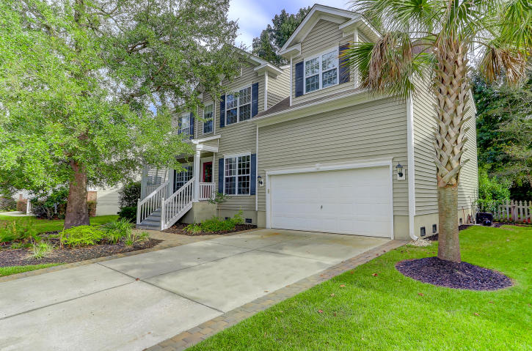
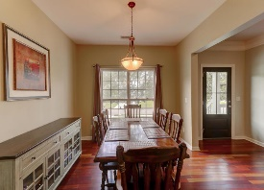
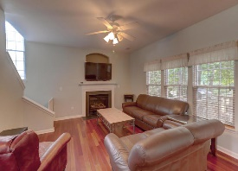
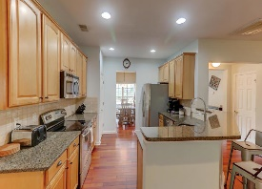
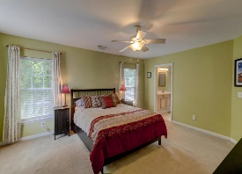
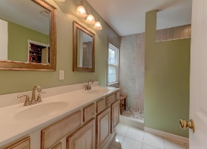
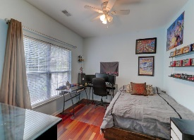
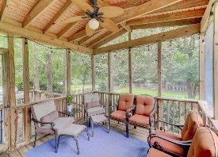

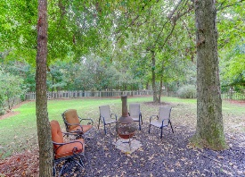

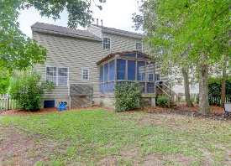
2230 Red Fern Lane Planters Pointe ~ Mt Pleasant ~ MLS# 18027804 ~ $435,000
Go And Show For Last Minute Thanksgiving Buyers!
Go And Show For Last
Minute Thanksgiving Buyers!
Fantastic home offering lots of upgrades. Incredibly beautiful hardwood floors through-out the entire downstairs floor including the staircase. Kitchen offers granite counters, rich honey colored 42'' cabinets, stainless steal appliances, tiled backslash. A bedroom downstairs perfect for guests, teenager, elderly parent, or office. Upstairs leads to a very spacious master bedroom, 2 additional bedrooms, a true laundry room with a window, and a very large bonus room that can be used as the 5th bedroom with it's walk-in closet, or game/media/TV room with built-in shelves and 3 additional storage closets, one being walk-in access. Garage offers walk-up access to floored storage. Master bath has a luxurious upgraded tiled walk-in shower. Open and airy home with lots of natural light.
House sits on a large lot with a picket fence, screened-in porch and deck with no houses behind and walking distance to the pool, play park, tennis courts and Planter Pointe's fabulous fitness trail. Map attached! Cul-de-sac is a definite plus with your own oak tree making your front porch private and cozy. A must see home. All information deemed to be true, but may not be exact, please verify all. Measure if important.
Brigitte McElroy CRS, GRI, REALTOR
M (843) 708-5353 | O (843) 886-8110
brigitte@brigittemcelroy.com | www.brigittemcelroy.com
CarCarolina One Real Estate 1503 Palm Blvd Isle of Palms, SC 29451-2280

