Slide 1
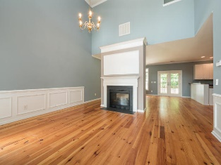
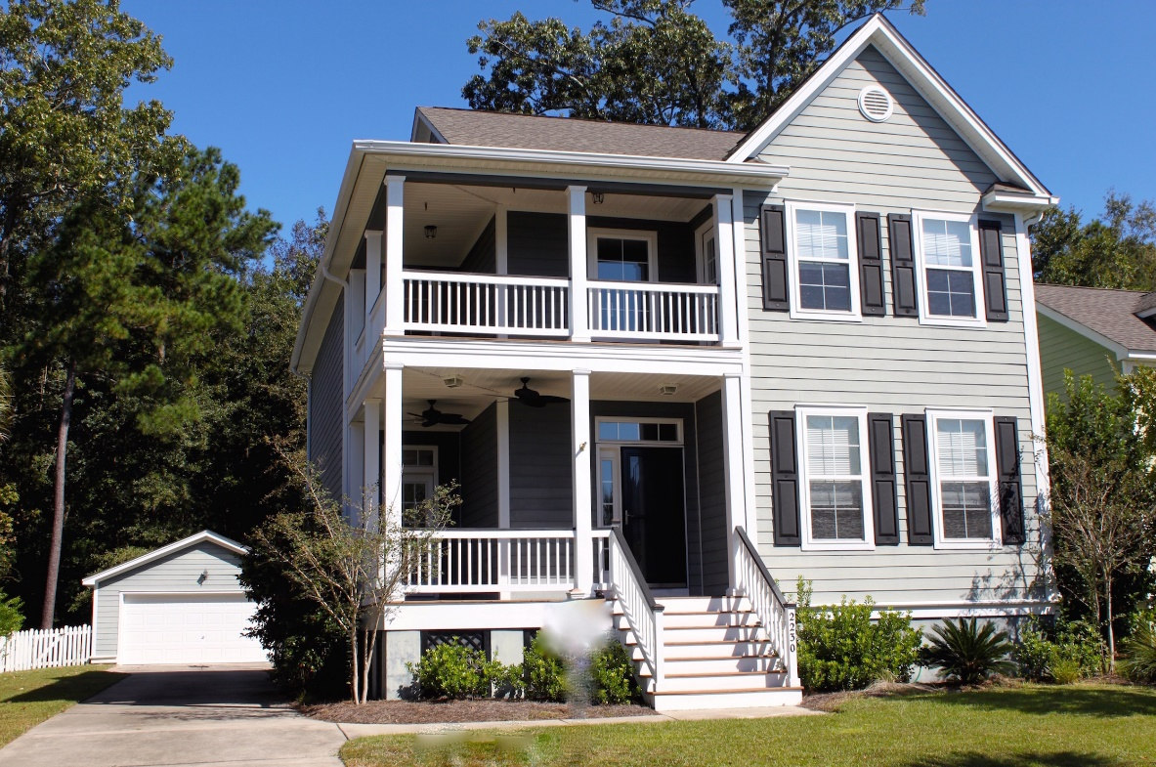
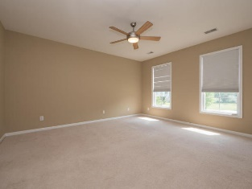
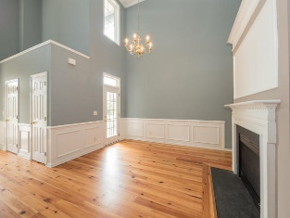
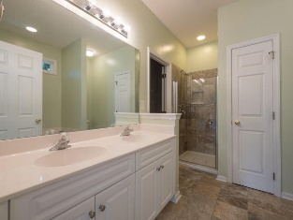
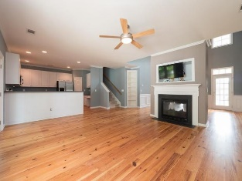
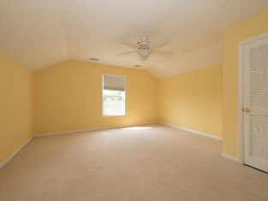
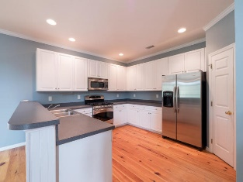
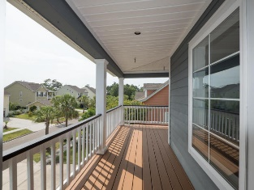
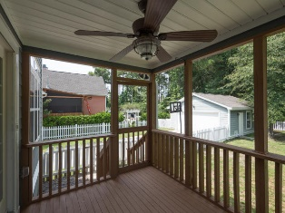
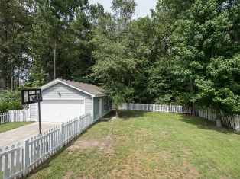

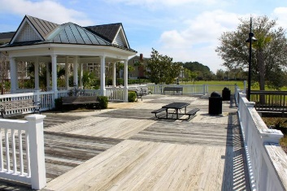
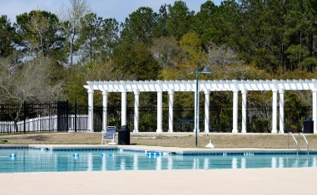
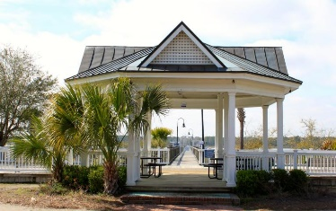
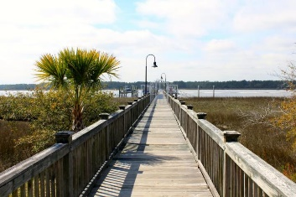
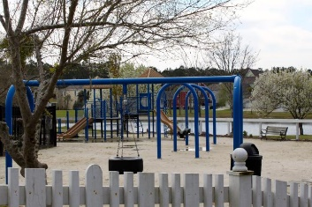


Bring all offers!
2230 Sandy Point Lane
Rivertowne On The Wando
Mount Pleasant
MLS# 15017921
$429,900
Lowest Price/Sq Ft In Neighborhood
4 True Bedrooms Plus A Bonus Room (Or 5th BR)
Newly Screened Back Porch
Fresh Interior Paint
Double Front Porches With New Ceiling Fans/Lighting
Large Lot That Backs To Woods
Downstairs Master Bedroom With Upstairs Master Option If Needed
Over 2,600 Sq Ft
Large Kitchen w/Stainless Appliances
Short Walk To Community Dock On The Wando River For Fishing/Kayaking,
Kris Higman
Realtor®
Cell Phone: (843) 810-8824
kris.higman@cbunited.com
Coldwell Banker United, REALTORS
1127 Queensborough Blvd, Ste 103
Mt Pleasant, SC 29464

