Slide 1
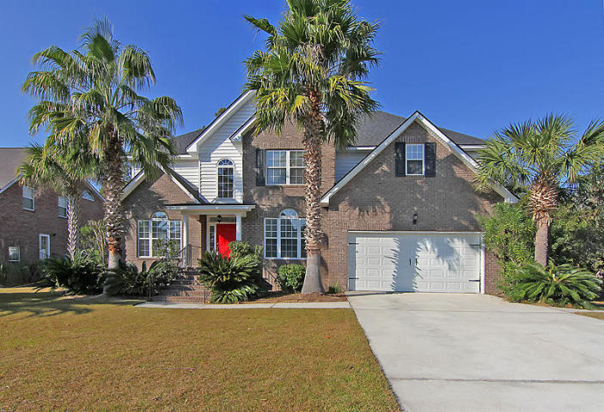
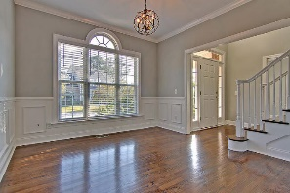
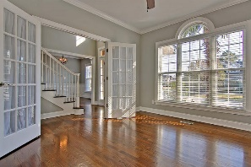
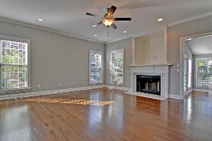
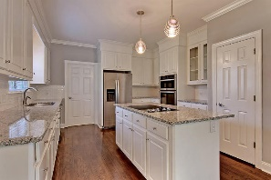
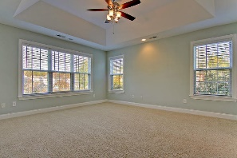
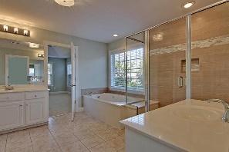
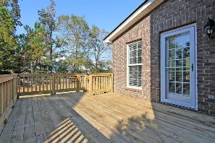
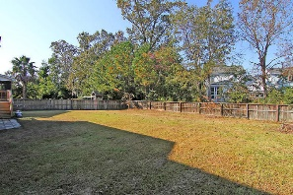
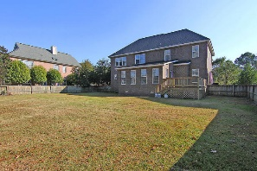

2232 Salt Wind Way
Planters Pointe ~ Mt Pleasant
MLS# 16029717 ~ $489,000
Updated,Spacious 5 Bedroom On Cul-de -Sac!
Loaded with Updates
Open floorplan with large bonus room on 1st floor, yet offers private front room (office/den) with beautiful French doors.
Many refreshing updates: new appliances, new granite, refinished hardwood floors, light fixtures + 5 generous sized bedrooms with great closet space & a master bathroom that serves as a calming, roomy retreat. Laundry room with sink, washer & dryer.
Neighborhood amenities include pool (with chillers to ensure its refreshing all summer), tennis courts, new basket ball court, new firepit & grill stations (ready by spring), clubhouse & work-out stations along trails. Walk to grocer, Starbucks, bar/restaurants, pizzeria & the Wando River.
Stan Huff
843-670-2835
stan.huff@agentowned.com
Alma Kenneally Certa
843-730-3356
alma@agentownedrealty.com
www.agentownedrealty.com
AgentOwned Realty Co. Preferred Group, Inc. | 824 Johnnie Dodds Blvd | Mt Pleasant, SC 29464

