Slide 1
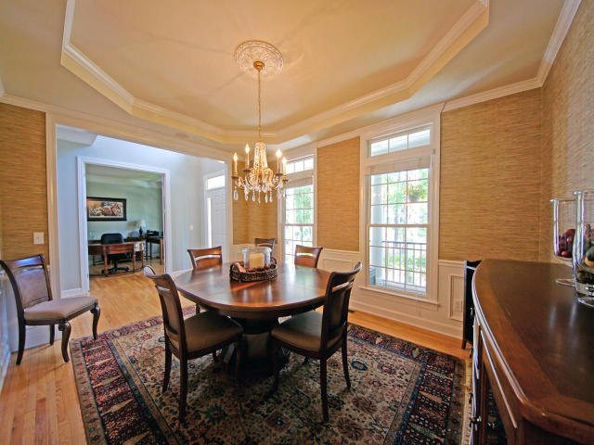
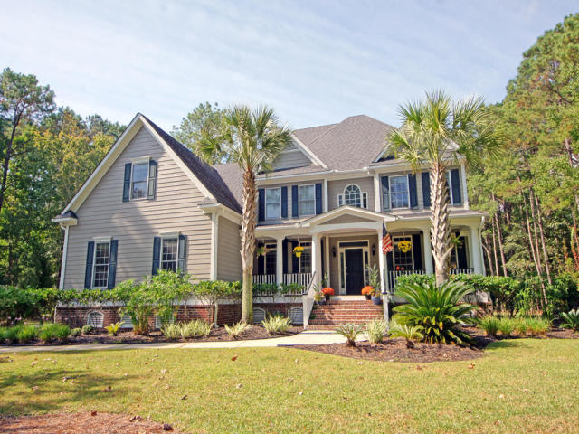
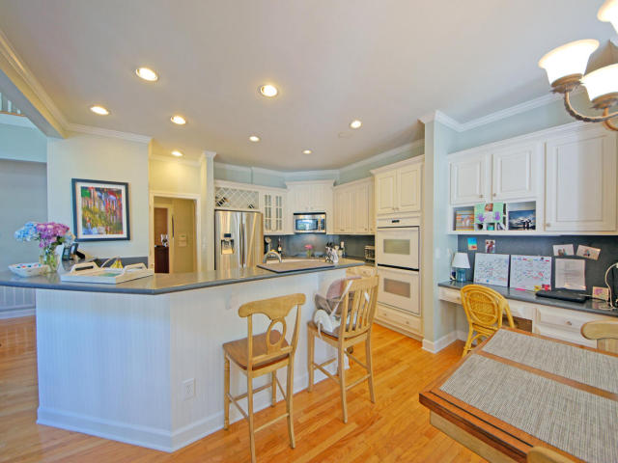
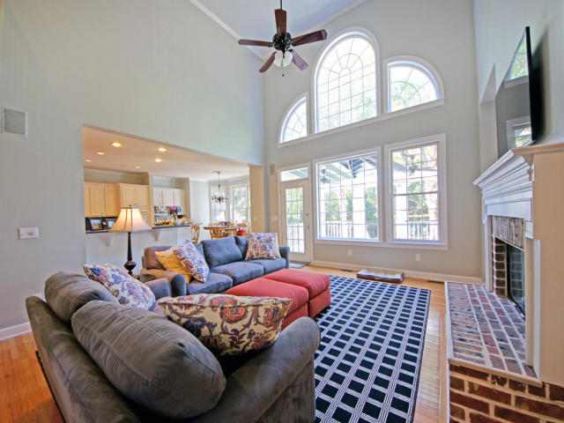
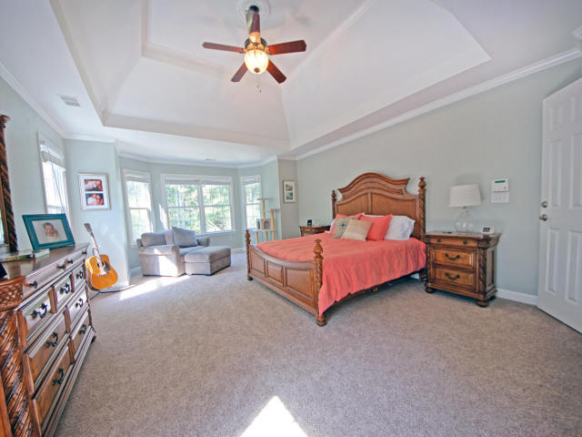
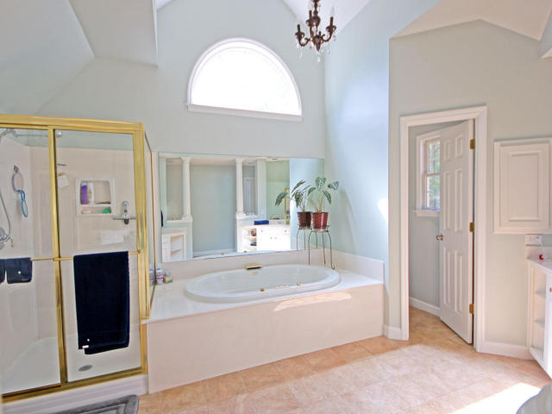
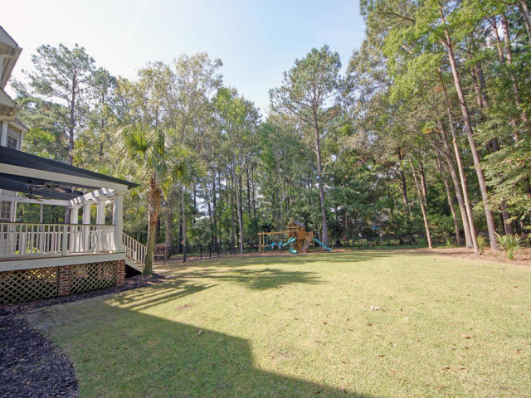

2236 Black Oak Court Mt Pleasant ~ MLS# 15027445 ~ $700,000
Dunes West
Open House
Saturday, 3/19, 12-3
Open Pass at the Gate
$35,000 PRICE DROP!!
Highly motivated sellers! Fantastic family home on cul-de-sac with lots of space and privacy on over an acre lot. Beautiful home located on over an acre of land in a gated community. Bright open floor plan thanks to a two story great room with lots of windows. Three 2013 HVAC's, new carpet, new paint, new tankless water heater, etc. See full upgrade list in documents. Master suite located on 2nd floor includes large separate sitting room with fireplace, a perfect retreat in the evening. Three BR's located on 2nd floor with a full guest room and bathroom on the main floor. Also a HUGE finished 3rd floor with bathroom which can be used as a BR or recreation space. Upgraded side-entry garage and trellis-covered deck overlooking a very private backyard.
Glenn Drew Wewers
(843) 534-6376
drew@charlestonproperty.net www.BrennamanGroup.com

