Slide 1
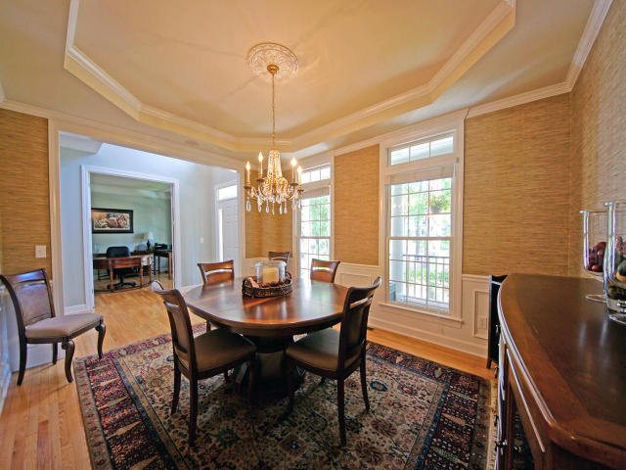
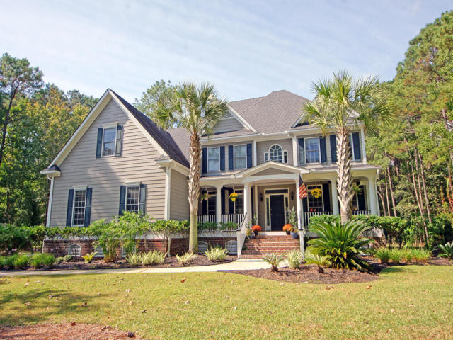
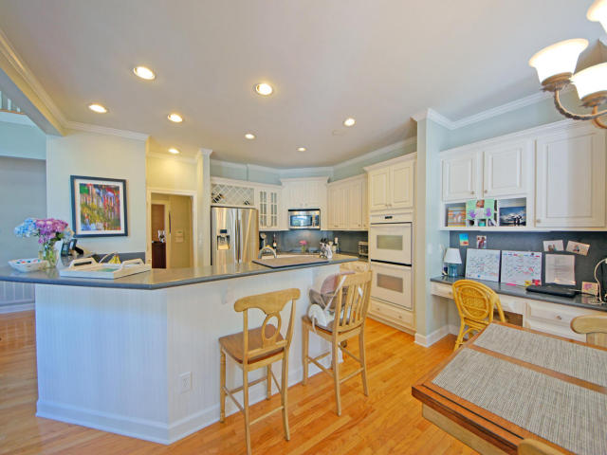
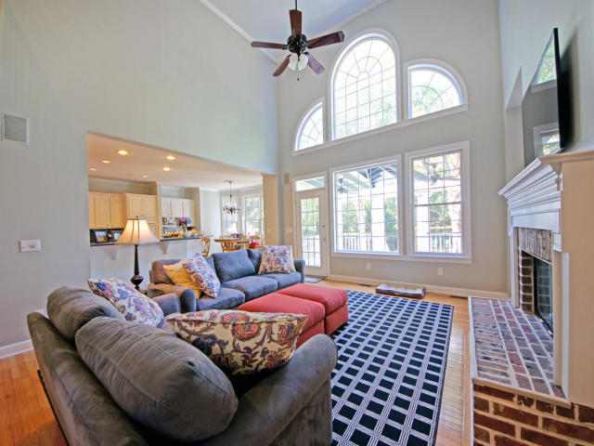
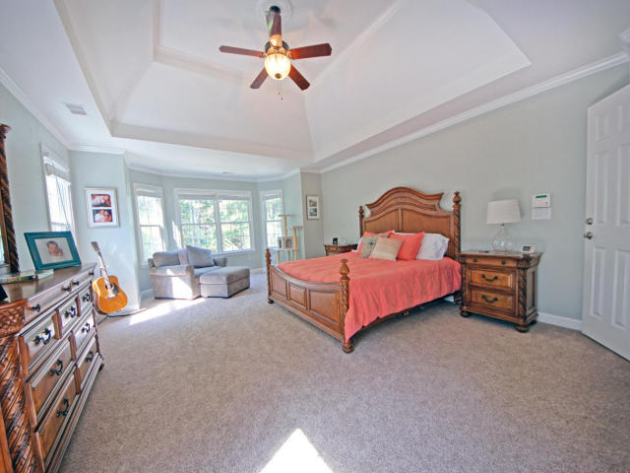
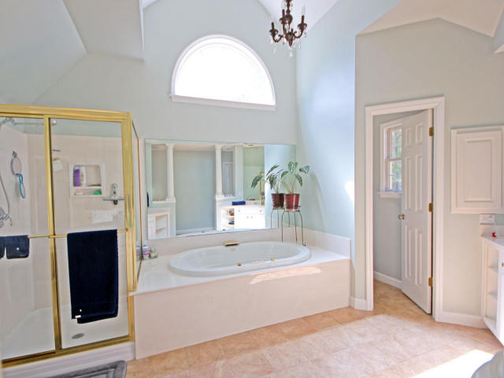
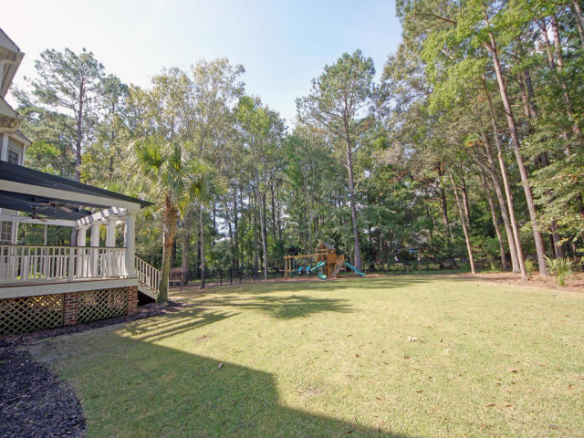

2236 Black Oak Court
Mt Pleasant ~ MLS# 15027445 ~ $725,000
$10,000
Price
Reduction!
Highly motivated sellers!
Fantastic family home on a cul-de-sac with lots of space and privacy. This beautiful home is located on over an acre of land in a gated community. The floor plan is open and bright thanks to a two story great room with lots of windows. There are just TOO MANY upgrades to list!(see upgrade list in documents) The master suite is located on the 2nd floor and includes a large separate sitting room with a fireplace, a perfect retreat in the evening. Three bedroom's are located on the 2nd floor with a full guest room and bathroom on the main floor. To top it off, there is a huge finished 3rd floor with bathroom which can be used as a bedroom or recreation space. There's an upgraded side-entry garage and a lovely trellis-covered deck overlooking a very private backyard.
Glenn Drew Wewers
(843) 534-6376
drew@charlestonproperty.net
www.BrennamanGroup.com

