Slide 1
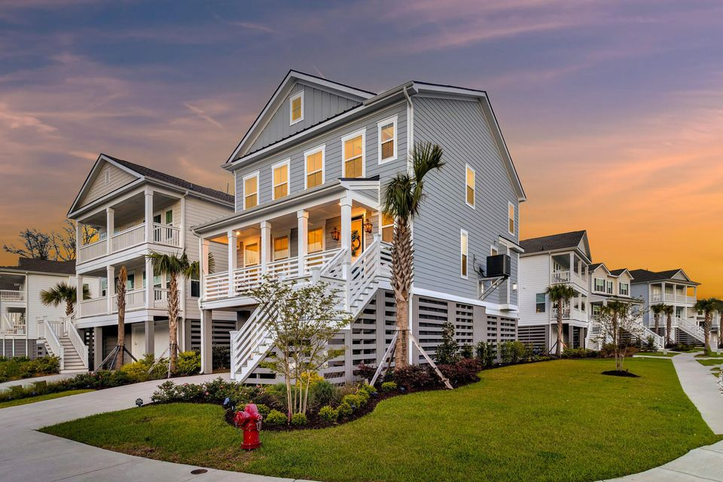

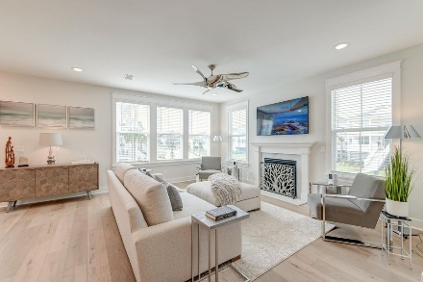
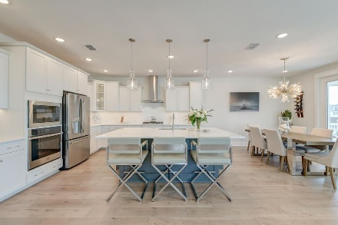
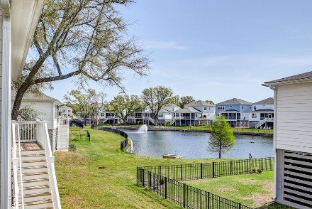
$90k Worth Of Upgrades!
OPEN HOUSE
SATURDAY 12-3
Open House Saturday 12-3
2237 Tillage Street
Liberty Hill Farm | Mount Pleasant, SC 29466 | MLS# 25009177 | $1,145,000
Welcome to this stunning, better-than-brand-new home featuring luxurious upgrades and thoughtful design in a highly desirable area in Mt Pleasant. Located on a corner lot with a water view and potentially room for a pool, the property boasts professional landscaping with accent uplighting. Enjoy outdoor living with a 16x30 Charleston-style brick patio, a 12x12 front courtyard, and screened decks and patios, all complemented by ceiling fans and custom plantation shutters for added privacy. Outdoor entertainment is enhanced with a wired lower patio for a TV setup. Inside, a high-end elevator provides easy access to all floors. The gourmet kitchen features quartz countertops, soft-close cabinets, under-cabinet lighting, stainless steel appliances, and a modern industrial hood. The spacious living areas showcase shiplap accents, recessed lighting, and decorative ceiling fans in every room. The main floor includes a guest suite with a full bath.
The three-car tandem garage is fully screened, partially shadow-boarded, and equipped with additional lighting. With decorative lighting, a gas fireplace, and Charleston-style gas lanterns, this home offers both style and functionality at every turn.
This location is tough to beat. Here you are conveniently located just 1.8 miles from the IOP Connector, 3 miles from shopping and dining at Mt Pleasant Towne Centre, 5 miles from the sandy shores of Isle of Palms, and 10.4 miles from downtown Charleston. Experience modern luxury and comfort in this exceptional property.
Book your showing today!
Amanda Kennedy-Colie akcolie@mattoneillteam.com 843-224-5865

