Slide 1
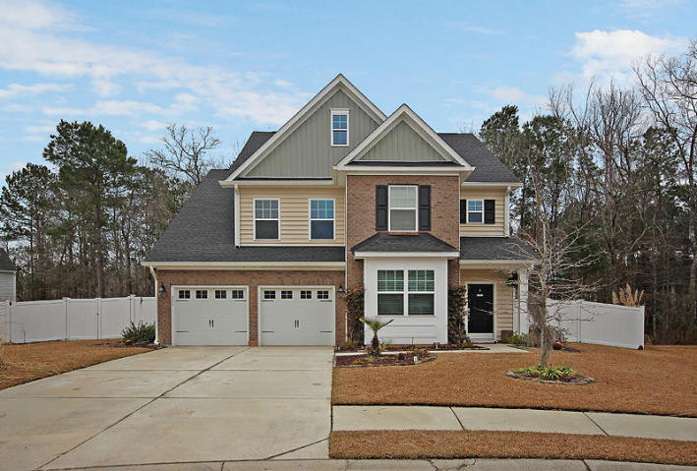
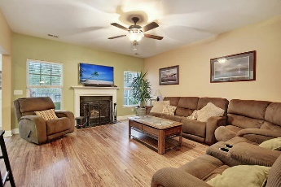
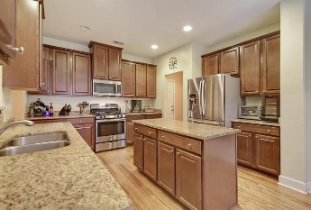
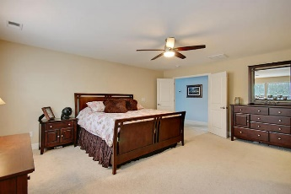
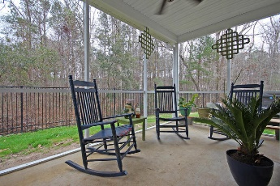
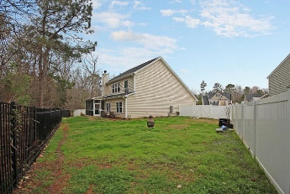
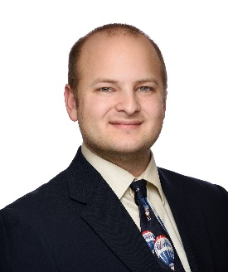

Open House Sunday 3/4 ~ 1-4pm
223 Buttonbush Court
Fairmont South
Moncks Corner, SC 29461
MLS# 18004112
$314,900
WELCOME HOME!
This home offers six large bedrooms, four full bathrooms, and one half bath. The home is approximately 3493sqft and is located on a private wooded lot in a cul-de-sac! When entering the home you will be greeted with bamboo flooring that flows into the open floor plan. The first floor offers a spacious office, large living room, formal dining room, breakfast nook, large open kitchen equipped with an island and gas range, and a Mother-In-Law Suite! On the second floor is the master suite, three more spacious bedrooms, and one full guest bath. The third floor boast a loft, another large bedroom and full bathroom! On the outside of the home you will find a large fenced in yard, a relaxing screened-in porch and a two car garage! Age, sqft, taxes, acreage, HOA dues, and schools are approximate buyer to verify any and all information deemed necessary.
Mason Thurber
(843) 709-5109 – C
(843) 576-2699 – O
mason@theeverettgroup.net
RE/MAX Pro Realty, 9209 University Blvd, Charleston, SC 29406

