Slide 1


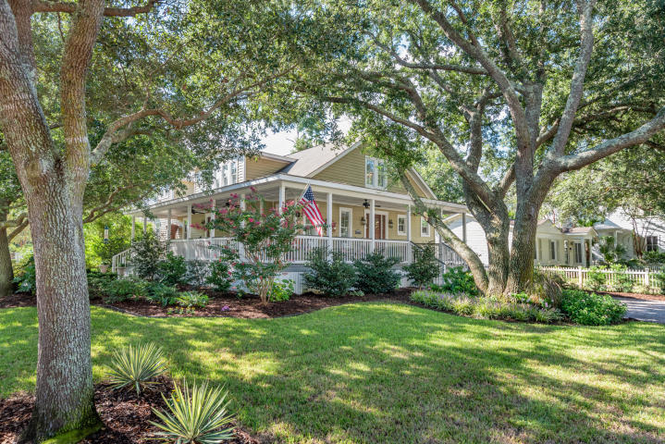
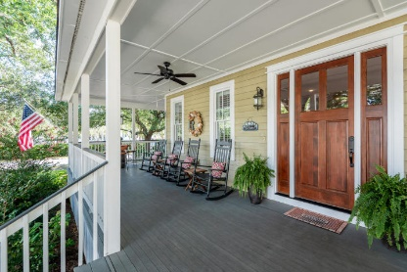
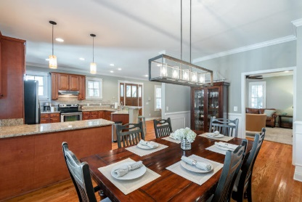
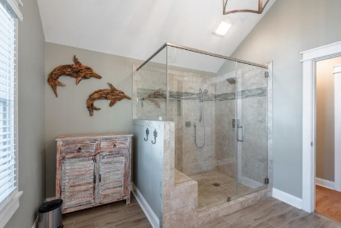
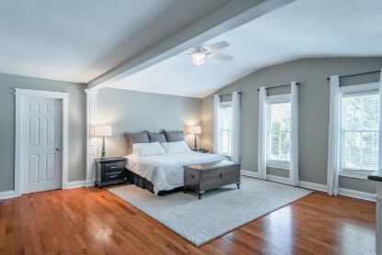
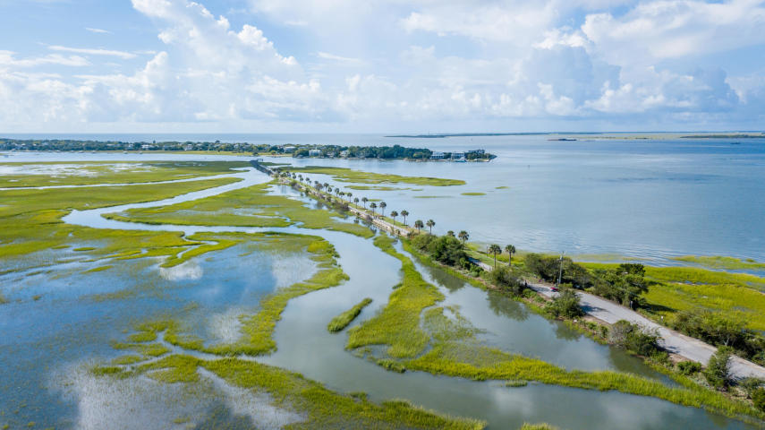





NEW TO MARKET!
$469,900
223 Center Street | Old Village | $1,175,000
Virtual Tour Available at
https://www.youtube.com/watch?v=B-ZMWzHEJu0&feature=youtu.be
4 Bed | 3.5 Bath | 3430 Sqft | MLS# 18025654
Beautiful home in a great location in the desirable Old Village of Mt. Pleasant.
Located at the corner of Pitt & Center Streets, this move-in ready home is just a short walk to the Pitt Street Bridge & Alhambra Hall.
Old Village lifestyle at its best!
More Info
Request Showing
Exclusively Offered By
Bill Barnhill | 843-364-6903 | bill@billbarnhill.com
Keller Williams Realty | Charleston / Mt. Pleasant | 496 Bramson Ct., Suite 200, Mount Pleasant, SC 29464

