Slide 1

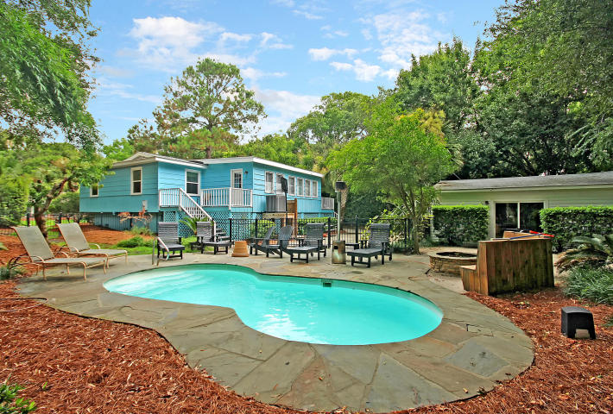
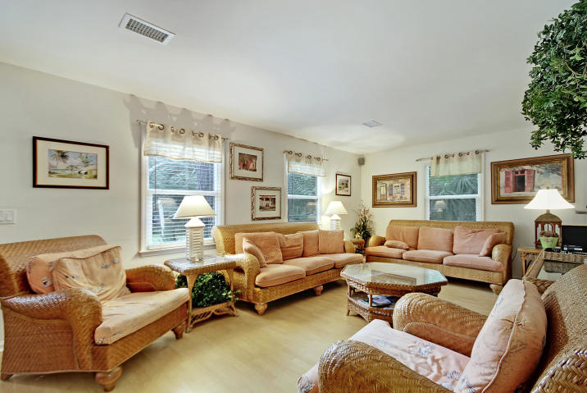
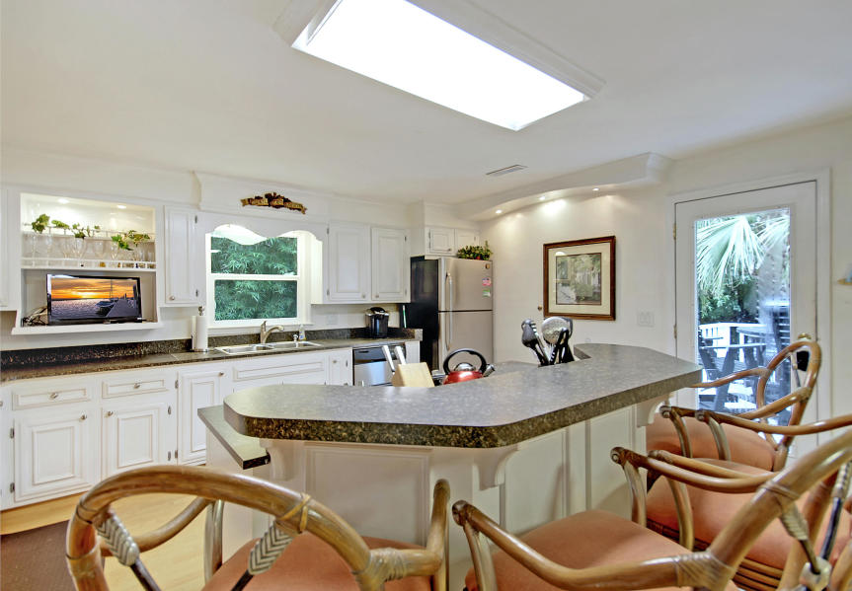
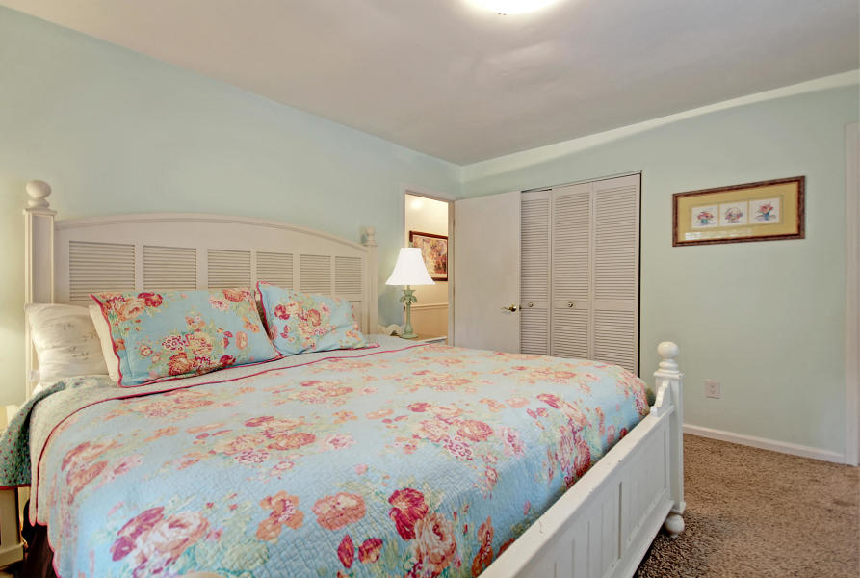
Beach House with Pool…Easy Beach Access
Price Reduced!
223 Forest Trail
Isle of Palms, SC 29451 ~ MLS# 18020756 ~ $889,000
Have you always dreamed of owning a home on beautiful Isle of Palms for your family and guests or for a great source of rental income? How about a home that includes an in-ground pool, a spacious patio, and has easy beach access with just a brief walk? If so, then your search is over. This three bedroom, two bathroom home has a large living room for people to gather, an outdoor shower to wash away the sand from the beach, and a garage that's currently used as a game room. The patio has plenty of room to stretch out, grill, and enjoy the sparkling pool. Whatever you desire, this home is a great fit. Rental income for 2013 was $83K+, 2015 was 97K+, and 2016 was $98K+. Book your showing today!
Completely redone, upgraded, and updated home
Fireplace in the living room has a seashell surround
Beautiful shiplap
Wainscotting in the dining room
Master bath has a tile, walk-in shower
Kitchen has center island, built-in wine rack, tile backsplash, stainless steel appliances and gas range
Permitted for a boat lift
Book your showing today!
Tyler Hawkins tyler@mattoneillteam.com (843) 908-2734

