Slide 1
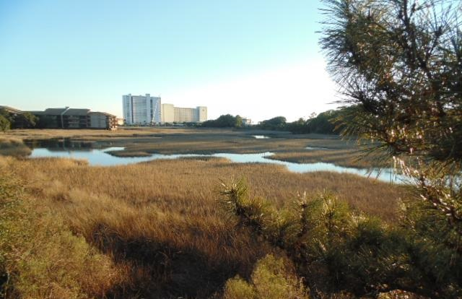
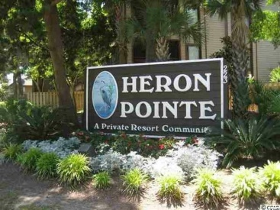
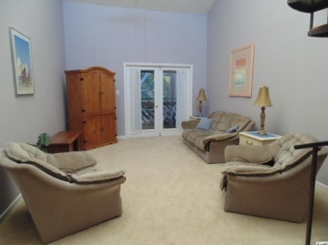
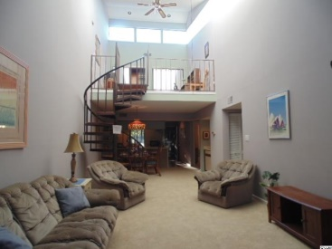
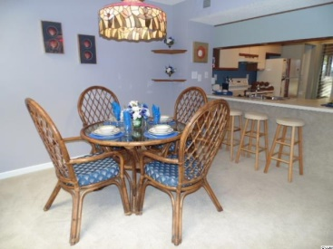
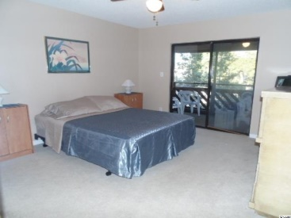
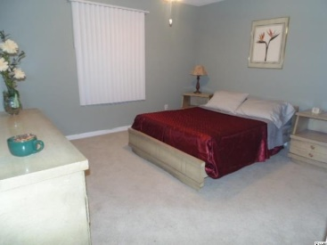
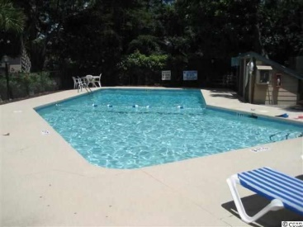
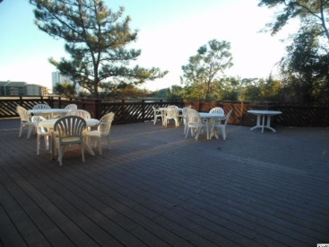


Public Open House ~ Sunday 1-4
In the beautiful Arcadian Shores area of Myrtle Beach.
223 Maison Drive
Units A-10 & A-11
Heron Pointe
Myrtle Beach, SC 29572
$129,900
One block walk to the beach! 3 bedroom, 2 bath furnished condo including a washer and dryer! Great second home at the beach or investment opportunity. Relax and enjoy the fresh air on one of three screened-in balconies. Ceiling fans are in bedrooms and living room. Has a wet bar for entertaining. Fresh paint and new carpet throughout the condo. New hot water heater. 2 bedroom and 2 bathrooms are on the first level and has an upstairs loft with bonus huge finished storage room. Short and long term rentals are allowed. Owners are allowed pets. Located in a beautiful condo complex featuring an outdoor AND indoor pool! Also indoor jacuzzi, sauna, showers and sundeck. The well maintained landscaping features beautiful trees and flowers with BBQ grills and picnic tables located throughout the complex. And there is a large clubhouse with huge deck overlooking the marsh facing the ocean available to residents for entertaining! Located in the popular Arcadian Shores section of Myrtle Beach which boasts the largest, most beautiful beaches along the Grand Strand! Walk to popular neighborhood establishments including Ocean Annie's oceanfront beach bar and Finn McCools Irish Pub. A quiet location yet less than a five minute drive to world class dining, shopping, golfing, and entertainment. Square footage is approximate and not guaranteed. Buyer is responsible for verification.
Julie Blethen | jazblethen@hotmail.com | (843) 564-8539
Wilkinson & Associates ERA Powered, 9652 North Kings Highway, Myrtle Beach, SC, 29572

