Slide 1
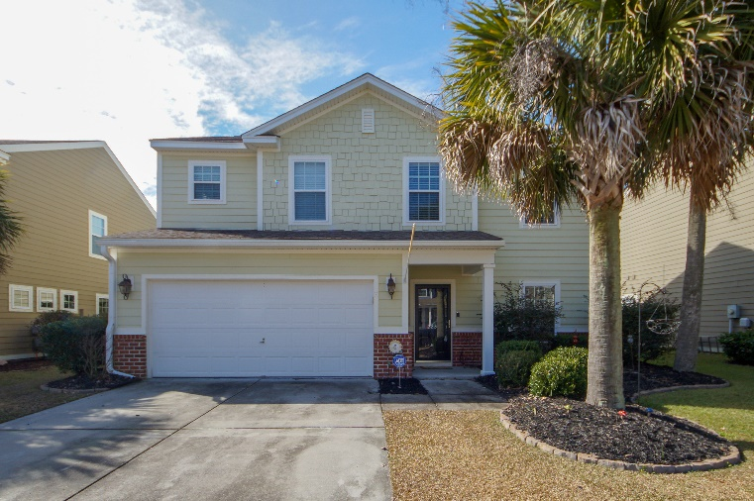
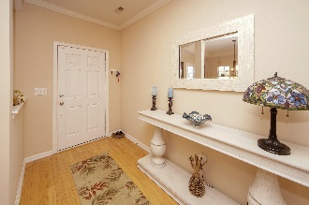
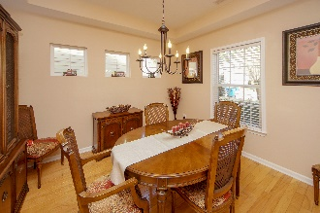
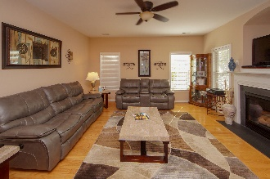
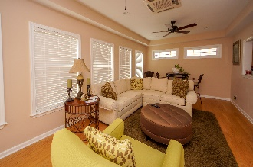
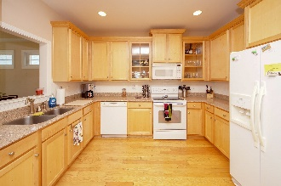
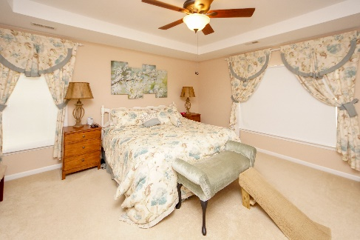
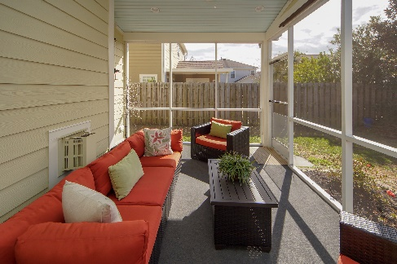
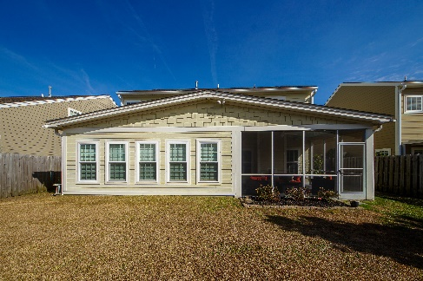



223 Nelliefield Creek Dr Nelliefield Plantation Wando, SC 29492 MLS# 19003593 4 Bed / 2½ Bath
New Listing in Nelliefield
$369,000, 2,600 sf ft.
Beautiful two story with 4 bedrooms, 2.5 baths and tons of upgrades. Gleaming hardwood floors throughout downstairs, smooth ceilings and ceiling fans. Home features large foyer, formal dining room with tray ceiling, kitchen with plenty of cabinets and granite counters, family room with gas fireplace, powder room, and newer addition of sunroom and screened porch. Master bedroom with tray ceiling and ceiling fan. Master bath with dual vanities, garden tub and separate shower. Three additional bedrooms are upstairs and second full bath with tub/shower combo. Two car garage with garage door openers, Rinnai tankless water heater, cement plank siding, and full privacy fence. No flood insurance required. Nelliefield is next to Cainhoy Plantation with new Philip Simmons Elementary, Middle, and High Schools. HOA includes pool with volleyball net and kiddie fountain area. New neighborhood golf cart trail to schools, park, and solar street lighting have just been approved. Buyer to pay $125 COA fee and $25 transfer fee at closing. Nelliefield is minutes away from Mt. Pleasant, Daniel Island, area beaches, shopping and dining. Easy access to Hwy 41 and I526.
Steps to the Beach!
Jennifer Nipper, Realtor®
(843) 478-1800 | jen@AgentOwned.com
www.AgentOwned.com
The AgentOwned Realty Co | 824 Johnnie Dodds Blvd | Mt. Pleasant, SC 29464
Real Estate • Mortgage • Insurance

