Slide 1
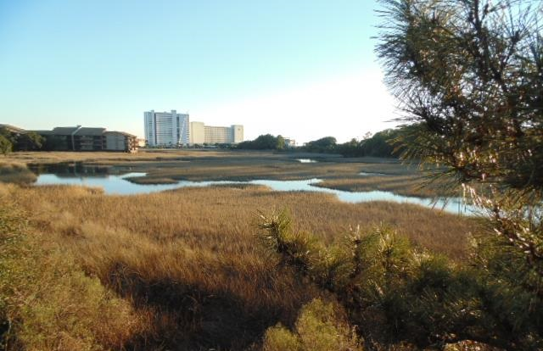
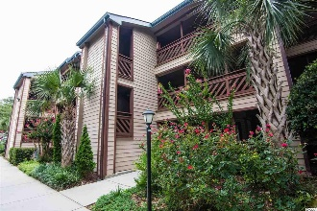
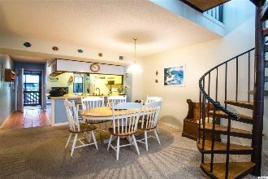
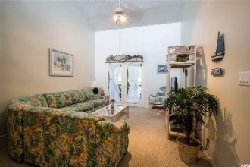
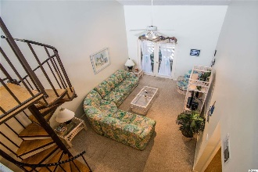
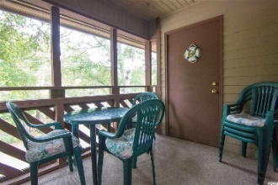
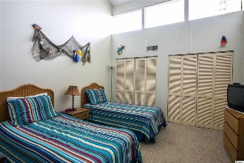
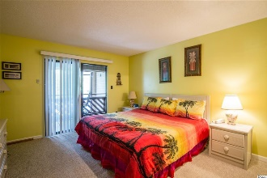
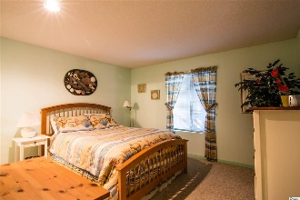
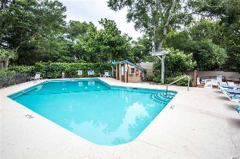
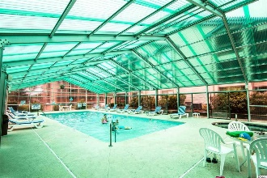


Steps to Beach!
Fully Furnished Condo $149,400!
223 Maison Drive
Unit A-11
Heron Pointe
Myrtle Beach, SC 29572
$149,400
Steps to the Beach! Beautiful, spacious 3 bedroom, 2 bath fully furnished condo with 3 balconies and wet bar! 2 balconies are screened in and all 3 have ceiling fans. Washer & Dryer in unit. Sleeps 8. Has 2 bedrooms and 2 bathrooms on 1st level and a wonderful upstairs loft/3rd bedroom with twin beds & extra storage room. Short and long term rentals allowed. Owners are allowed pets. Perfect Beach getaway or a great Investment opportunity with excellent rental history. One of the most desirable condo complexes in the area, it features outdoor AND indoor swimming pools! Also, indoor Jacuzzi, sauna, changing rooms & sundeck. BBQ grills and picnic tables are located throughout the complex along with a clubhouse with a huge deck for entertaining overlooking the marsh facing the ocean. The well maintained landscaping features beautiful trees and flowers. Within walking distance of the beach, several restaurants, bars, stores and the walking/biking path along Arcadian Shores Golf course. A quiet location, yet less than a 5 minute drive to Restaurant Row & great shopping at Tanger outlets and the Myrtle Beach Mall. New HVAC 1 year old. Come experience one of the best neighborhoods with the most beautiful beaches along the Grand Strand!
Julie Blethen | jazblethen@hotmail.com | (843) 564-8539
Wilkinson & Associates ERA Powered, 9652 North Kings Highway, Myrtle Beach, SC, 29572

