Slide 1
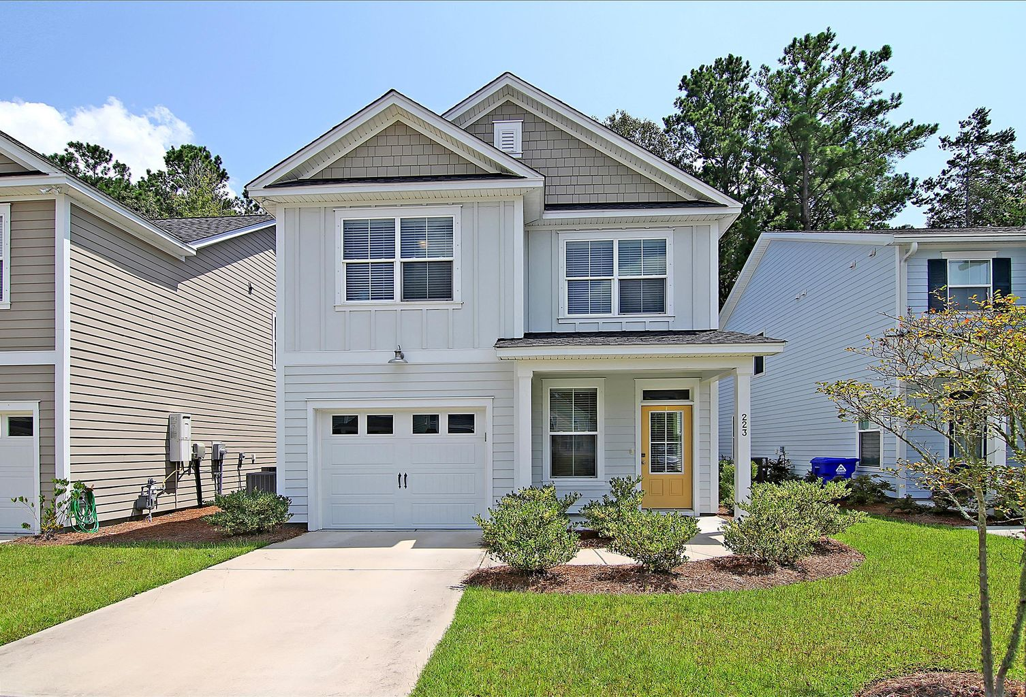
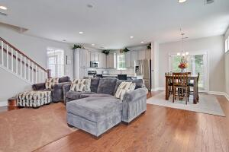
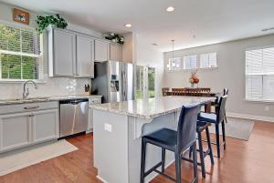
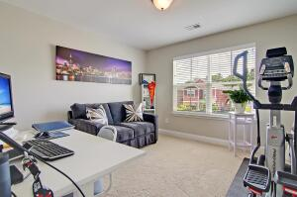
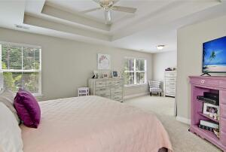
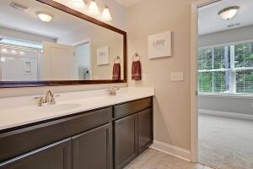
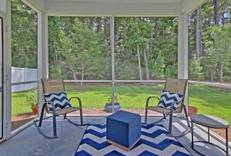
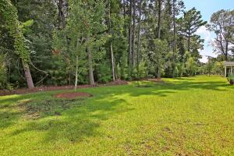
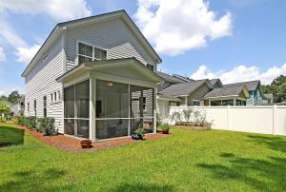

223 Brambling Lane
Grand Oaks Plantation · Charleston, SC 29414
MLS# 21022043 · $370,000
Just Listed in Grand Oaks Plantation
STUNNING move-in ready 3 bedroom, 2.5 bath townhouse with tons of upgrades and awesome curb appeal. Upon entering you are greeted with gorgeous herringbone tile floors in foyer, and half-bath which offers a custom vanity with vessel sink. Continueing in there are hardwood floors throughout the great room, kitchen and dining area that opens to a relaxing screened porch. The CHEF INSPIRED GOURMET kitchen includes granite countertops, spectacular HUGE island, stainless steel appliances, gas stove, tile backsplash, 42'' cabinets with pull outs and soft close hinges ...even a mixer shelf! The kitchen is a must see and is perfect for entertaining family and friends.The grand master bedroom suite is upstairs and features a large sitting/flex room, two large walk-in closets, tray ceiling, and an ensuite spa-like master bath with dual sink vanity, tile floors, linen closet and oversized walk-in shower. There are two additional nicely sized bedrooms that share a a full bath upstairs as well. The Landing in Grand Oaks Plantation in West Ashley is a wonderfully landscaped community with a dog park! The neighborhood is close to local shopping and grocery stores and is a short drive to downtown Charleston with 5-star restaurants, world class shopping and iconic history as well as a short drive to the beaches, the airport, Boeing and Volvo.
Take a video tour: https://vimeo.com/585574709
Stan Huff
843-670-2835
stan.huff@agentowned.com
Jill Marcacci
843-297-5590
jill@agentowned.com
www.agentownedrealty.com
AgentOwned Realty Co. Preferred Group, Inc. | 824 Johnnie Dodds Blvd | Mt Pleasant, SC 29464

