Slide 1
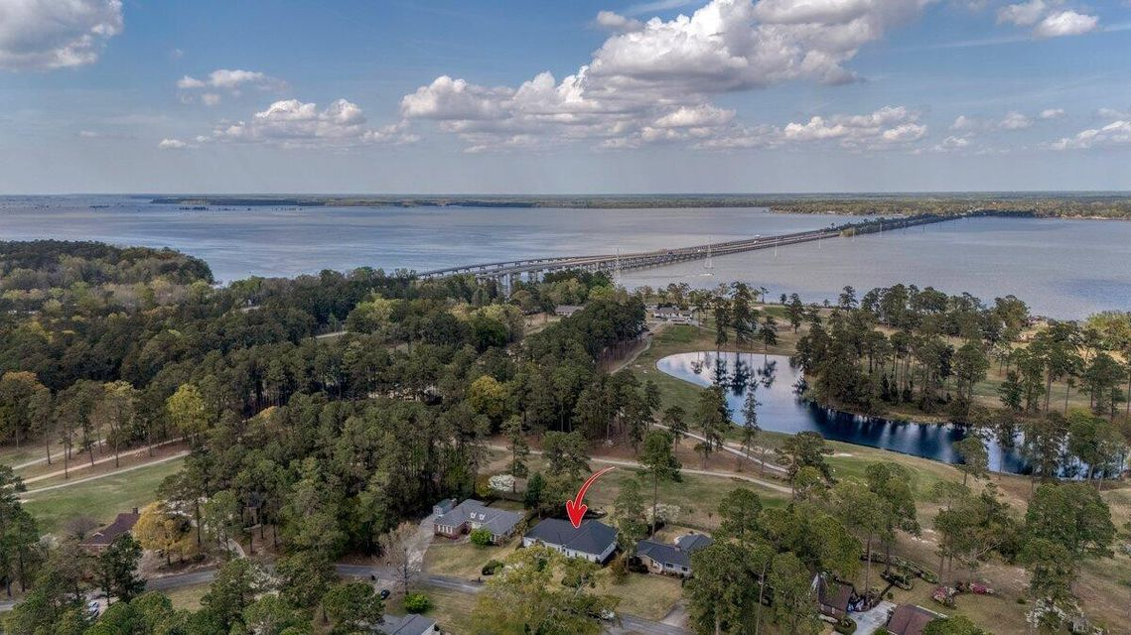
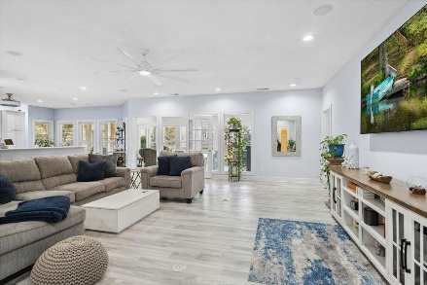
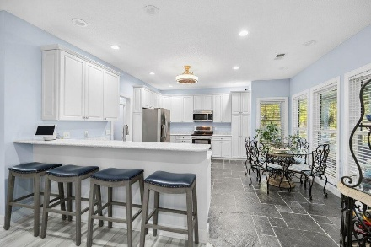
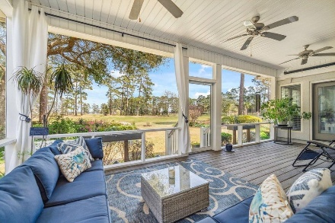
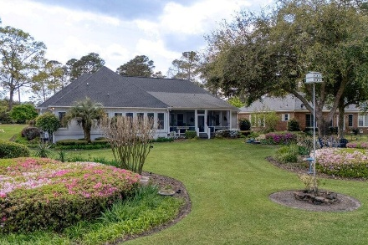

223 Cooper Drive Santee Cooper Resort | Santee, SC 29142 | MLS# 25009048 | $529,900
Darrell Creek Elevated Home With Elevator & Salt Pool
Home on the Lake? Home on the Golf Course?
Now you can have Both!
Full of upgrades and located on Second Tee of the Golf Course Community situated on Lake Marion.
OPEN HOUSE SUNDAY 1-3PM
Co-hosting with Lisa Wood from Crown Home Mortgage
Offering $2500
Lender Credit
Location, Location, Location! If you've dreamed of living on Lake Marion while also craving the excitement of golf course life, now you can have both! Welcome to 223 Cooper Drive, a Turn-Key Home nestled on the second tee box, with lake views . As you pull up to the home, you'll immediately notice the most expansive and colorful gardens in the Resort, setting the stage for what's to come. Step inside, and you're greeted by an open floor plan that exudes warmth and style. The freshly painted interior and upgraded LVP flooring (NO CARPET!) create a sleek, modern aesthetic throughout. The home has been thoughtfully designed with smart light fixtures and upgraded ceiling fans, making it both functional and chic. The foyer opens into an expansive Great Room, which is versatile enough to be split into two separate areas if you'd like additional dining space or a cozy reading nook. The heart of the home, the large eat-in kitchen, has been freshly repainted and is designed with ample cabinet space and plenty of room to entertain family and friends.
On the opposite side of the home, you'll find a large guest suite with its own private en suite bath. Down the hall are the other 2 guest rooms, both generously sized, along with another full bath. The Master Retreat is a true slice of heaven, where you can wake up to the breathtaking views and sounds of all the birds! Step into your fully remodeled en-suite bath, featuring dual vanities, custom-designed walk-in closets and linen closet by Closet Tech, and a brand-new oversized frameless shower that will make every day feel like a spa day! Down the hall, you'll find the Laundry Room, which offers added convenience with upper cabinets for storage. Best of all, the washer and dryer will convey with the home, making moving in a breeze. Don't forget the Oversized Garage! Recently repainted, this garage is spacious enough to hold not only your car, but also your boat and golf cart, offering all the room for your recreational vehicles and more. The sunroom offers stunning views of both the fairway and Lake Marion, making it the perfect spot for a gathering room, dining area, or whatever suits your lifestyle. Adjacent to the sunroom, a spacious, oversized screened-in porch invites you to relax with a glass of sweet tea or savor your morning coffee while watching golfers tee off, with three ceiling fans providing a gentle breeze. You can also water your show-stopping lawn and gardens at no extra cost, as the irrigation system is on it's separate well!
Living at Santee Cooper Resort offers endless opportunities for recreation. The community has a very active social club with many monthly events. The Resort features a clubhouse and outdoor picnic areas, a sparkling pool, and tennis courts for proposed renovation for a pickleball/ tennis court combo. The Resort maintains its own Marina where owners can rent boat slips and jet ski slips, providing easy access to the water whenever you're ready to take advantage of lake life. Spend your afternoon on the Lake boating, kayaking or fishing and come home to relax and unwind within your gardens and gorgeous stone patio. This home offers the perfect combination of lakeside serenity and golf course living. Don't miss the chance to own this tranquil retreat...it won't be available for long. Make 223 Cooper Drive your new home today!
House Tour
Elissa Campbell
843-853-1433 | elissa.campbell@agentownedrealty.com
AgentOwned Realty Preferred Group | 824 Johnnie Dodds Blvd | Mt Pleasant, SC 29464

