Slide 1
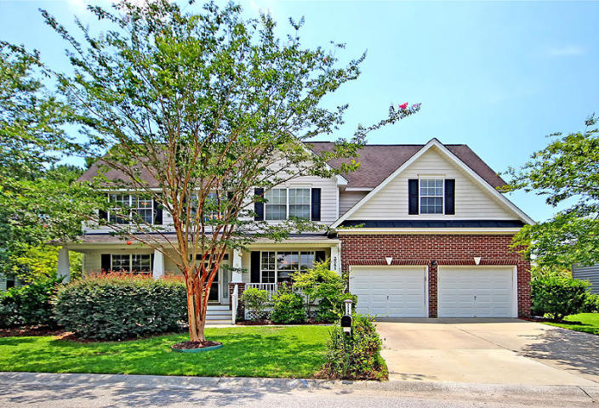
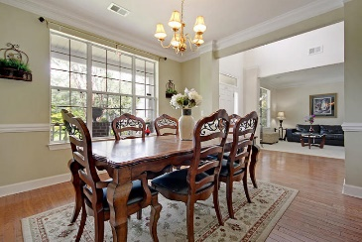
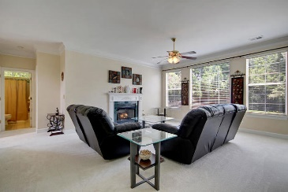
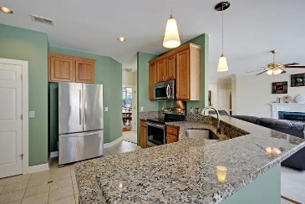
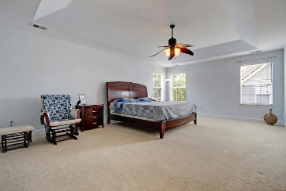
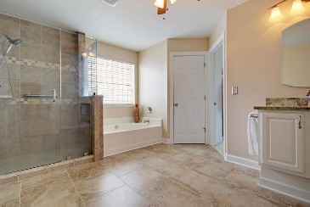
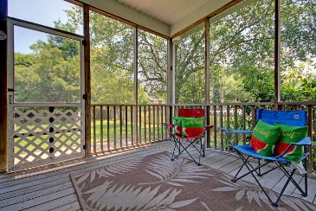
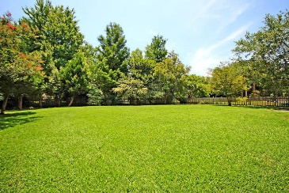
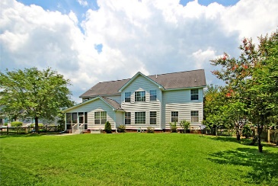

2241 Salt Wind Way Mount Pleasant, SC 29466 · MLS# 19019310 · $525,000
Just Listed-Planters Pointe-Saltwood
Just Listed-Planters Pointe-Saltwood
Beautiful 5 BR/4 BA home with an oversized fenced backyard in Mt. Pleasant! Great curb appeal and a full front porch that is perfect for rocking chairs. Upon entering you are greeted with a grand 2-story foyer that is open to a formal dining room to the right and a flex room/home office to the left. The large family room is open to the kitchen and offers an abundance of natural light, fireplace with gas logs and ceiling fan. The chef inspired gourmet eat-in kitchen has tile flooring, granite counter tops, stainless appliances including a built-in microwave, smooth top range, single bowl sink, dishwasher and two pantries! The big walk-in laundry room is conveniently located near the kitchen and 2 car garage. The breakfast area is spacious and opens to the screen porch. The screen porch overlooks the huge fenced back yard which would be perfect for entertaining family and friends. This home offers a bedroom and full bath on the main level which would serve well as a mother-in-law suite or guest room. The substantial master suite has enough room for a sitting area or office space. The spa-like luxurious master bath has been renovated. You'll love the large oversized tiled shower with a frameless glass door, new Italian porcelain tile flooring, dual vanity with beautiful granite, relaxing soaking tub and a massive walk-in closet. The upstairs features three additional bedrooms, plus a large loft area which could serve as a media room, game room or playroom. One of the bedrooms has a private bath which would work well for guests. Planters Pointe in Mount Pleasant is a wonderfully landscaped community with a play park, tennis courts and community pool! The neighborhood is close to local shopping and grocery stores and is a short drive to downtown Charleston with 5-star restaurants, world class shopping and iconic history as well as a short drive to the beaches, the airport, Boeing and Daniel Island. Come take a look because you will not find another home that offers as much as this one!
Seller will pay buyer's agent $5,000 at closing
with accepted offer by noon June 7, 2019!
Stan Huff
843-670-2835 stan.huff@agentowned.com
Jill Marcacci
843-297-5590 jill@agentowned.com
www.agentownedrealty.com
AgentOwned Realty Co. Preferred Group, Inc. | 824 Johnnie Dodds Blvd | Mt Pleasant, SC 29464

