Slide 1
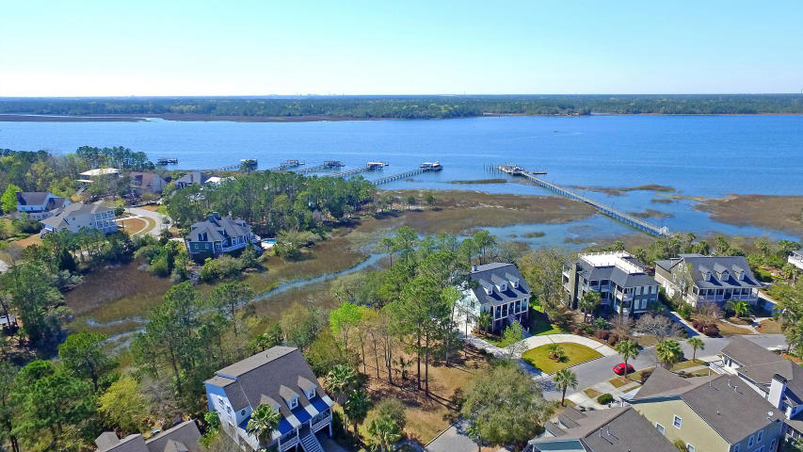
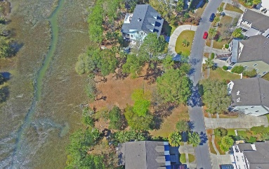
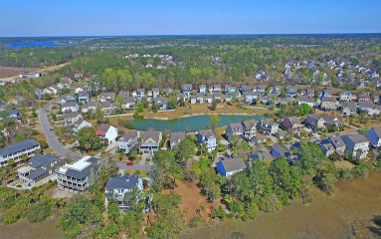
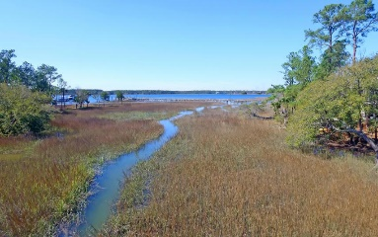
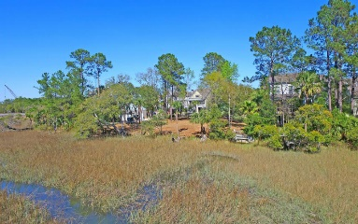
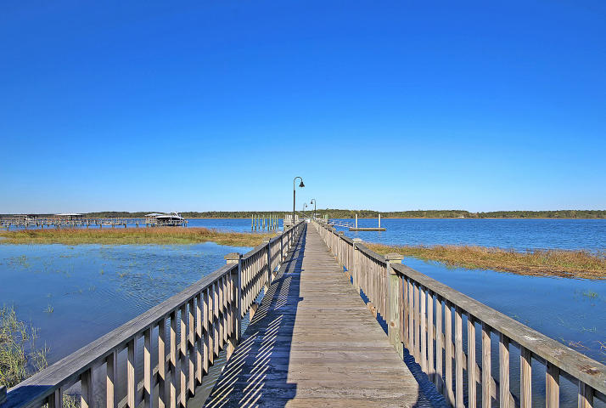
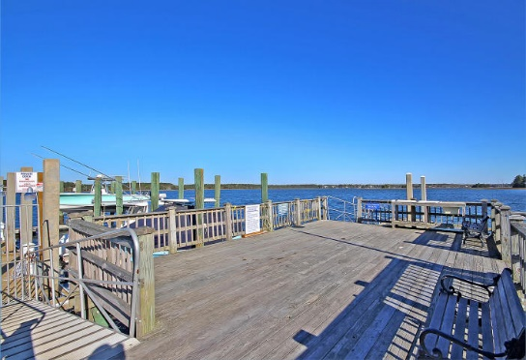
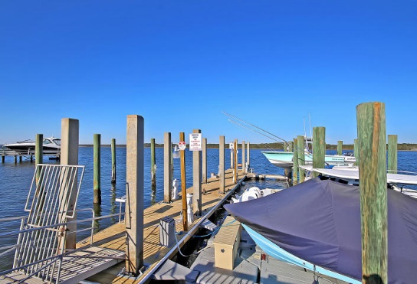

2243 N Marsh Drive
Rivertowne On The Wando
Mount Pleasant, SC 29466
MLS# 17008126 ~ $450,000
Soaring Ceilings, Open Concept & Dock
Deep Water Shared Dock On The Wando River!
No more worry about the tide, no longer does it take 30 minutes to get out of the creek! Gated Dock is just 3 doors away and boasts a Private Slip with NEW Boat Lift! - Stunning SUNSET VIEWS! - Very Rare Opportunity to purchase a Marsh Front lot in Rivertowne on The Wando, one of Mount Pleasant’s most sought after neighborhoods. This is a special place to live. Palmetto trees line the streets and there are lots of neighborhood functions to attend. It is a big neighborhood with a small neighborhood feel. The Community Pool & 3 Tennis Courts are just a short distance away. The Arnold Palmer designed Golf Course was named "Charleston Golf Course of the Year" by the Charleston Golf Course Association. It is the only Charleston Golf course to have a sister course at Snee Farm Country Club! Junior Golf is also available. Award Winning Mount Pleasant Schools including Charles Pinckney Elementary, Thomas C Cario Middle School, and Wando High School. Natural Gas available. Only 19 minutes to Isle of Palms Beach, 26 minutes to Downtown Charleston & 16 min to 1-526.
Don't miss out on this incredible opportunity!
Call or email for details: (843) 214-8451 or Robin@ThePhillipsRealtyGroup.com

