Slide 1
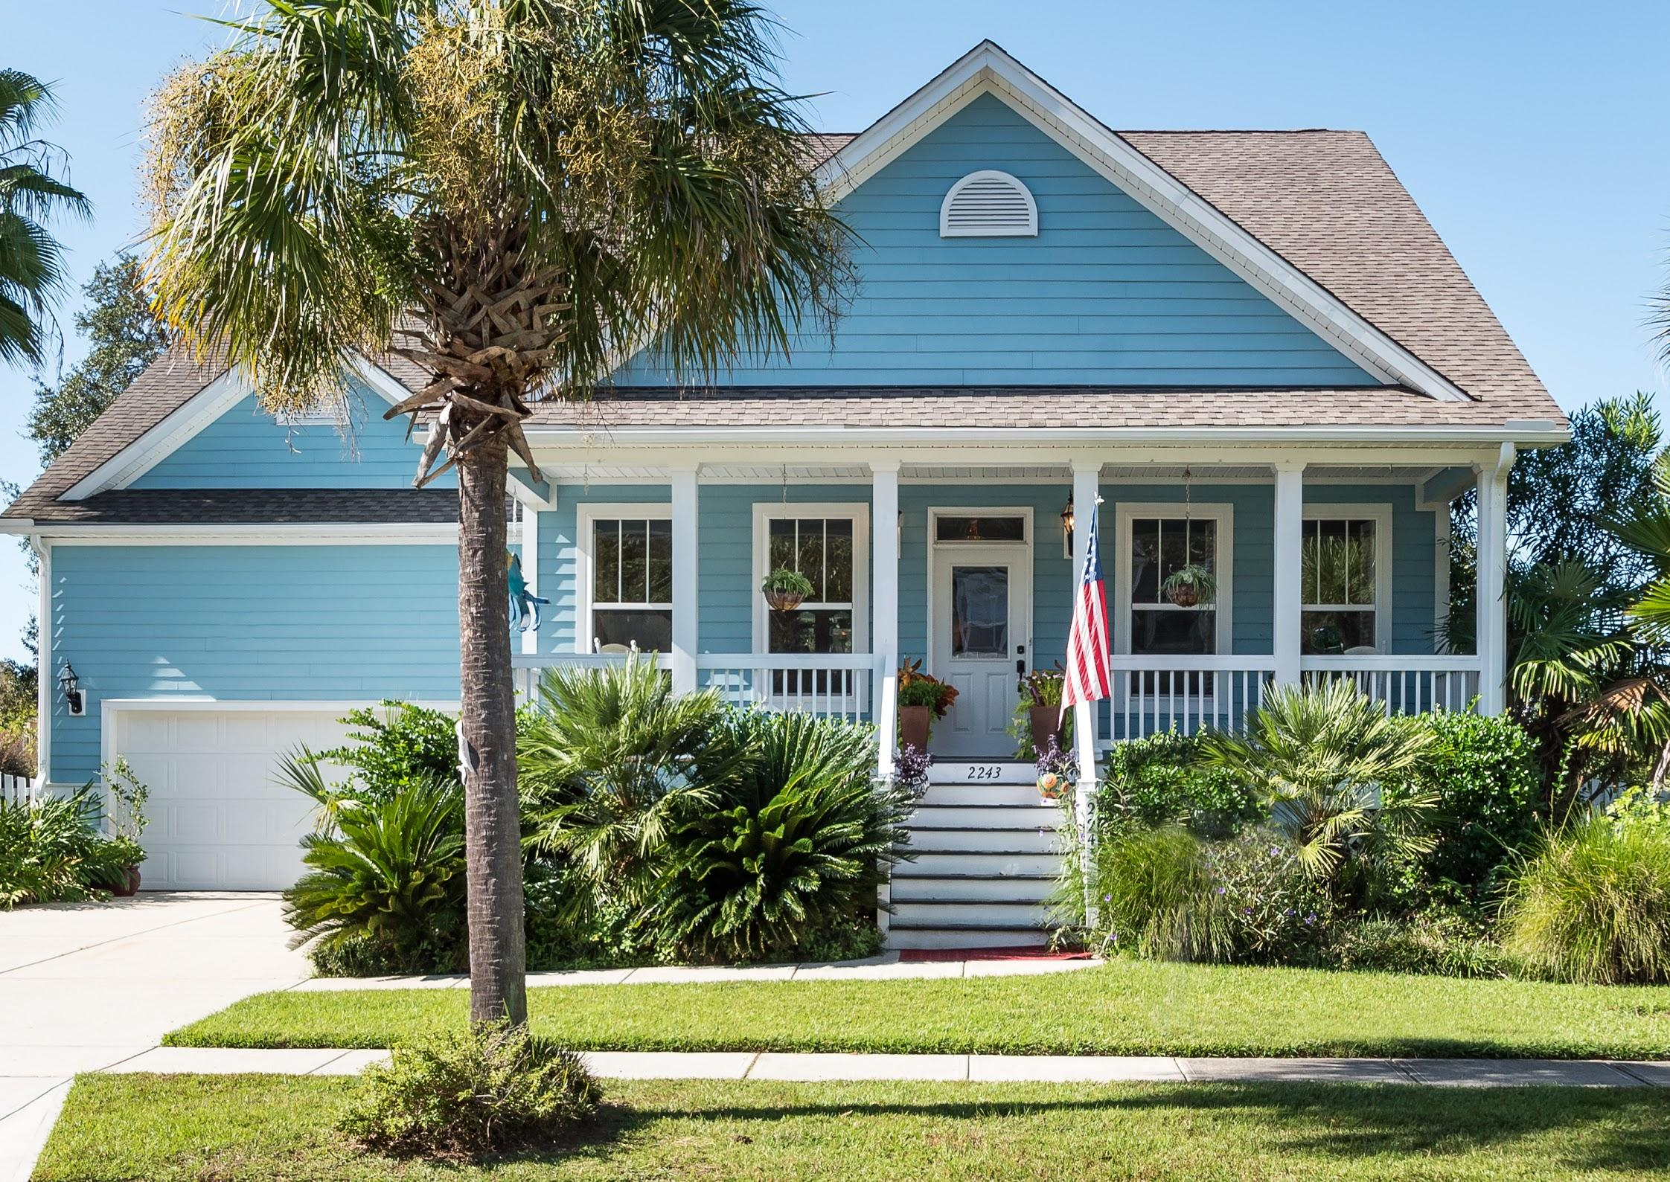
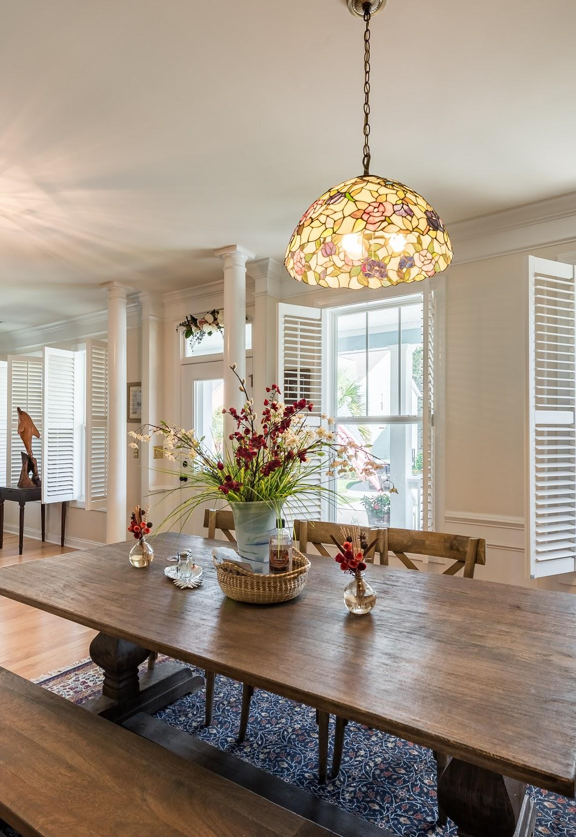
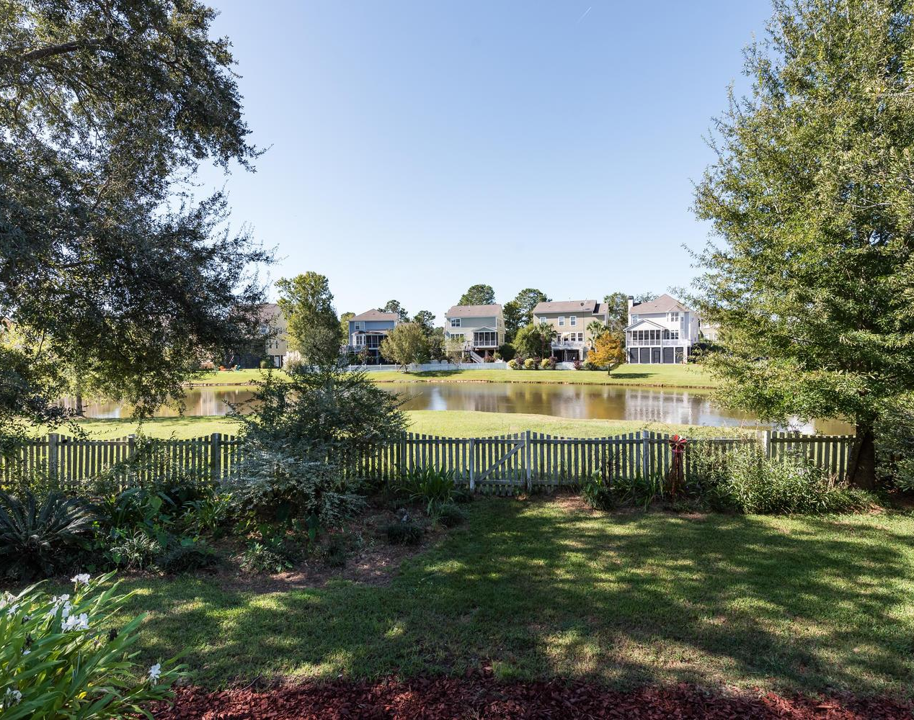

2243 Sandy Point Lane
Rivertowne on the Wando
Mt. Pleasant, SC
$430,000
3 Beds
2 Baths
2,062 SqFt
Solid Oak Flooring
Full Front Porch
Large Screened Porch
Fenced Backyard
Beautiful one story located
on an exquisite pond lot.
Jennifer Nipper-Crockett
REALTORⓇ
843-478-1800
Jen@AgentOwned.com
AgentOwned.com
Notes:
DO NOT ALTER LAYOUT. YOUR FILE WILL BE RETURNED OR EDITED IF IT IS RECEIVED ALTERED.

