Slide 1
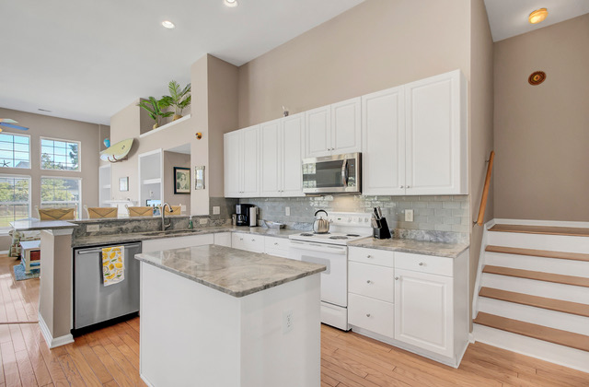
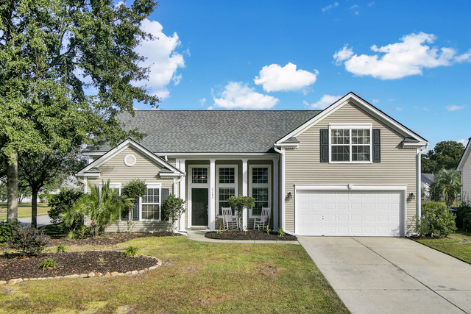
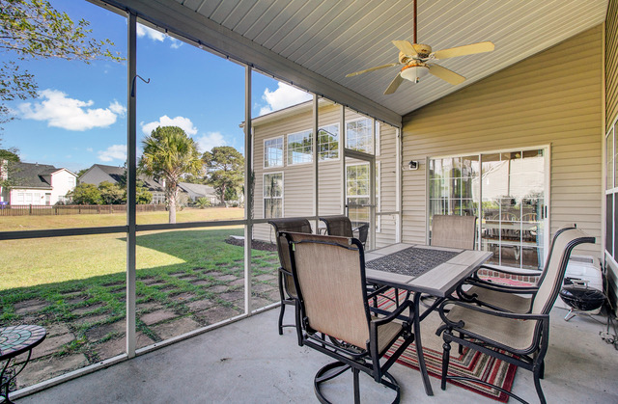
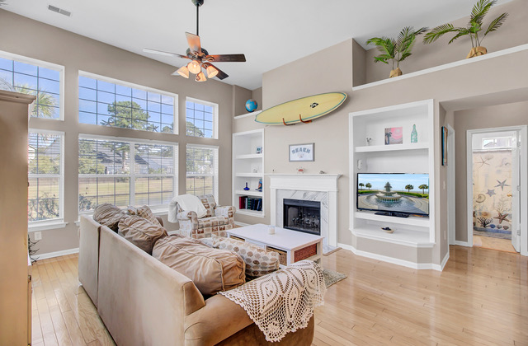
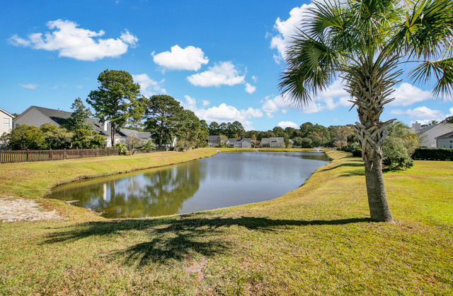
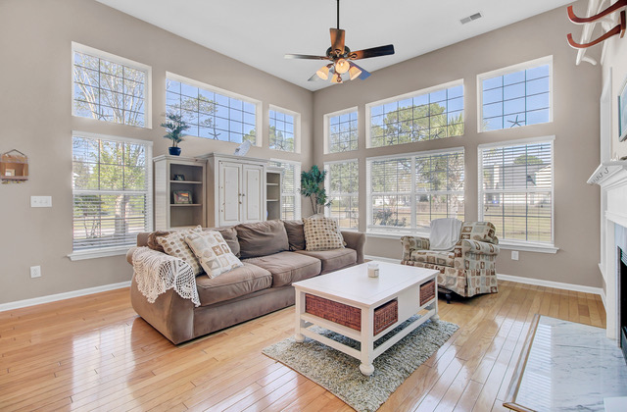
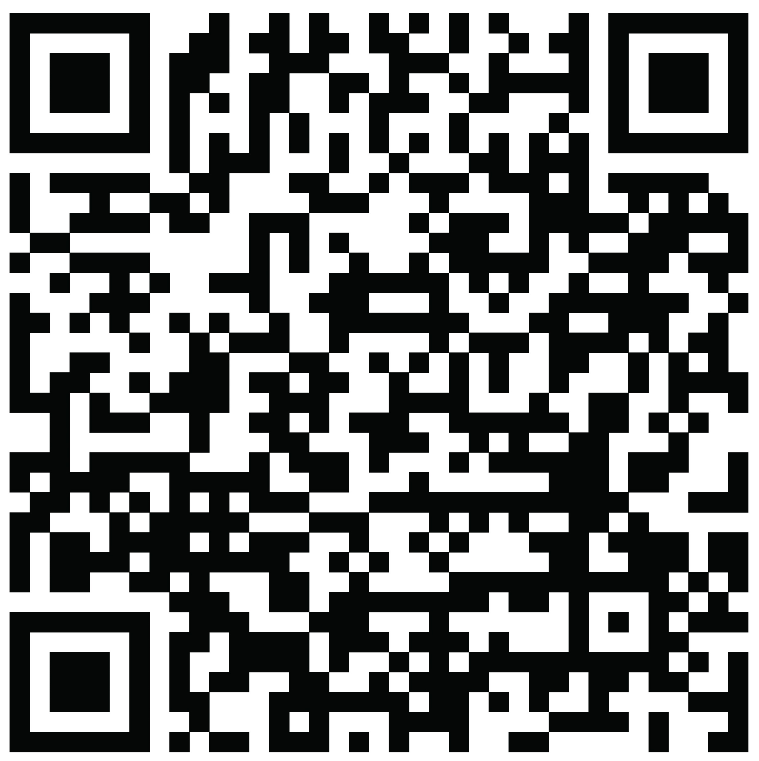


The WHOLE PACKAGE! That is what you have found at 2243 Andover Way.
2243 Andover Way
Park West
Mount Pleasant, SC 29466
MLS# 22027499 | $659,000
It has been hard to find a beautiful home- one with an open concept, versatile floor plan on a corner lot with pond views. A home in a sought after neighborhood with phenomenal amenities including 2 pools, tennis courts, a playground, volleyball court, and MILES of walking and jogging trails. A house in a community with schools, shopping, restaurants, a fitness center, park and recreation campus, and various professional businesses of all types. A desirable location, being a short drive to the beaches at Isle of Palms and Sullivans Island, in the midst of the shopping, restaurants and conveniences Mt. Pleasant is known for, and a straight shot into Historic Downtown Charleston. Well now you have found it! When you arrive you will be impressed with the home's curb appeal and the welcoming front porch. Step inside and prepare to be wowed at the soaring ceilings, arched doorways, and light filled spaces throughout the home. This floor plan is a WINNER! With the owner's suite on the main level, the split floor plan offers two additional first floor bedrooms on the opposite side of the home. The renovated kitchen with beautiful granite, tile backsplash and an island, opens up to a large family room with two walls of windows - the bright, sunny heart of the home that you will love! Additionally there is a formal living room and dining room, each with the ability to be used as a home office, play room, or any other creative use of space to suit your lifestyle needs. The two guest bedrooms share a bath (all on the main level). Upstairs find another (4th) large bedroom (FROG) with closet. Take notice of the hardwood flooring throughout the main level, with tile floors in the baths. The large screened porch looks out over the generous sized back yard, and this house being on the corner, affords an extra yard space beside the home-truly one of the MOST DESIRABLE LOTS you can find in the coveted Arlington subsection of Park West. This home has been lovingly maintained by its current owners, and it is now ready for you to make it your own! A phenomenal home in an ideal community - what more could you ask for?
Property Website | Video Tour
Ellen O'Neil
Broker/Owner, ABR, e-PRO, CNE
Charleston Realtor of Distinction
(843) 300-8530
www.EllenONeilProperties.com

