Slide 1
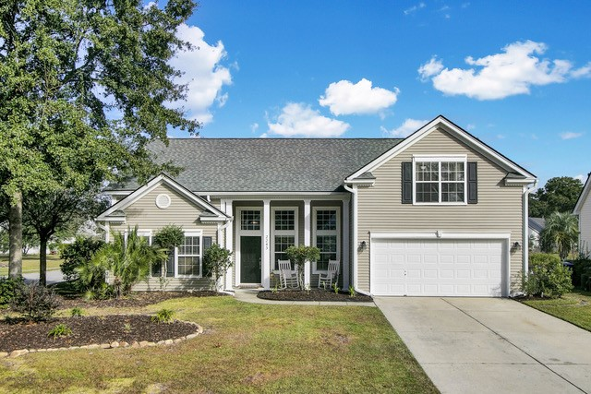
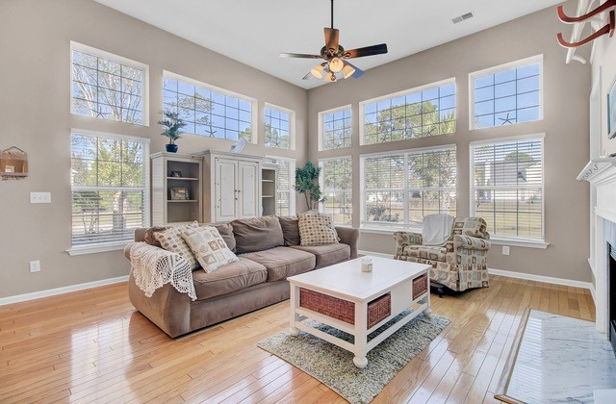
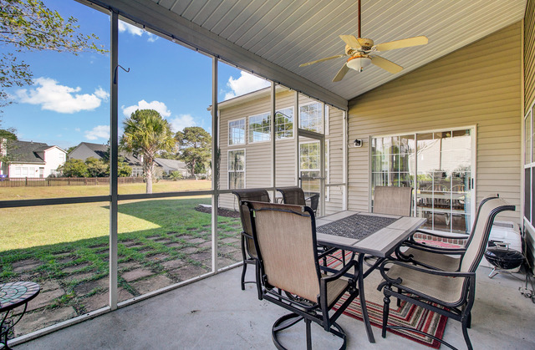
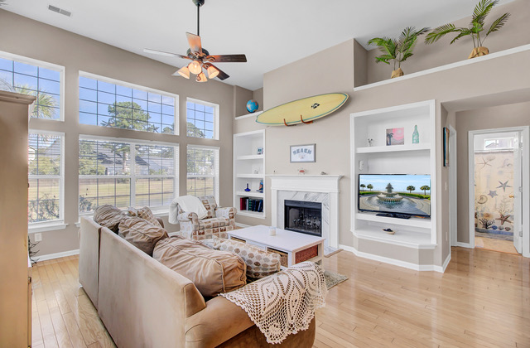
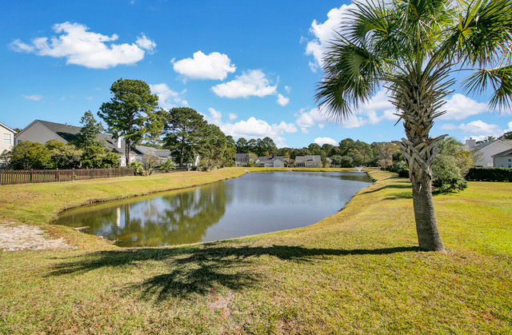
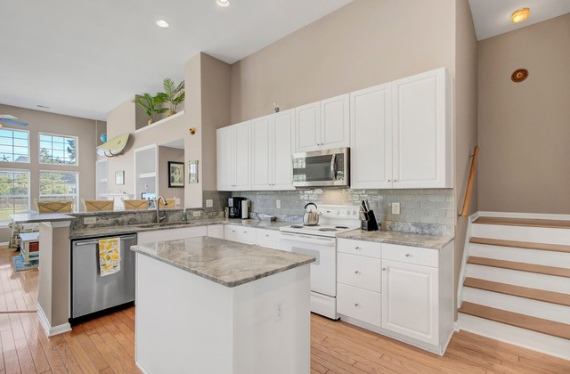
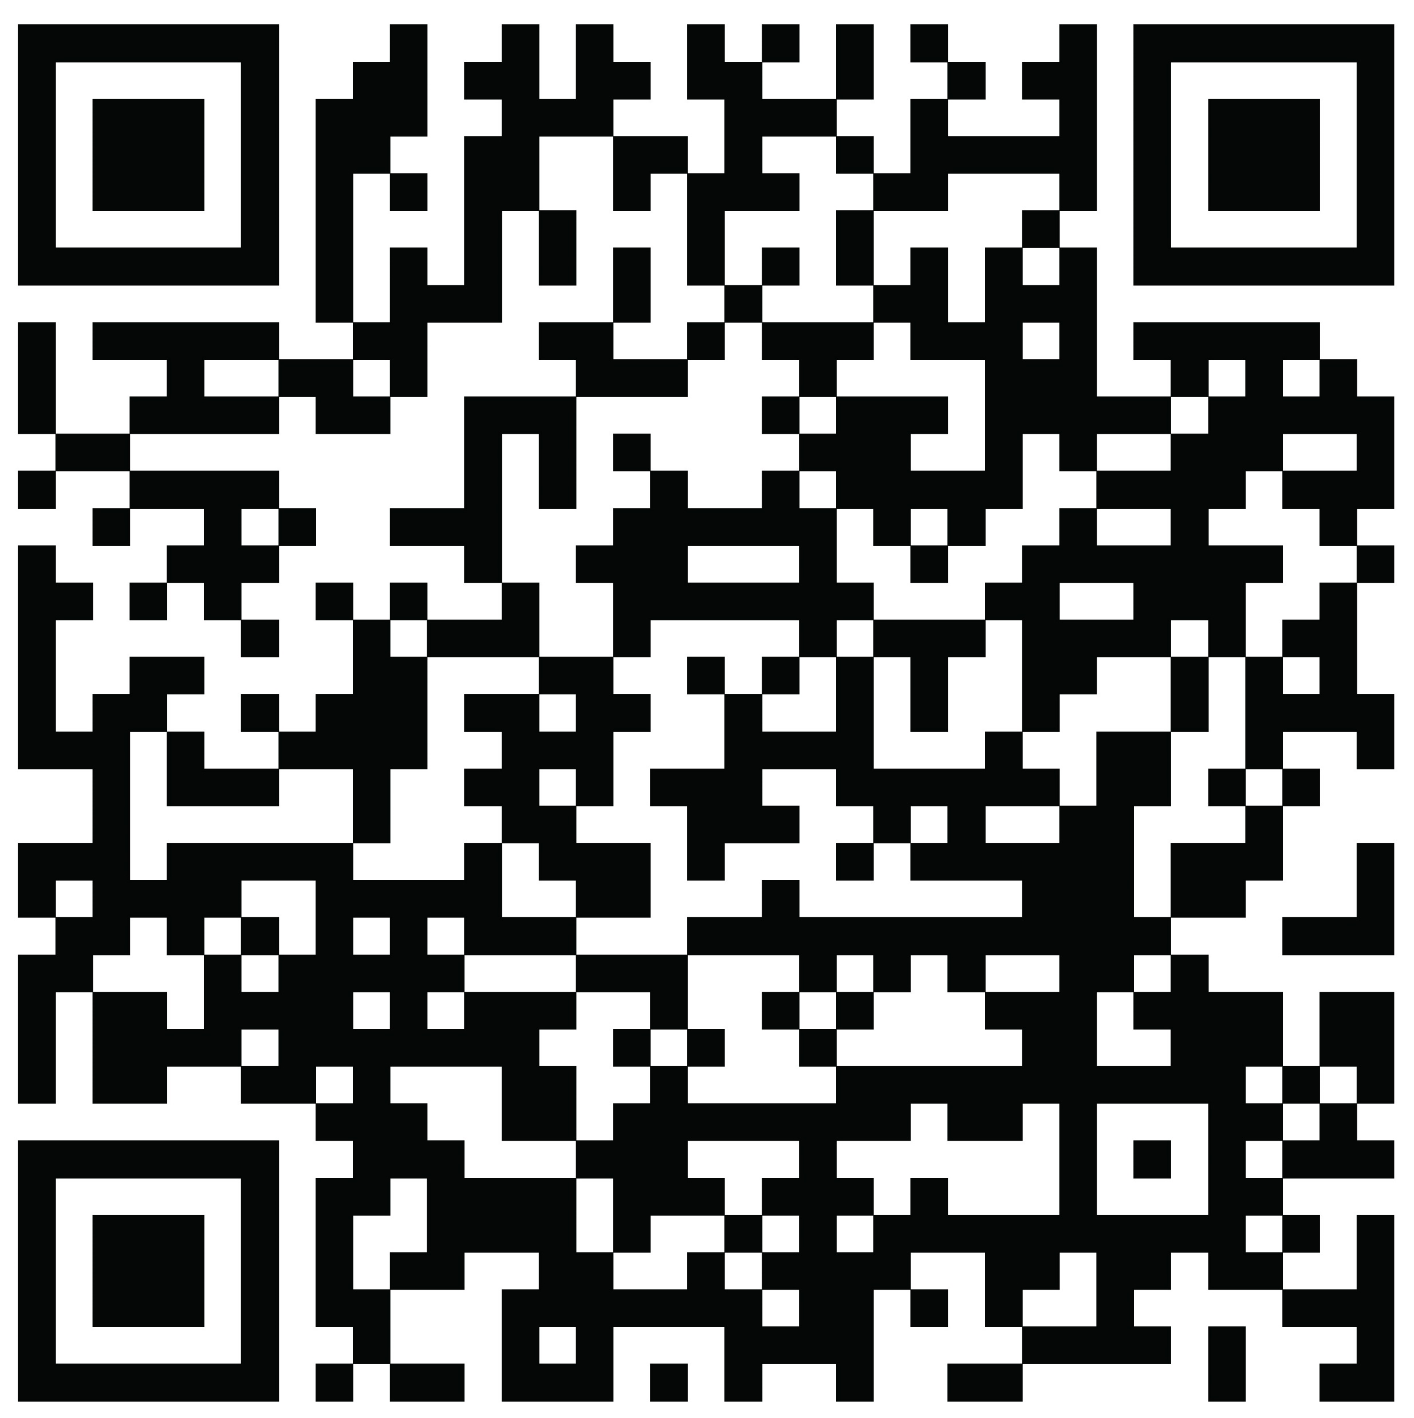


New Price- New Incentive Awesome House in Park West
2243 Andover Way
Park West
Mount Pleasant, SC 29466
MLS# 22027499 | $654,000
The sellers of this amazing ONE STORY home in Park West have REDUCED the PRICE and are offering $10,000 to the buyers at closing!!! Whether the buyer wishes to use it for a rate buy down, cash to save on closing costs and bring less money to the table...
Now is the time to make this one story home with sought after open concept, split floor plan YOURS!! The bright sun filled living space in this house is so uplifting! Soaring ceilings, views of the pond, and updated kitchen create a main living area to love! The master is on the main level and is on the opposite side of the home from the two additional guest bedrooms on the main level. Upstairs, over the garage is the 4th bedroom or bonus area. This is a versatile floor plan, with an eat in kitchen, formal dining area (currently used as a home office) and separate living area! You define the space to suit your needs! Located on a corner lot, one of the best Arlington has to offer, provides extra privacy/space from neighbor. Award winning schools, excellent amenities, proximity to shopping, beaches, and historic downtown Charleston- this home is a WINNER!
Just in time for the holidays…
Take a look at the property video and more by clicking the link below!
Property Website | Video Tour
Ellen O'Neil
Broker/Owner, ABR, e-PRO, CNE
Charleston Realtor of Distinction
(843) 300-8530
www.EllenONeilProperties.com

