Slide 1
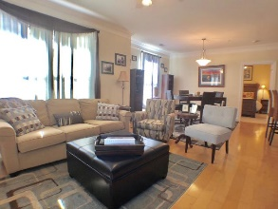
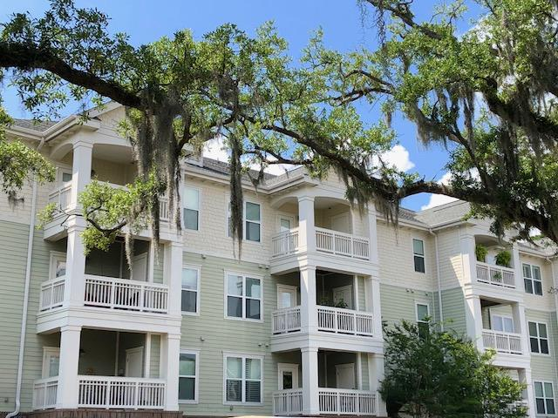
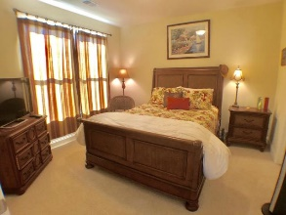
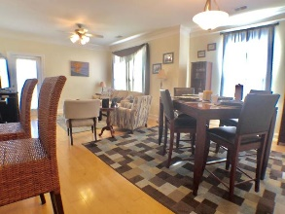
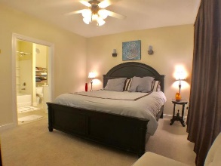
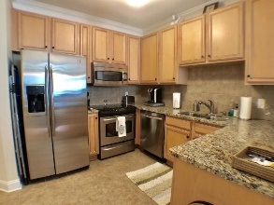
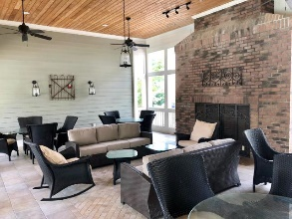
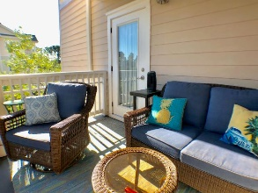
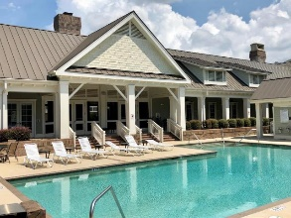
Luxury Condo In The Heart Of West Ashley
2244 Ashley Crossing Drive #1121
Arboretum | Charleston | MLS# 18027282 | $198,500
Luxury condo with maintenance free living, Drive under designated parking, personal storage room, secure building entry that leads directly into elevator lobby (climate controlled) and much more. Has wonderful amenities like Great room, business center, gym, pool, and spa. This home has many upgrades including: Hardwood floors, upgraded cabinets, fixtures, granite counter tops, tile kitchen, wall to wall carpet in bedrooms and crown molding. This complex is located minutes to hospital, restaurants, shopping and 526!
Jeffrey Sheahan
jeffrey.sheahan1@gmail.com | (843) 276-9220 | www.JeffreySellsCharleston.com
Brand Name Real Estate | 4 Carriage Lane, Suite 106 | Charleston, SC 29407

