Slide 1
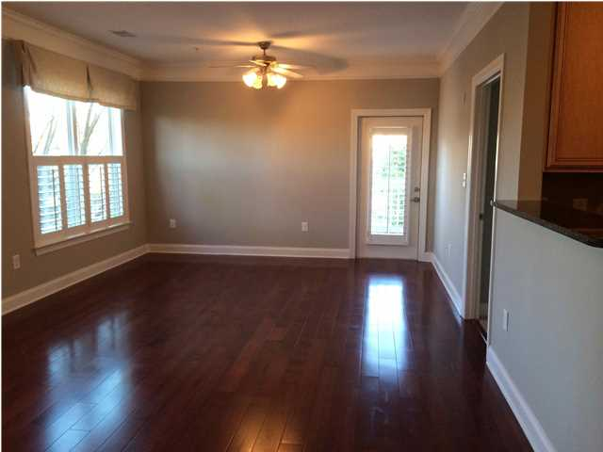
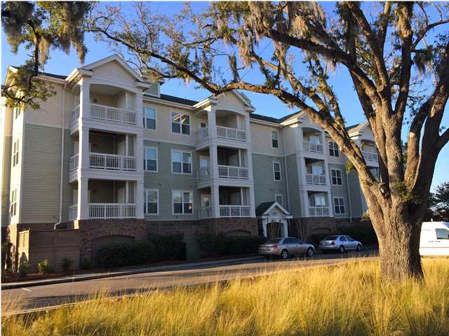
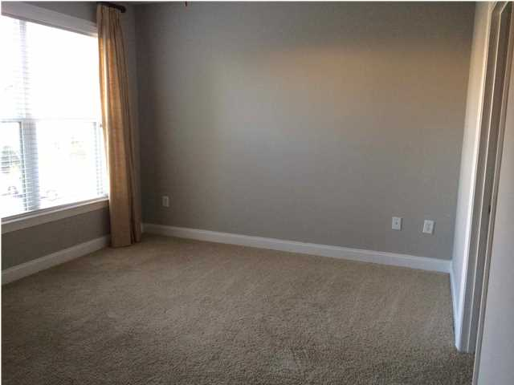
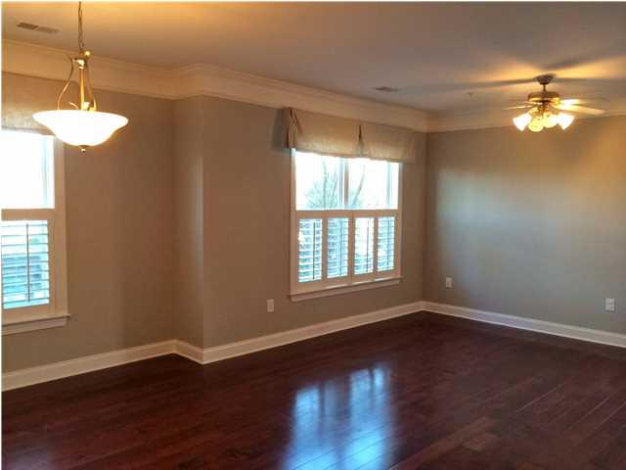
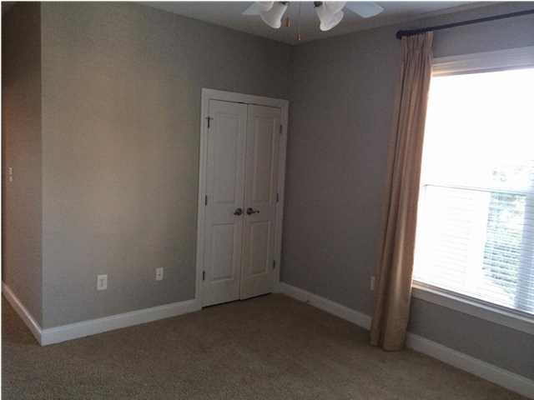
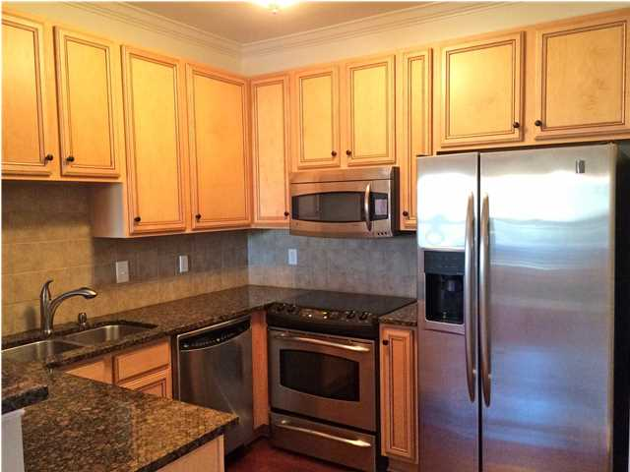
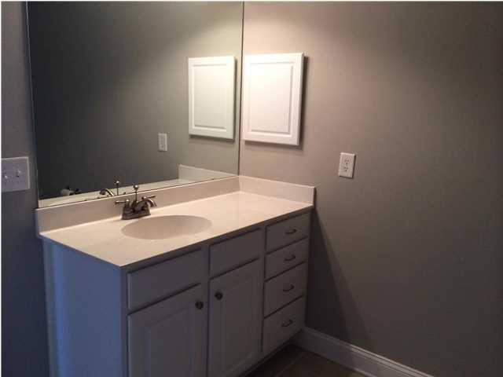
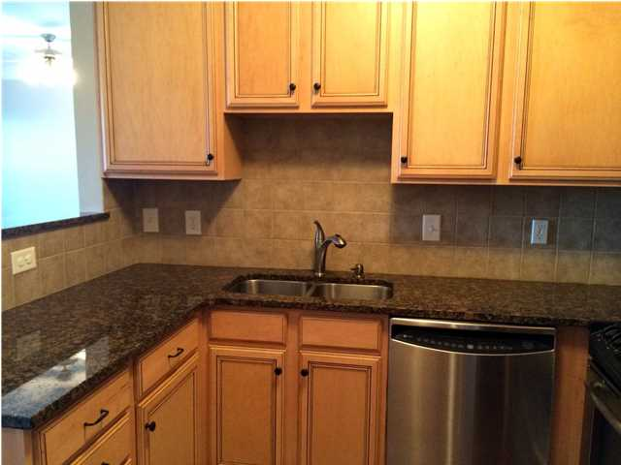
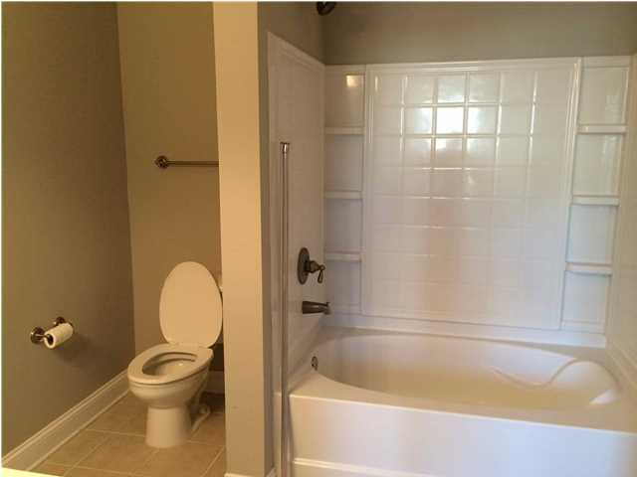
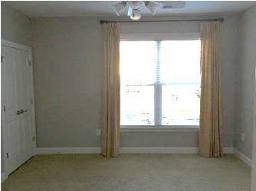
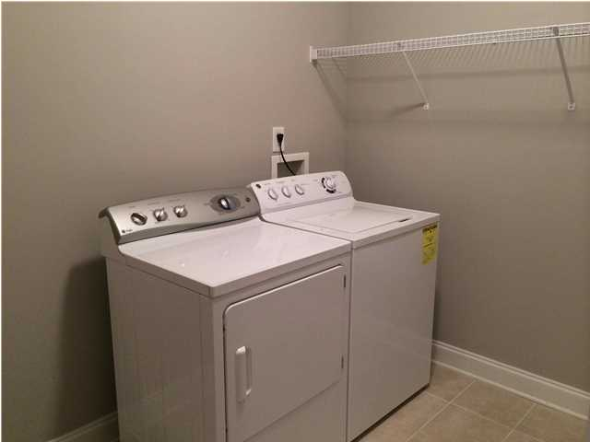
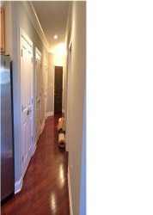
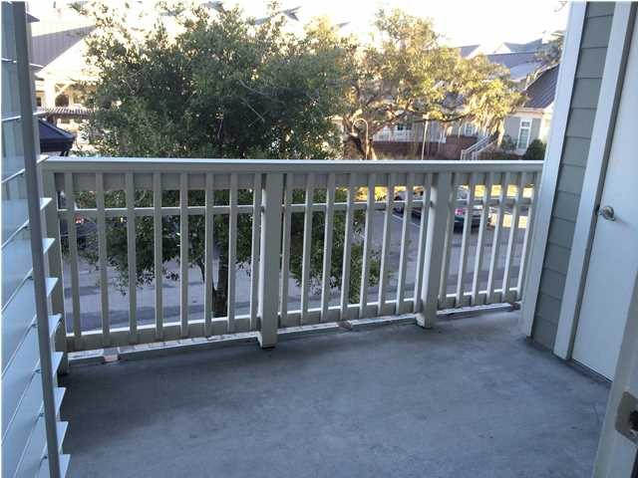
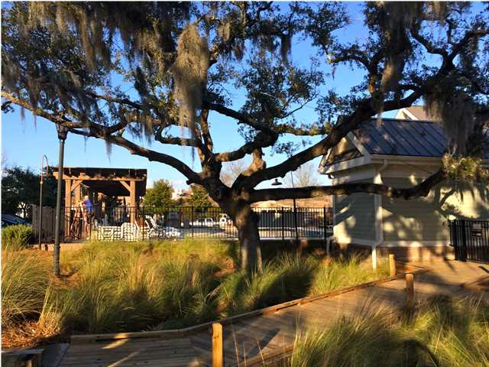
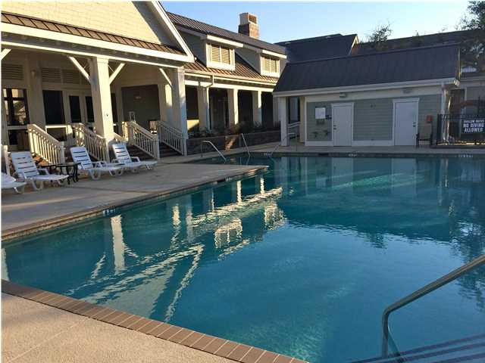

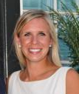
Gorgeous Charleston Condo
2244-116 Ashley Crossing Drive
Arboretum – West Ashley – MLS# 1403192 – $175,000
Gorgeous corner unit in a convenient West Ashley location! Just 15 minutes from MUSC and downtown Charleston! This freshly painted, pristine condo has all of the upgrades: hardwoods in all living areas, 10 inch crown molding, granite counters, beautiful cabinets and stainless steel GE Profile appliances! The open floor plan divides the two bedrooms nicely with a covered deck off the living room. Custom plantation shutters and curtains finish off the living space perfectly. There is a pantry and separate laundry room off the kitchen. The bedrooms both have on-suite baths as well as walk-in closets. There is ample storage in the unit with a closet off the porch and 2 closets in the hallway. The unit overlooks the stunning oak trees that surround the community pool and clubhouse. There is an assigned parking space in the garage underneath the condo for easy parking. This is truly a move-in ready home and a must see!
Lara Stephens Harpe, Realtor
843-298-6669
lara@thepulsecharleston.com
www.thepulsecharleston.com
ERA Wilder Realty, 125-F Wappoo Creek Dr, Charleston, SC 29412

