Slide 1
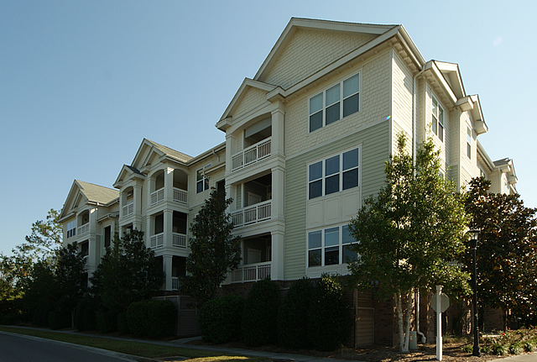
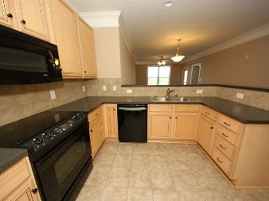
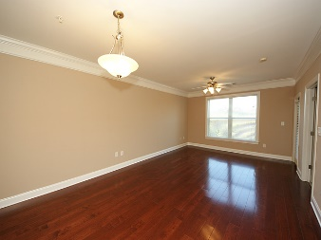
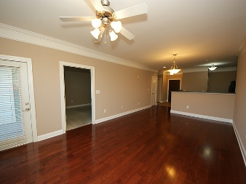
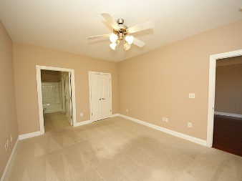
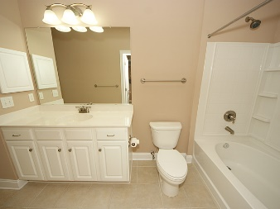
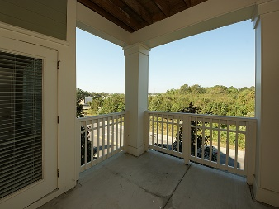
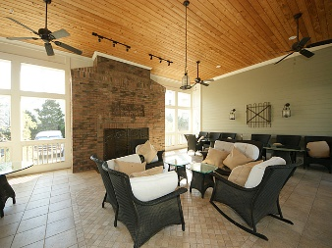
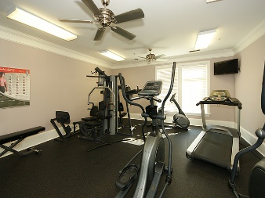
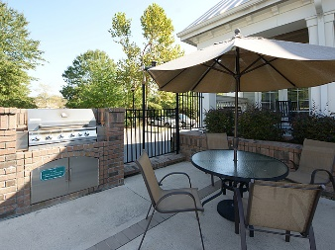
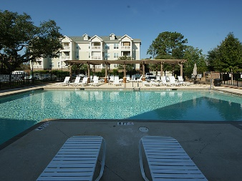


2244 Ashley Crossing Dr #123 Charleston, SC 29414 MLS# 16028555 $145,000 1 Bedrooms | 1 Baths | 806 sf
Exquisite Condo & Amenities at The Arboretum
Fantastic condo in prime location! The Arboretum offers carefree condominium living with resort like amenities at an affordable price! Freshly painted this open floor plan design offers secured elevator building access, designated curbside parking, beautiful cherry hardwood floors, tiled foyer, kitchen, bathroom and carpeted master bedroom complete with large walk-in closet.
A well appointed condo with tasteful finishes throughout such as ceiling fans, tiled kitchen backsplash, high ceilings, 42 inch cabinets, crown molding and large windows allowing lots of natural lighting. Step outside and enjoy your private balcony with outside storage closet. Unit also has additional outside storage located under the building.
The amenities are second to none with clubhouse, beautiful pool area, fireplace, business center, conference room, and workout facility. There's even a spa & salon for residents by appointment! All this in a beautifully landscaped condominium community conveniently located to 26/526, Boeing, airport, and downtown Charleston.
Stephen Kugelman
(843) 330-0403
steve@agentowned.com
www.kugelmanrealestate.com
AgentOwned Realty Co. Premier Group, Inc. | 824 Johnnie Dodds Blvd | Mt Pleasant, SC 29464

